Slide 1
EEE4084F
Digital Systems
Lecture 26:
Design of Parallel Programs / Heterogeneous Computing Solutions
PART 2/4
Presented by:
Simon Winberg

Slide 2
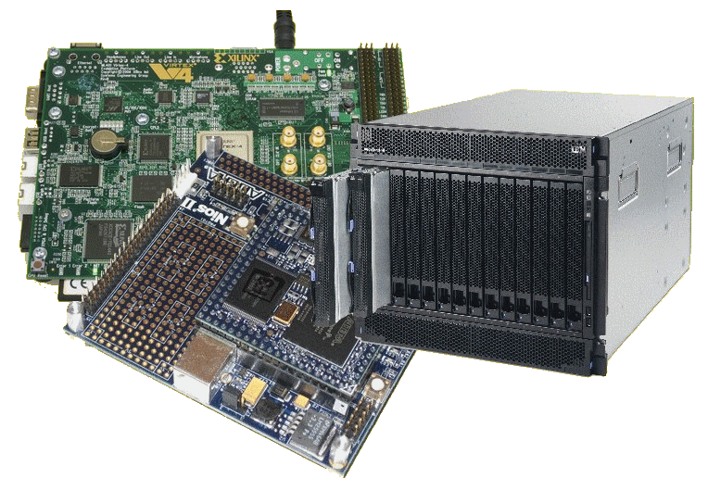
Lecture Overview
Steps in designing parallel solutions
Step 4: communication
Factors related to Communication
Cost of communications
Latency vs. Bandwidth
Baud rate vs. Bandwidth
Effective bandwidth
Visibility of Communications
Synchronous vs. asynchronous
Scope of communications
Collective communications
Efficiency of communications

Slide 3
Steps in designing parallel programs
The hardware may be done first… or later.
The main steps:
Understand the problem
Partitioning (separation into main tasks)
Decomposition & Granularity
Communications
Identify data dependencies
Synchronization
Load balancing
Performance analysis and tuning
this lecture
…

Slide 4
Step 4: Communications
EEE4084F

Slide 5
Step 4: Communications
The communications needs between tasks depends on your solution:
Communications not needed for
Minimal or no shared data or results.
E.g., an image processing routine where each pixel is dimmed (e.g., 50% dim). Here, the image can easily be separated between many tasks that act entirely independently of one other.
Usually the case for embarrassingly parallel solutions4

Slide 6
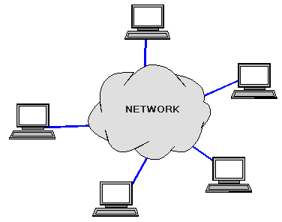
Communications
The communications needs between tasks depends on your solution:
Communications is needed for…
Parallel applications that need to share results or boundary information. E.g.,
E.g., modeling 2D heat diffusion over time – this could divide into multiple parts, but boundary results need to be shared. Changes to an elements in the middle of the partition only has an effect on the boundary after some time.

Slide 7
Factors related to Communication
Cost of communications
Latency vs. Bandwidth
Visibility of communications
Synchronous vs. asynchronous communications
Scope of communications
Efficiency of communications
Overhead and Complexity

Slide 8
Cost of communications
Communication between tasks has some kind of overheads, such as:
CPU cycles, memory and other resources that could be used for computation are instead used to package and transmit data.
Also needs synchronization between tasks, which may result in tasks spending time waiting instead of working.
Competing communication traffic could also saturate the network bandwidth, causing performance loss.

Slide 9
Latency vs. Bandwidth
Communication Latency =
Time it takes to send a minimal length (e.g., 0 byte) message from one task to another. Usually expressed as microseconds.
Bandwidth =
The amount of data that can be sent per unit of time. Usually expressed as megabytes/sec or gigabytes/sec.

Slide 10
Latency vs. Bandwidth
Many small messages can result in latency dominating communication overheads.
If many small messages are needed:
It can be more efficient to package small messages into a larger ones, to increasing the effective bandwidth of communications.

Slide 11
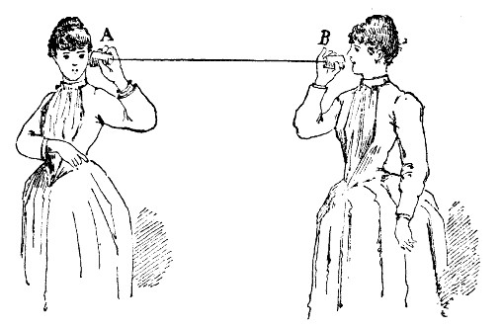
Baud rate vs. Bandwidth
Avoid misuse of using these terms interchangeably
The general public seem to think these refer to the same thing, and in some cases, from a user perspective, this may be OK.
Nevertheless an engineer should know that: baud specifies the symbol rate (or signal changes) per unit of time, and this could be an entirely analogue measure.
Bandwidth is different depending whether you are considering computer networks/telecoms or signals more generally (e.g. in a RF system). For computing Bandwidth is a measure of data rate in bits per second. But more generally in the electrical engineering Bandwidth refers to the frequency range within a particular band (typically a band that is used for transmitting some sort of signal).
My dear Alice, it is much the same as your end. Limited to about 200 twangs per second.
I say, Beatrice, how is the baud rate on your end?
B
A

Slide 12
Baudrate – an issue of standards (from a computing/telecoms perspective)
Baudrate is not always interpreted the same way for all applications when it comes to deciding the amount of bytes that the link provides. This is due to other aspects of the protocol used, e.g. if each byte is surrounded by error detection bits.
Remember a byte is always understood as 8 bits – but the byte is just the ‘useful data’ that is being transferred.
If the connection is specified as a speed in bits per second, then it is 8 bits per byte. When you specify the speed in baud rate, you're specifying symbol rate (see previous slide) in which case you might be using 10 symbols to a byte when using start-data-stop or 8b/10b encoding schemes. So, in other words you may quite likely find yourself in a situation where you have a bandwidth of say 1Mbps but a baud rate of 1.25 mega symbols per second.
There is even an official SI unit for “baud”: when writing it out as "Bd" you are specifying the symbol rate. And this shouldn’t be confused with the more commonly known bps (bits per second) or Bps (bytes per second). So you should now know that x MBd is not always = x Mbps
Example:
If you have an 8b/10b encoded line that has a bandwidth of 10 MBd, you can automatically say that it has a bandwidth of 8 Mb/s, or 1 MB/s (excluding overhead such as packet headers, of course).
MBps
Further reading: http://en.wikipedia.org/wiki/Baud
Mbps

Slide 13
Suggested further reading on baud rate and bandwidth
(these readings are not examined)
If you’re one of those super keen students, you might like to look at these nuggets of knowledge and web pages for further reading on this topic:
PCIe 1.0 and 2.0 (including Ethernet and USB) uses 8b/10b encoding. PCIe 3.0 and 4.0 uses 128b/130b encoding. Read more at: http://en.wikipedia.org/wiki/PCI_Express#History_and_revisions
Historically, Hamming code refers to the Hamming (7, 4) code, which uses 7 symbols for every 4 data bits. There are many other variations on this which you can explore at http://en.wikipedia.org/wiki/Hamming_code
DVD encoding uses Reed-Solomon error correction in two stages (note, in case you were wondering, this encoding has nothing to do with grass or mines) read more at http://en.wikipedia.org/wiki/Reed%E2%80%93Solomon_error_correction#Data_storage.
There are even more interesting cases where run-length limited codes are used with error correction and (for argument sake) 16 QAM signal encoding. 1 MBd 16 QAM has a bandwidth of 4 Mb/s (rather interesting case because the baud rate here is a quarter of the bit-rate! You also get 32, 64, 128 and 256 QAM systems....)
Acknowledgement: thanks to John-Philip Taylor for these interesting reading suggestions.

Slide 15
Effective bandwidth
PS: a favourite thing to ask in tests and exams
Total latency =
Sending overhead + Transmission time + time of flight + Receiver overhead
Effective bandwidth = Message size / total latency
Sending overhead
Transmission time
Time of flight
Transmission time
Receive overhead
Transport latency
Total latency
time of flight is also referred to as ‘propagation delay’ – it may depend on how many channels are used. E.g. a two-channel path will give an effective lower propagation. With switching circuitry, the propagation delay can increase significantly.

Slide 16
Effective bandwidth calc.
Message 10,000 bytes
Sending overhead 200us
Receiving overhead 300us
Example:
Distance 100m
Raw bandwidth 10Mbit/s
Solution:
Transmission time = 80,000 bits
=
80,000 bits
=
8,000 μs
10Mbits/s
10bits/μs
Time of flight =
100m
=
1m
=
0.33 μs
3 x 10⁸ m/s
3 x 10⁶ m/s
Total latency =
Sending overhead + Transmission time + time of flight + Receiver overhead
Total latency =
200μs + 8,000μs + 0.33μs + 300μs = 8,500.33μs
Effective bandwidth = Message size / total latency
Effective bandwidth = 80,000bits / 8,500μs = 9.41 Mbits/s

Slide 17
Visibility of Communications
Communications is usually both explicit and highly visible when using the message passing programming model.
Communications may be poorly visible when using the data parallel programming model.
For data parallel design on a distributed system, communications may be entirely invisible, in that the programmer may have no understanding (and no easily obtainable means) to accurately determine what inter-task communications is happening.

Slide 18
Synchronous vs. asynchronous
Synchronous communications
Require some kind of handshaking between tasks that share data / results.
May be explicitly structured in the code, under control of the programmer – or it may happen at a lower level, not under control of the programmer.
Synchronous communications are also referred to as blocking communications because other work must wait until the communications has finished.

Slide 19
Synchronous vs. asynchronous
Asynchronous communications
Allow tasks to transfer data between one another independently. E.g.: task A sends a message to task B, and task A immediately begin continues with other work. The point when task B actually receives, and starts working on, the sent data doesn't matter.
Asynchronous communications are often referred to as non-blocking communications.
Allows for interleaving of computation and communication, potentially providing less overhead compared to the synchronous case

Slide 20
Scope of communications
Scope of communications:
Knowing which tasks must communicate with each other
Can be crucial to an effective design of a parallel program.
Two general types of scope:
Point-to-point (P2P)
Collective / broadcasting

Slide 21
Scope of communications
Point-to-point (P2P)
Involves only two tasks, one task is the sender/producer of data, and the other acting as the receiver/consumer.
Collective
Data sharing between more than two tasks (sometimes specified as a common group or collective).
Both P2P and collective communications can be synchronous or asynchronous.

Slide 22
Collective communications
Typical techniques used for collective communications:
BROADCAST
SCATTER
Task
Task
Task
Task
Task
Task
Same message sent to all tasks
Different message sent to each tasks
Initiator
Initiator
REDUCING
GATHER
Task
Task
Task
Task
Task
Task
Only parts, or reduced form, of the messages are worked on
Messages from tasks are combined together
Task
Task

Slide 23
Efficiency of communications
There may be a choice of different communication techniques
In terms of hardware (e.g., fiberoptics, wireless, bus system), and
In terms of software / protocol used
Programmer may need to use a combination of techniques and technology to establish the most efficient choice (in terms of speed, power, size, etc).

Slide 24
Next lecture
Continuation of the steps:
Identify data dependencies
Synchronization
Load balancing
Performance analysis and tuning

Slide 25
Further Reading / Refs
Suggestions for further reading, slides partially based / general principles elaborated in:
https://computing.llnl.gov/tutorials/parallel_comp/
http://www2.physics.uiowa.edu/~ghowes/teach/ihpc12/lec/ihpc12Lec_DesignHPC12.pdf
Some resources related to systems thinking:
https://www.youtube.com/watch?v=lhbLNBqhQkc
https://www.youtube.com/watch?v=AP7hMdnNrH4
Some resources related to critical analysis and critical thinking:
An easy introduction to critical analysis:
http://www.deakin.edu.au/current-students/study-support/study-skills/handouts/critical-analysis.php
An online quiz and learning tool for understanding critical thinking:
http://unilearning.uow.edu.au/critical/1a.html

