Slide 1
EEE4084F
Digital Systems
Lecture 25:
Design of Parallel Programs / Heterogeneous Computing Solutions
PART 1/4
Presented by:
Simon Winberg

Slide 2
Comments concerning the title for this set of slides*
Previously this aspect was referred to as “Designing Parallel Programmes” in this slides series. However I think this is somewhat restrictive; while you could consider the combination of HDL and software that runs on a heterogeneous computer as a ‘program’, I tend to think the term is too specific towards software. So I’m referring to the concept more as ‘design of heterogeneous computing solutions’.
* S. Winberg
See refs on last slide

Slide 3
Introduction
These steps to designing parallel computers are pertinent to large and small scale projects.
While watching these slides you can keep in mind how the topics covered could relate to your future YODA (Your Own Digital Accelerator) team project.
Essentially the plan with these lectures are integrating all the pieces together into a functional HPEC system.

Slide 4
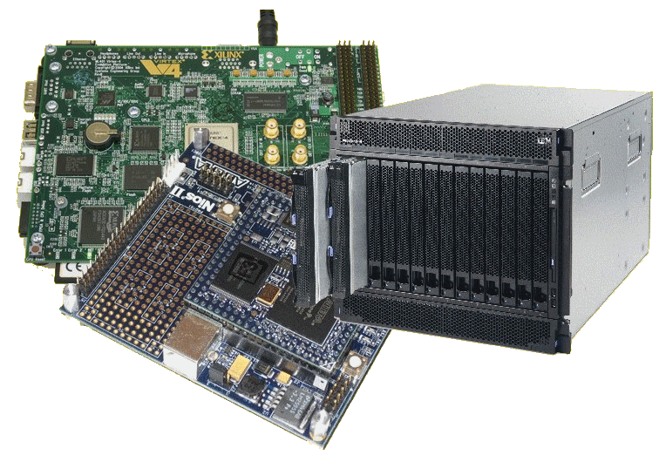
Lecture Overview
Steps in designing parallel solutions
Some of these aspects have been
Step 1: understanding the problem
Step 2: partitioning
Step 3: decomposition & granularity

Slide 5
Thinking ahead, towards…
Design Review
Some of these slides are of course relevant when considering what you are going to be reporting on during your Design Review
But NOTE: the design review assignment specifications need to be focused on when you are doing the design review (bring along some visual aid / resources to show)
YODA ‘mini conference’
You can reflect briefly during your group’s presentation on aspects of what the problem is, sub-problems, partitioning methods etc.

Slide 6
Understanding the Problem
EEE4084F

Slide 7
Steps in Designing Parallel Programs
…

Slide 8
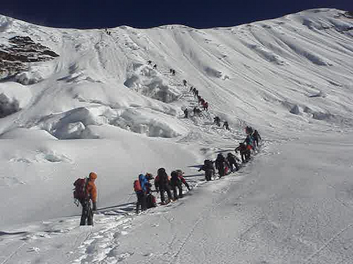
Steps in Designing Parallel Programs
Hardcore competent parallel programmers
(leading the way to greater feats)
Starting the somewhat long and arduous trek on the topic of designing parallel programs
EEE4084F
Sequential programmers in their comfort zone.

Slide 9
Steps in designing parallel programs
The hardware may be done first… or later.
The main steps:
Understand the problem
Partitioning (separation into main tasks)
Decomposition & Granularity
Communications
Identify data dependencies
Synchronization
Load balancing
Performance analysis and tuning
…
this lecture

Slide 10
Step 1: Understanding the problem
Make sure that you understand the problem, that is the right problem, before you attempt to formulate a solution
Some problems aren’t suited to parallelization – it just might not be parallelizable
(i.e. ‘problem validation’)
Example of non-parallelizable problem:
Calculating the set of Fibonacci series e.g., Fib(10²⁰) as quickly as possible.
Fib(n) = n } if n < 2
= Fib(n – 1) + Fib(n – 2) } otherwise

Slide 11
Step 1: Understanding the problem
Many problems may have obvious parallel solutions.
Others may need some concerted effort to discover the parallel nature.
Easily parallel example:
Given two tables, client (clientname,clientnum) and orders (clientnum,ordernum,date) find the name of clients who ordered something on 1 March 2010.
Obvious solution: divide orders into smaller parts, each task checks the dates in its partition, it it matches the clientnum is added to a temporary list, at the end all the temporary lists are combined and clientnum replaced by clientname.

Slide 12
Step 1: Understanding the problem
Identify: Critical parts or ‘hotspots’
Determine where most of the work needs to be done. Most scientific and technical programs accomplish the most substantial portion of the work in only a few small places.
Focus on parallelizing hotspots. Ignore parts of the program that don’t need much CPU use.
Consider which profiling techniques and Performance Analysis Tools (‘PATs’) to use

Slide 13
Step 1: Understanding the problem
Identify: bottlenecks
Consider communication, I/O, memory and processing bottlenecks
Determine areas of the code that execute notably slower than others.
Add buffers / lists to avoid waiting
Attempt to avoid blocking calls (e.g., only block if the output buffer is full)
Try to rearrange code to make loops faster

Slide 14
Step 1: Understanding the problem
General method:
identify hotspots, avoid unnecessary complication, identify potential inhibitors to the parallel design (e.g., data dependencies).
Consider other algorithms…
This is an most important aspect of designing parallel applications.
Sometimes the obvious method can be greatly improved upon though some lateral thought, and testing on paper.

Slide 15
Step 1: Identifying the Problem: where the solution may fit…
This also brings in aspects of Lecture 1, ‘the Landscape of Parallel Computing’*
Considering the 7 questions:
What are the applications?
What are the common kernels?
What are the hardware building blocks?
How to connect them?
How to describe allocations and kernels?
How to program the hardware?
How to measure success?
* The Landscape of Parallel Computing Research: A View from Berkeley” by Krste Asanovic, Ras Bodik, Bryan Catanzaro, et al.

Slide 16
Step 1: Identifying the Problem: where the solution may fit…
Considering the type of solution…
Can consider Flynns models (SISD, SIMD, etc.)
Thinking of available kernels or patterns (e.g. DWARFs as per Asanovic et al.)

Slide 17
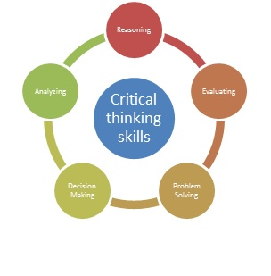
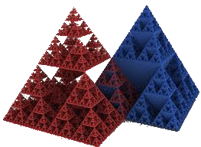
Different perspectives: Gaining a better understand of the problem
General Systems Thinking (GST)
Critical Analysis
(& Critical Thinking)
Applying rational and logical thinking while deconstructing texts or subject matter studied.*
How does the problem of focus relate to more general problems?
What other systems are being depended on or are affected?
Has a systems approach been considered in addition to the usual divide and simplify approach?
Let’s consider what happens, in a logical scientific / deductive manner, if we discard or replace some of the traditions or ‘conditioned choices’.
Reflecting on choices and descriptions
Considering ‘what if…’ scenarios (e.g. what if a chair had only one leg instead of four)
See last page for suggested sites to learn more about critical analysis
* Adapted from: Browne, M & Keeley, S 2001, Asking the right questions: a guide to critical thinking, 6th edn, Prentice-Hall, Upper Saddle River, N.J.

Slide 18
Video Clip: Systems Thinking
This is a suggested video clip to view for gaining an insight into what Systems Thinking is about.
YouTube clip: Systems thinking an introduction.mp4

Slide 19
Step 2: Partitioning
The Problem
partitioning
This step involves breaking the problem into separate chunks of work, which can then be implemented as multiple distributed tasks.
Two typical methods to partition computation among parallel tasks:
Functional decomposition or
Domain decomposition

Slide 20
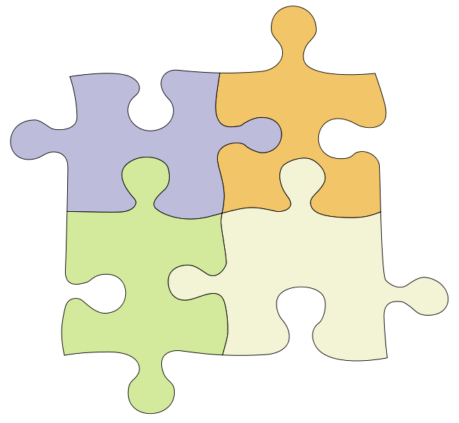
Functional decomposition
The Problem
Solution Parts
This is about considering the whole problem / overall solution, and the thinking about how it can be decomposed into independent functional parts (not necessarily looking at how the data is separated at this stage).
Functional decomposition is suited to problems that can be split into different tasks

Slide 21
Functional decomposition
Step 2: Partitioning
Functional decomposition focuses on the computation to be done, rather than the way data is separated and manipulated by tasks.
The problem is decomposed into tasks according to the work that must be done.
Each task performs a portion of the overall work.
Tends to be closer to message passing and MIMD systems

Slide 22
Functional decomposition
Task #2:
1.
2.
3.
Task #1:
1.
2.
3.
4.
The Problem
Task #3:
1.
2.
3.
4.
5.
Task #4:
1.
2.
Functional decomposition is suited to problems that can be split into different tasks

Slide 23
Functional decomposition
Example applications
Environment modelling
Simulating reality
Signal processing, e.g.:
Pipelined filters: in → P1 → P2 → P3 → out
Here P1 is filled first, its result is sent to P2 while simultaneously P1 starts working on a block of new input, and so on.
Climate modelling (e.g., simultaneously running simulations for atmosphere, land, and sea)

Slide 24
Domain decomposition
Involves separating the data, or taking different ‘views’ of the same data. E.g.
View 1 : looking at frequencies (e.g. FFTs)
View 2 : looking at amplitudes
Each parallel task works on its own portion of the data, or does something different with the same data
The Data
The Data
Task1
Task2
Task3
View 1
View 2
Task1
Task2
Result
Result

Slide 25
Domain decomposition
Good to use for problems where:
Data is static (e.g., factoring; matrix calculations)
Dynamic data structures linked to a single entity (where entity can be made into subsets) (e.g., multi-body problems)
Domain is fixed, but computation within certain regions of the domain is dynamic (e.g., fluid vortices models)

Slide 26
Domain decomposition
(terms introduced in Lecture 3)
Many possible ways to divide things up. If you want to look at it visually…
continuous
Blocked (same-size partitions)
Blocked
Interlaced
Interleaved or
cyclic
Other methods can be done

Slide 27
Step 3: Decomposition and Granularity
EEE4084F

Slide 28
Step 3: Decomposition and Granularity
Decomposition – how the problem can be divided up; looked at earlier:
Functional decomposition
Domain (or data) decomposition
Granularity
How big or small are the parts that the problem has been decomposed into?
How interrelated are the sub-tasks
This was introduced this in Lecture 5

Slide 29
The Ratio of Computation : Communication
This ratio can help to decide is a problem is fine or course grained.
1 : 1 = Each intermediate result needs a communication operation
100 : 1 = 100 computations (or intermediate results) require only one communication operation
1 : 100 = Each computation needs 100 communication operations

Slide 30
Granularity
Fine Grained:
One part / sub-process requires a great deal of communication with other parts to complete its work relative to the amount of computing it does (the ratio computation : communication is low, approaching 1:1)
course grained …

Slide 31
Granularity
Fine Grained:
One part / sub-process requires a great deal of communication with other parts to complete its work relative to the amount of computing it does (the ratio computation : communication is low, approaching 1:1)
Course Grained:
A coarse-grained parallel task is largely independent of other tasks. But still requires some communication to complete its part. The computation : communication ratio is high (say around 100:1).

Slide 32
Granularity
Fine Grained:
One part / sub-process requires a great deal of communication with other parts to complete its work relative to the amount of computing it does (the ratio computation : communication is low, approaching 1:1)
Course Grained:
A coarse-grained parallel task is largely independent of other tasks. But still requires some communication to complete its part. The computation : communication ratio is high (say around 100:1).
Embarrassingly Parallel:
So course that there’s no or very little interrelation between parts/sub-processes

Slide 33
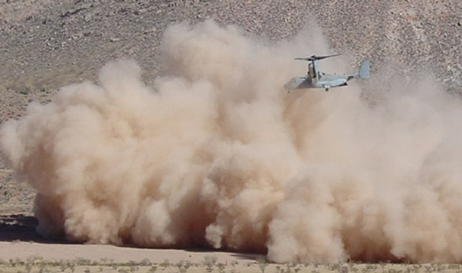
Decomposition and Granularity
Fine grained:
Problem broken into (usually many) very small pieces
Problems where any one piece is highly interrelated to others (e.g., having to look at relations between neighboring gas molecules to determine how a cloud of gas molecules behaves)
Sometimes, attempts to parallelize fine-grained solutions increased the solution time.
For very fine-grained problems, computational performance is limited both by start-up time and the speed of the fastest single CPU in the cluster.

Slide 34
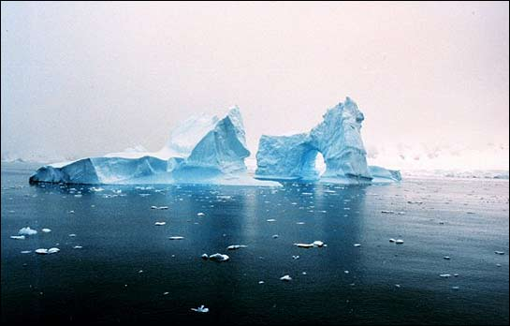
Decomposition and Granularity
Course grained:
Breaking the problems into larger pieces
Usually, low level of interrelations (e.g., can separate into parts whose elements are unrelated to other parts)
These solutions are generally easier to parallelize than fine-grained, and
Usually, parallelization of these problems provides significant benefits.
Ideally, the problem is found to be “embarrassingly parallel” (this can of course also be the case for fine grained solutions)

Slide 35
Decomposition and Granularity
Many image processing problems are suited to course grained solutions, e.g.: can perform calculations on individual pixels or small sets of pixels without requiring knowledge of any other pixel in the image.
Scientific problems tend to be between coarse and fine granularity. These solutions may require some amount of interaction between regions, therefore the individual processors doing the work need to collaborate and exchange results (i.e., need for synchronization and message passing).
E.g., any one element in the data set may depend on the values of its nearest neighbors. If data is decomposed into two parts that are each processed by a separate CPU, then the CPUs will need to exchange boundary information.

Slide 36
Class Activity: Discussion
Which of the following are more fine-grained, and which are more course-grained?
Matrix multiply
FFTs
Decryption code breaking
(deterministic) Finite state machine validation / termination checking
Map navigation (e.g., shortest path)
Population modelling

Slide 37
Class Activity: Discussion
Which of the following are more fine-grained, and which are course-grained?
Matrix multiply - fine grain data, course func.
FFTs - fine grained
Decryption code breaking - course grained
(deterministic) Finite state machine validation / termination checking - course grained
Map navigation (e.g., shortest path) - course
Population modelling - course grained

Slide 38
Next lecture
Continuation of the steps:
Communications
Identify data dependencies
Synchronization
Load balancing
Performance analysis and tuning

Slide 39
Further Reading / Refs
Suggestions for further reading, slides partially based / general principles elaborated in:
https://computing.llnl.gov/tutorials/parallel_comp/
http://www2.physics.uiowa.edu/~ghowes/teach/ihpc12/lec/ihpc12Lec_DesignHPC12.pdf
Some resources related to systems thinking:
https://www.youtube.com/watch?v=lhbLNBqhQkc
https://www.youtube.com/watch?v=AP7hMdnNrH4
Some resources related to critical analysis and critical thinking:
An easy introduction to critical analysis:
http://www.deakin.edu.au/current-students/study-support/study-skills/handouts/critical-analysis.php
An online quiz and learning tool for understanding critical thinking:
http://unilearning.uow.edu.au/critical/1a.html

