Slide 1
EEE4084F
Digital Systems
NOT IN 2018 EXAM
Lecture 24X
RC Platform Case Studies 2/2:
Large & small FPGA-based RC systems
Microprocessor-based: The Cell Broadband Engine Architecture, IBM Blade
FPGA-based:
PAM, VCC, SPLASH …
(this lecture)
(previous lecture)
Lecturer:
Simon Winberg
Attribution-ShareAlike 4.0 International (CC BY-SA 4.0)

Slide 2
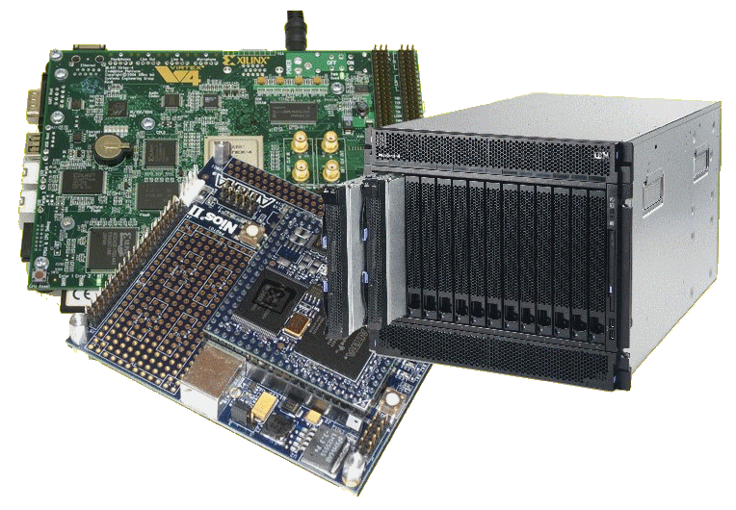
Lecture Overview
Large-scale FPGA-based RC system examples
PAM, VCC, Splash
Small-scale FPGA-based RC system examples
PRISM
Algotronix CAL, XC620,
Cray Research XD1,
SRC
Silicon Graphics RASP

Slide 3
Large-scale RC Systems
A look at platforms architectures

Slide 4
Large RC System - PAM
Programmable Active Memories (PAM)
Produced by Digital Equipment Corp (DEC)
Used Xilinx XC3000 FPGAs
Independent banks of fast static RAM
SRAM
SRAM
SRAM
SRAM
Host
CPU
FPGA
FPGA
FPGA
FPGA
FPGA
FPGA
FPGA
FPGA
DRAM
SRAM
SRAM
SRAM
SRAM
Digital Equipment Corp. PAM system (1980s)
Image adapted from Hauck and Dehon (2008) Ch3

Slide 5
Large RC System - VCC
Virtual Computer Corporation (VCC)
First commercially commercial RC platform*
Checkerboard layout of
Xilinx XC4010 devices and
I-Cube programmable interconnection devices
SRAM modules on the edges
SRAM
FPGA
FPGA
FPGA
FPGA
…
FPGA
FPGA
SRAM
SRAM
FPGA
I-Cube
FPGA
I-Cube
…
I-Cube
FPGA
SRAM
…
…
…
…
…
…
…
…
SRAM
FPGA
I-Cube
FPGA
I-Cube
…
I-Cube
FPGA
SRAM
VCC Virtual Computer
* Hauck and Dehon (2008)

Slide 6
Large RC System - Splash
Dev. by Super Computer Research (SCR) Center ~1990
Well utilized (compared to previous systems).
Comprised linear array of FPGAs each with own SRAM *
Summary of the Splash system
Developed initially to solve the problem of mapping the human genome and other similar problems. Design follows a reconfigurable linear logic array. The SPLASH aimed to give a Sun computer better than supercomputer performance for a certain types of problems. At the time, the performance of SPLASH was shown to outperform a Cray 2 by a factor of 325. FPGAs were used to build SPLASH, a cross between a specialized hardware board but more flexible like a supercomputer. The SPLASH system consists of software and hardware which plugs into two slots of a Sun workstation. **
Illustration of the
SPLASH design
(adapted from *)
FPGA
FPGA
…
FPGA
SRAM
SRAM
SRAM
…
SRAM
FPGA
Crossbar
Dedicated
controller
FPGA
FPGA
…
FPGA
SRAM
SRAM
…
SRAM
* Hauck and Dehon (2008)
SRC Splash version 2
**Adapted from: Waugh, T.C., "Field programmable gate array key to reconfigurable array outperforming supercomputers," Custom Integrated Circuits Conference, 1991., Proceedings of the IEEE 1991 , vol., no., pp.6.6/1,6.6/4, 12-15 May 1991 doi: 10.1109/CICC.1991.164051

Slide 7
Small-scale RC Systems
A look at platforms architectures

Slide 8
Small RC Systems
Brown University’s PRISM
Single FPGA co-processor in each computer in a cluster
Main CPUs offloading parallelized functions to FPGA
Algotronix
Configurable Array Logic (CAL) – FPGA featuring very simple logic cells (compared to other FPGAs)
Later become XC6200 (when CAL bought by Xilinx)
* Hauck and Dehon (2008)

Slide 9
Reconfigurable Supercomputers
Cray Research
XD1: 12 processing nodes
6x ADM Opteron processors
6x Reconfigurable nodes built from Xilinx Vertex 4
Each XD1 in own chassis, can connect up to 12 chassis in a cabined (i.e. 144 processing nodes)
SRC
Traditional processor + reconfig. processing unit
Based on Xilinx Virtex FPGAs
Silicon Graphics
RASP (reconfigurable application-specific processor)
Blade-type approach of smaller boards plugging into larger ones
Ref: Hauck and Dehon Ch3 (2008)

Slide 10
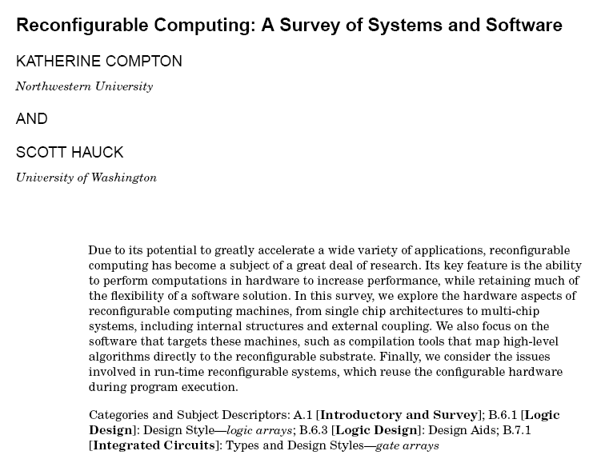
Additional Reading
Reading
Reconfigurable Computing: A Survey of Systems and Software (ACM Survey) *
(not specifically examined, but can help you develop insights that help you demonstrate a deeper understanding to problems)
-- End of the Cell Processor case study --
* Compton & Hauck (2002) .“Reconfigurable Computing: A Survey of Systems and Software” In ACM Computing Surveys, Vol. 34, No. 2, June 2002, pp. 171–210.

Slide 11
Conclusion & Plans
Reading
Hauck, Scott (1998). “The Roles of FPGAs in Reprogrammable Systems” In Proceedings of the IEEE. 86(4) pp. 615-639.
Next lecture:
Amdahl’s Law
Discussion of YODA phase 1

Slide 12
Disclaimers and copyright/licensing details
I have tried to follow the correct practices concerning copyright and licensing of material, particularly image sources that have been used in this presentation. I have put much effort into trying to make this material open access so that it can be of benefit to others in their teaching and learning practice. Any mistakes or omissions with regards to these issues I will correct when notified. To the best of my understanding the material in these slides can be shared according to the Creative Commons “Attribution-ShareAlike 4.0 International (CC BY-SA 4.0)” license, and that is why I selected that license to apply to this presentation (it’s not because I particulate want my slides referenced but more to acknowledge the sources and generosity of others who have provided free material such as the images I have used).
Image sources:
Wikipedia open commons

