Slide 1





EEE4084F
Digital Systems
Lecture 13
Software Quality Assurance
Lecturer:
Simon Winberg
ソフトウェア
Attribution-ShareAlike 4.0 International (CC BY-SA 4.0)

Slide 2
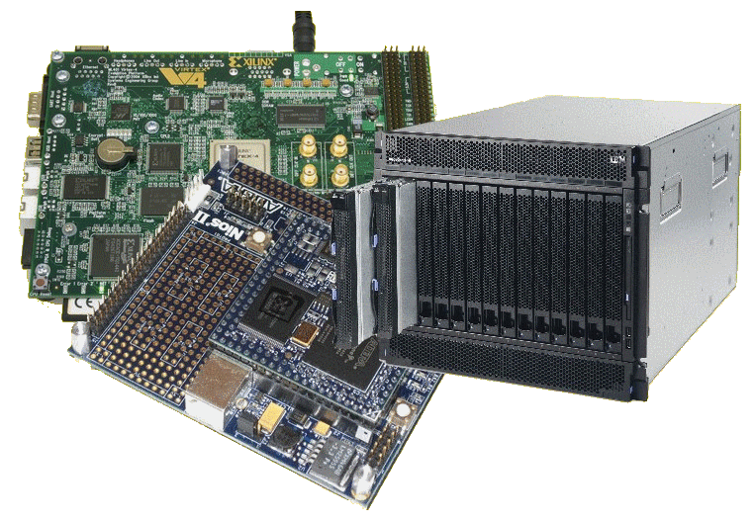
Lecture Overview
What is quality?
Software quality
Software quality assurance (SQA)
Software quality systems
Consequences of
bad SQA
Evolutionary model
of SQA in orgs
Kaizen of software

Slide 3

What is Quality?
General definition of quality:
  It is a products ‘fitness of purpose’
  A product is good quality if it does exactly what the users wants it to do!
‘Fitness of purpose’
  The system satisfies the
  requirements as specified in
  requirements document
  (agreed contract)
requirements

Slide 4

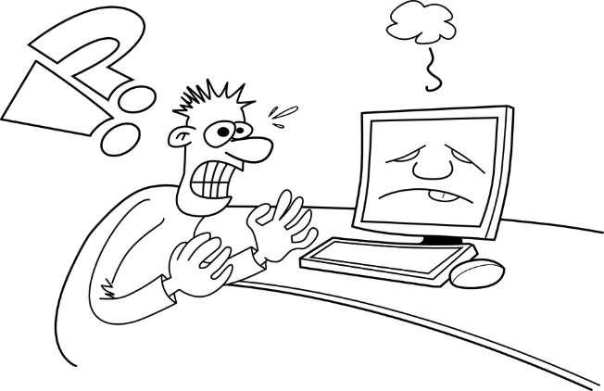
Consider this
A computer system (e.g. accounting program) that
- is functionally correct (e.g. accurately
records debits/credits)
- meets all the requirements as laid out in
the contract …
Your lucky
day!! ☺
but one that
- is sometimes incredibly slow (takes 5 minutes or more
to complete a transaction)
- the user interface is very difficult to use takes days
for a new user to learn how to use it
- occasionally hangs for no reason
(but doesn’t loose/corrupt data) …
Give
me a
break!
Is that Software Quality?
NO!

Slide 5

Brief Brainstorm
Software quality is not just about satisfying requirements, it is also about…
Work with a buddy and decide at least 5 things besides satisfying
requirements that a quality system provides.

Slide 6

Software Quality
Software quality is not just about satisfying requirements, it is also about:
  Correctness and
  “The 7 desirable ‘ilities” :
    Usability
    Maintainability (incl. documentation)
    Scalability / Extensibility
    Reliability
    Reusability
    Securability (more formally ‘security’)
    Portability
T
I
I
L
E
I
S
You should know what these 7 ilities are, read up if you don’t

Slide 7
Software Quality Assurance
Software quality assurance is the:
  Guidance/process for recognizing, defining, analysing, and improving the software production process.
  It is achieved through a software quality system

Slide 8
Software Quality System
Organizational responsibility
Managerial structures
Individual SQA Responsibilities

Slide 9
Software Quality System Activities
Auditing software projects
Establishing:
  Standards
  Procedures
  Guidelines, etc.
Producing reports for high-level management
Continuously review & refining the organization’s quality system
Often quite specific to a particular organization but often based around published recommended practices

Slide 10
Software Quality System Activities
Effective quality system are well documented
Without a properly documented quality system, application of quality procedures become ad-hoc, results in large variations in the quality of the products delivered*.
* Sadly this is commonly what happens to most hons and postgrad projects... because there tends not to be enough time to learn or apply quality practices; imagine how impressive out projects could become if there was sufficient time for this!!

Slide 11

Bad/Inconsistent SQA
→ Bad Attitudes and Behaviour
An undocumented/poor quality system:
  Sends clear messages to the staff about the organization’s attitude of quality assurance.
  Can contribute towards project failure/delays
  Can make maintenance impossible/expensive
  Can leads to disagreements between staff
My code was perfect, you
broke it!
Rubbish, no
one confirms
your story!

Slide 12




Evolution of Quality Assurance
The SQA of a particular organization can usually be placed into the following continuum of Software Quality Systems
evolved
4. Total Quality Management (TQM)
3. Quality Assurance (QA)
2. Quality Control (QC)
1. Inspection
unevolved
It’s up to you to decide where programmers are the happiest!

Slide 13
The Levels
Inspection
  Check for defects and eliminate them
Quality Control
  Not just detect & eliminate defects…
  Also determine causes behind defects
Quality Assurance
  Above + this basic premise:
    If quality processes are good, and followed rigorously, the products are bound to be good!
  Includes guidance for recognizing, defining, analysing, and improving the production process

Slide 14
The Levels
Total Quality Management (TQM)
  Continuous improvements to the quality process through measurement and refinement.
  “Continuous Process Improvement”
There is a Japanize term for this … and people who strive toward this ideal in their work are considered something like Samurai Warriors (or like an ‘Iron Chef’) … the work is …

Slide 15

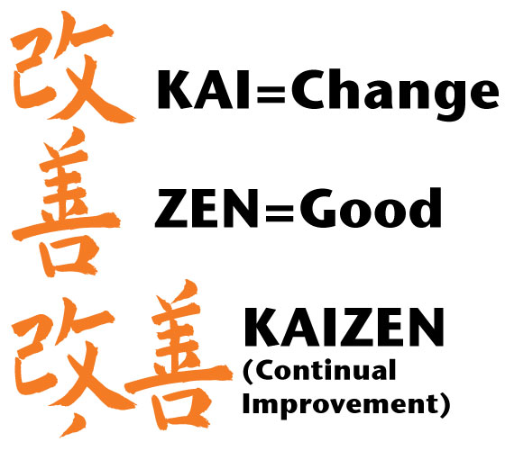
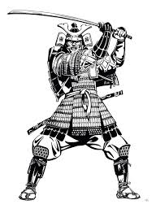

Kaizen
Kaizen :
The method of continuous incremental improvements is an originally Japanese management concept for incremental (gradual, continuous) change towards improvement. Kaizen is actually a way of life philosophy, assuming that every aspect of our life deserves to be constantly improved.
Samurai warriors strove towards the kaizen of the warrior, that is to say they aimed to become perfection in all areas of combat, from the appearance of their armour, the way they moved, to the mental preparation, and physical preparation for strategy, defensive tactics, striking skill, etc.
Toyota the huge automotive giant proudly strives towards the kaizen of automobile manufacture
What would it take to strive towards the kaizen of HPEC system development?... Like a samurai, it takes much time & practice!

Slide 16

Formal Specification
Towards precision of implementation meeting the requirements

Slide 17
Formal Specification
In computer science Formal Specifications (FS) =
  Mathematically based techniques the purpose of which is to help the implementation of a systems and its software meet its requirements.
Formal specifications are used to
  Describe a system
  Analyse its behaviour
  Aid the design by verifying key properties of interest through rigorous and effective reasoning tools.
These specifications are formal in that they have a syntax and semantics that can be used to infer useful information and formulate proofs.

Slide 18
Formal Specification
Why FS
  Computer systems have become increasingly more powerful and integrated into society over the years, have impacted society and the environment to an ever greater extent – people have become more dependent on their computer systems
  Due to their increasing complexity and ubiquity, they have also become more difficult to analyse, both their workings and their impact on other systems.
  For these reasons methods are needed to more decisively, if not undisputedly, reason and know that these systems will do what they are supposed to do.
  Formal specifications are one such way to achieve this in software engineering, particularly for applications where reliability and predictability is paramount, and regimes of testing may not be adequate – such as in medical systems and rocket control modules where you want an unequivocal proof that the system satisfy its requirements.

Slide 19
Formal Specifications
To do FS properly, we would probably need a whole course on it. So in this course the concept is just introduced so that you know about it, as FS is indeed highly relevant to HPEC where these types of systems are often used in safety-critical applications.
One thing I do want to delve into is the concepts of pre- and postconditions…

Slide 20
Preconditions and Postconditions
Often a programmer must needs to describe exactly what a function needs to accomplish, without any indication of how the function does its work.
i.e. you need to describe what the result of the function will be, and conditions in which it is expected to work, without explaining in details (of a particular programming language) what it does.

Slide 21
Preconditions and Postconditions
One method to explain the operation of a function without explaining its implementation is using
  Preconditions
    A statement indicates what must be true before the function is called.
    Programmer needs to ensure the precondition is valid when function is called
  Postconditions
    A statement indicates what will be true when the function finishes its work.

Slide 22
Preconditions and Postconditions Example
Consider this disp_sqrt function.
void disp_sqrt ( float x )
{
// calculate the square root and print the result to the stdout
}

Slide 23
Preconditions and Postconditions Example
Consider the sqrt function.
void disp_sqrt ( float x )
{
// calculate the square root r and print this result to the stdout
}
We know that for negative x it should give imaginary numbers, but assume that use of imaginary numbers are not possible by the specification. So in that case, we can specify the post condition for the function: that it will only work for non-zero numbers…

Slide 24
Preconditions and Postconditions Example
Consider the sqrt function.
void disp_sqrt ( float x )
{
// PRECONDITION: (x>=0)
// calculate the square root r and print this result to the stdout
}
We
could
add
We know that for negative x it should give imaginary numbers, but assume that use of imaginary numbers are not possible by the specification. So in that case, we can specify the post condition for the function: that it will only work for non-zero numbers…

Slide 25
Preconditions and Postconditions Example
Consider the sqrt function.
void disp_sqrt ( float x )
{
// PRECONDITION: (x>=0)
// calculate the square root r and print this result to the stdout
}
What should happen after the function? It should come out with a result r such that r*r = x, and print this result to the screen…

Slide 26
Preconditions and Postconditions Example
Consider the sqrt function.
void disp_sqrt ( float x )
{
// PRECONDITION: (x>=0)
// calculate the square root r and print this result to the stdout
// POSTCONDITION: (r * r = x) & has send data to stdout
}
What should happen after the function? It should come out with a result r such that r*r = x, and print this result to the screen…

Slide 27
Pre- and post-conditions in C
The assert function can be used to test conditions in a simple way
void disp_sqrt ( float x )
{
assert(x>=0); // check precondition
// calculate the square root r and print this result to the stdout
assert(r*r==x); // check postcondition
}
How assert(val) works: if val is true, does nothing, if val is false then prints an error that indicates the module file name, the line number and what val is.
e.g.
Assertion violation: file mysqrt.c, line 12: x <= 0

Slide 28
Any Questions?
End of Slideshow

Slide 29
Disclaimers and copyright/licensing details
I have tried to follow the correct practices concerning copyright and licensing of material, particularly image sources that have been used in this presentation. I have put much effort into trying to make this material open access so that it can be of benefit to others in their teaching and learning practice. Any mistakes or omissions with regards to these issues I will correct when notified. To the best of my understanding the material in these slides can be shared according to the Creative Commons “Attribution-ShareAlike 4.0 International (CC BY-SA 4.0)” license, and that is why I selected that license to apply to this presentation (it’s not because I particulate want my slides referenced but more to acknowledge the sources and generosity of others who have provided free material such as the images I have used).
Image sources:
– Wikipedia open commons
Businessman juggling - Pixabay
Samurai, Kaizen Japanese lettering – sources include flickr and openclipart.org

