Slide 1
Motion estimated frame interpolation
YODA Project 2016
Sean Wood | Ross MacArthur | Shaylin Chetty

Slide 2
4K 60Hz HDMI
ASIC
4K 120Hz

Slide 3
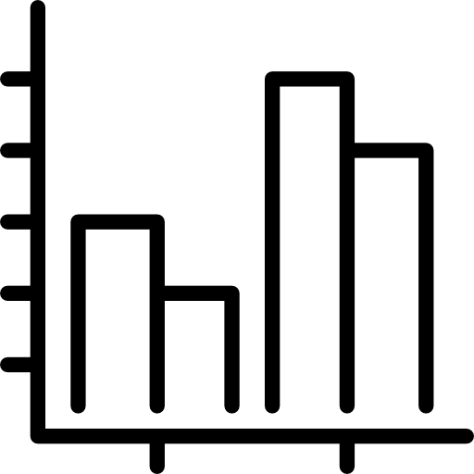
Pipelined Interpolation Execution
Correlate
Interpolate
Mask
Notes:
Made sense to structure the execution flow in a pipelined fashion → Interdependency
Correlate
Interpolate
Mask

Slide 4
Motion vector detection
Correlate
Frame Buffer A
Fourier Transform A
Inverse FFT
FFT
Multiply
Motion Vector Estimation
Motion Vector Buffer
Phase Correlation
Frame Buffer B
Fourier Transform B
Quad Tree partitioning
FFT
Complex Conjugate

Slide 5
Frame interpolation
Interpolate

Slide 6
Artifact masking
Mask

Slide 7
Concept Pipeline Structure and Buffering
Input Buffer Fill
Correlation
Interpolation
Artifact Masking and Output

Slide 8
Concept Pipeline Structure and Buffering
Buffer Advance

Slide 9
Concept Pipeline Structure and Buffering
Buffer Utilisation

Slide 10
Concept Pipeline Structure and Buffering
Advancing
Utilising

Slide 11
Concept Pipeline Structure and Buffering
Utilising
Advancing

Slide 12
Concept Pipeline Structure and Buffering
T = 1
A
A

Slide 13
Concept Pipeline Structure and Buffering
T = 2
B
A
Advancing
B
A

Slide 14
Concept Pipeline Structure and Buffering
T = 3
C
B
A
C
B
A
Advancing

Slide 15
Concept Pipeline Structure and Buffering
T = 4
D
C
B
A
Advancing
AB
D
C
B
A
Utilising

Slide 16
Concept Pipeline Structure and Buffering
T = 5
E
D
C
B
A
Utilising
BC
AB
E
D
C
B
A
Advancing

Slide 17
Concept Pipeline Structure and Buffering
T = 6
F
E
D
C
B
Advancing
CD
BC
AB
F
E
D
C
B
A
Utilising

Slide 18
Concept Pipeline Structure and Buffering
T = 7
G
F
E
D
C
B
Utilising
DE
CD
BC
AB
G
F
E
D
C
Advancing

Slide 19
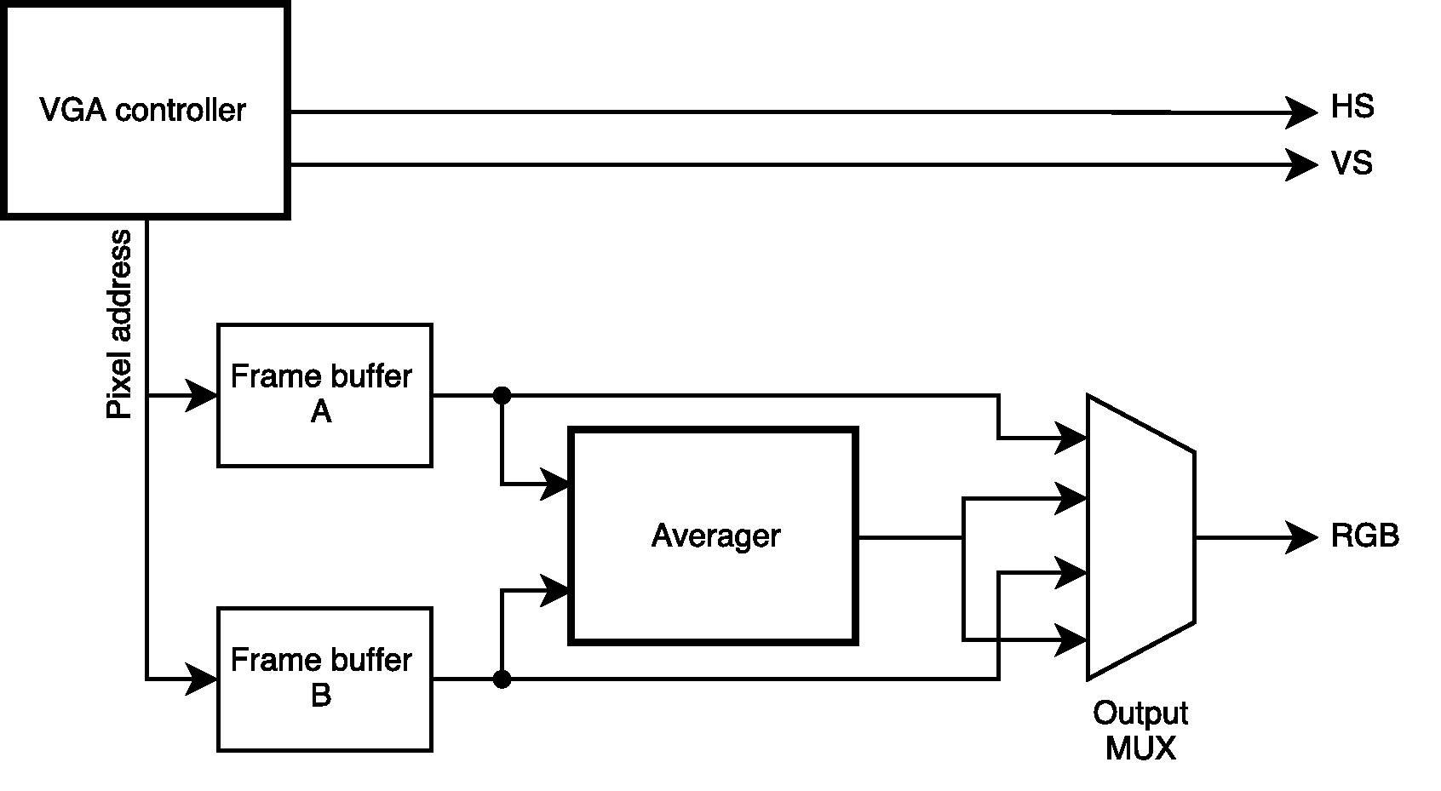
Prototype implementation

Slide 20
Motion estimated frame interpolation
Thank you, any questions?

