Slide 1
EEE4084F
Digital Systems
Lecture 21
Reflections, key steps* and
A short comprehensive assignment
* Relates to Martinez, Bond and Vai Ch 4.
Lecturer:
Simon Winberg

Slide 2
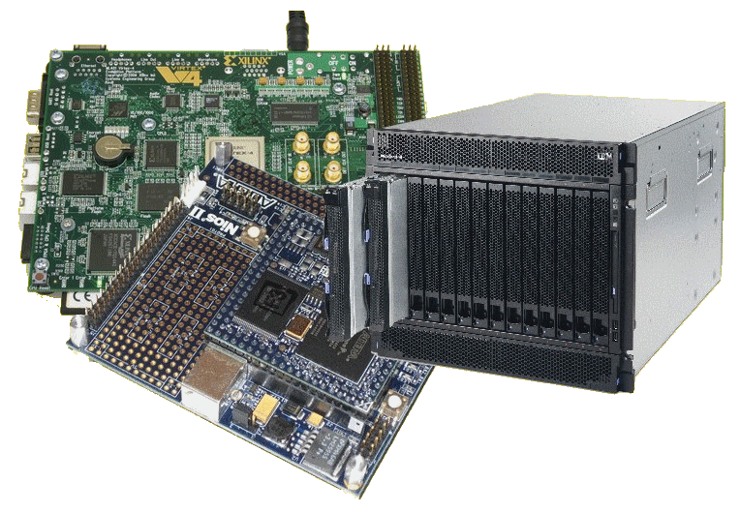
Lecture Overview
Key steps to consider
Class activity:
A comprehensive short assignment to discuss in groups

Slide 3
Reflections on: Key steps to consider
As per general development projects, Reconfigurable and High-performance computing systems have a similar set of phases:
Main phases
of development
(usually starts with
requirements; the
subsequent iterations start with a requirements review and deciding what next to do.)
Starting small (i.e. from centre of spiral), with little risk. Adding features and mitigating risk with each additional iteration.
Review
Analysis
Testing /
Release /
Planning
Design and
Implementation
A spiral* model view of development
* B. W. Boehm, “A spiral model of software development and enhancement,” Computer, vol. 21, pp. 61-72, 1988.

Slide 4
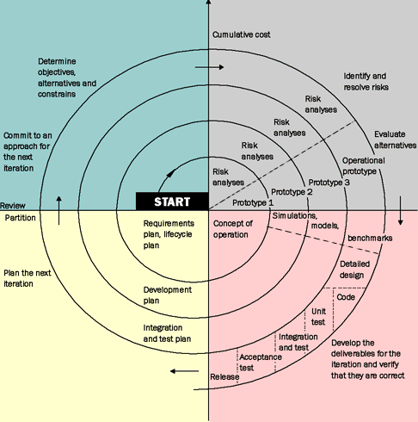
Spiral model
Martinez, Bond and Vai, 2008, “High Performance Embedded Computing Handbook”, CSC Press, pg 43.

Slide 5
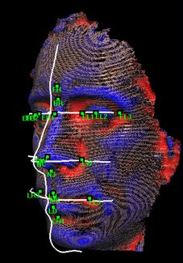
Reflections – short activity
Keep in mind the main recurring phases of the spiral model:
Analysis
Review
Design /
implementation /
prototype
Testing and
Planning of
next iteration
Consider that you are embarking on a project that involves developing a face recognition system for The Hawks *. The system is accessed via possibly (very low budget) workstation PCs, which are used to upload photos to a remote central computing site where the face recognition functions are run. The central computing site comprises a fast PC with one or more digital accelerator to do the main number crunching. (to next slide..)
* The Hawks, officially called the ‘Police's Directorate for Priority Crime Investigation’, is the South African current take on the US’s version of the FBI.

Slide 6
Todo – group task
Form into groups to discussion:
How would the first step of the spiral model be carried out for the face recognition system
What are some of the risks to content with for the first thing to carry out
What would you do to test and analyse the results (if applicable)
What would the next cycle involve?

Slide 7
Reflection on: Key Steps in design
System-level analysis and testing
Analyse for communication bottlenecks
Analyse for sequences of operations (arithmetic, memory access, etc)
Identify flexibility and key parameters (algorithm vs. architecture parameters)
Architecture-level analysis and testing
ALU and processing kernel definitions
Memory profiling
Alternatives types configurability
Sequencer/scheduler development and connection paths
Implementation
Software model(s) developed at architecture specification stage
Software APIs and integration with behavioural models & prototyped hardware
VLSI- and FPGA-focus activities: checking timing and routability constraints

Slide 8
Alternative approach: The RAD process
RAD = Rapid Application Development
Speeding-up activities in each phase
Speeding up the iterative development
Building working prototypes faster to get feedback quicker (can then be directly expanded to finished system)
Intensive meetings with key individuals to get decisions faster
Problem: If not managed well, can greatly increase the development risky

Slide 9
Common causes of failure
Requirements Analysis
Nothing recorded / no written requirements
Requirements vague or insufficiently described
No directions on user interface
No end-user involvement (occasionally difficult to organize)
Design
Insufficient design and planning done
No documents (or poorly formed)
Inefficient data structures / file formats
Infrequent or no design reviews
Lack of consultation/input from experts and senior engineering staff

Slide 10
Common causes of failure
Implementation
Lack of, or insufficient coding standards
Infrequent or no code reviews
Poor in-line code documentation
Subsystem/component testing & Integration
Insufficient component testing
Incomplete testing or running ineffective tests
No quality assurance

Slide 11
Most common cause of success??
How can we avoid making the mistakes that lead to project failure? Besides the obvious point of having competent staff?
Apparently* the answer is simply:
By using “simple common sense… which is often ignored in systems projects.”*
Need the three pillars of success:
A sound methodology
Solid technical leadership by someone who’s successfully done a similar project
Management support
A happy project
sound methodology
Good leadership
Management
support
* M. I. Sanchez-Segura, J. García, A. Amescua, F. Medina-Dominguez, and A. Mora-Soto, “A Study on How Software Engineering Supports Projects Management,” Innovative Techniques in Instruction Technology, E-learning, E-assessment, and Education, pp. 161-165, 2008.

Slide 12
Processes and trends
Please ready through the rest of CH4 on your own. We’ve already seen much of what is said there, and experienced simplified instances of the development issues in pracs.

Slide 13
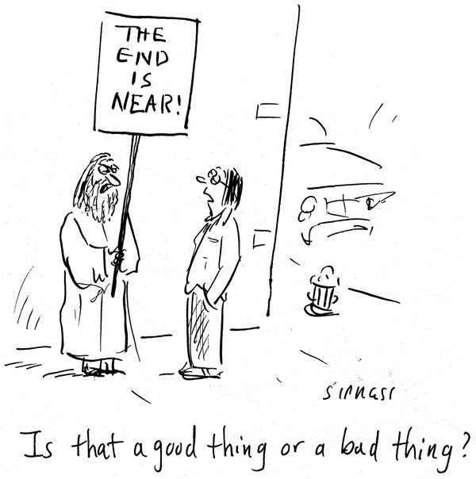
End of Content Lectures!
for
EEE4084F
Next Lecture:
Recap and
Exam syllabus

