Slide 1
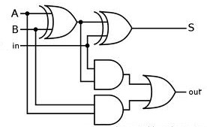
EEE4084F
Digital Systems
Lecture 20
C → HDL Automatic Conversion
Lecturer:
Simon Winberg

Slide 2
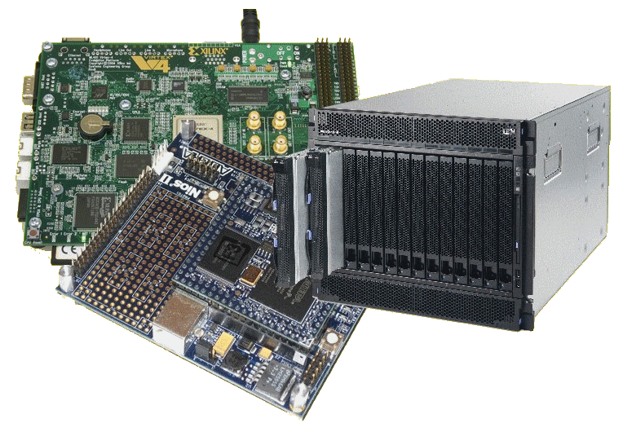
Lecture Overview
Reminders
C → HDL automatic conversion
Overview of conversion process
Limitations
Scenario
Mapping C to VHDL behavioural
Some tools

Slide 3
Reminder : Quiz 4
The Last Quiz…
Quiz 4 to be held next Thursday (9 May)
Lecture 16 (slide 13) → Lecture 20
CH24 (pages: 463-469; 473; 475-476)

Slide 4
YODA Groups and their managers
Design reviews: May 9, 10
See wiki for your ‘group manager’ assignment
(copied to next slide too)
Make contact with your group manager

Slide 5
# | Name and Link | TeamA | TeamB
01 | SF - Smoothing Filter P01?
02 | TLUA – Table Look-up Accelerator P02? P*
03 | IF – Interpolation Filter P03? | LQLTUM001 HNGDAN001 (OH)
04 | PRNG – Parallel Random Number Generator P04?
05 | DM - Delta modulator P05?
06 | ASG - Arithmetic series generator P06? | MTKMOO001 NSKCHR001 ATMLOR001 (JE) | BSXLAS001 DLLMIK001 (JE)
07 | SALG – Selection Address List Generator P07? P*
08 | FSG – Function Samples Generator P08? P* | MTBMOR002 XMBSAN001 (OH)
09 | BCDC - Binary Coded Decimal Convertor P09? | CHPDAV005 VVNJON001 RSHNIK001 (KR) | YGMPEN001 NDHNYI002 (KR)
10 | NCSM - Nonlinear Check Sum Module P10? P*
11 | CRCC - Cyclic Redundancy Check Calculator P11? | GWNJAM001 RTFFRA004 (IT)
12 | MMA - Matrix Multiplier Accelerator P12? | MNYPAU005 MPNALF001 (JE) | JKXGEO001 OPNWIL001 CDRNEL001 (JE)
13 | IMA - Image Masking Accelerator P13? | CTSJUS001 MSSDAN004 (OH)
14 | PSA - Pattern Seek Accelerator P14? P*
15 | DE - Data encryption accelerator P15? | CWDMAT001 TNGOLO001 (IT)
16 | DEA - TBD
17 | O - Digital Encryption Recovery Accelerator P17? P* | BRMGRE003 LRNFED001 (IT)
18 | AA - Audio Accelerator P18?
19 | SPA - Shortest Path Accelerator P19 | NCLAND004 (KR)
Assignments 2013
Initials | Name
(KR) | Karthik Rajeswaran
(OH) | Ojonav Hazarika
(IT) | Israel Tshililo
(JE) | Jason Esselaar

Slide 6
YODA Project Issues
Some teams not yet booked
Please email me your requested slot (see announcement sent earlier)
Demos are still 15 and 16 May
Final report and code hand in: 20 May
Heavy penalties for late demo

Slide 7
Terminology buffs?
Every heard of DMIPS?
In relation to a VAX?
How bizarre… how is that possibly of any relevance to HPCE?...

Slide 8
Terminology point
DMIPS =
Dhrystone MIPS (Million Instructions Per Second). Shows number of iterations of the Dhrystone loop repeated per second.
MIPS along are not all that meaningful for benchmarking because 1 CISC instruction may be worth many RISC instructions (but the CISC might still complete the task faster)
DMIPS = Dhrystone_score / 1,757
The value 1,757 is the number of Dhrystones per second obtained on the VAX 11/780, nominally a 1 MIPS machine

Slide 9
Whetstone, Dhrystone and CoreMark
Whetstone is a collection of commonly used computation tasks, repeated in a loop, and the time the loop takes to complete equates to the Whetstone rating.
For further details see:
http://www.coremark.org/home.php

Slide 10
Whetstone, Dhrystone and CoreMark
The Dhrystone benchmark contains no floating point operations; it is works similarly to the Whetstone, but uses computations appropriate for fixed-point or integer based applications.
For further details see:
http://www.coremark.org/home.php

Slide 11
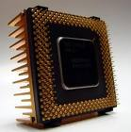
Whetstone, Dhrystone and CoreMark
CoreMark is a smaller benchmark
Developed by the Embedded Microprocessor Benchmark Consortium (EEMBC)
Focuses on the CPU core, similar to Dhrystone.
CoreMark is intended to
Execute on any processor, incl. small micro-controllers.
Avoid issues such as the compiler computing the work during compile time
Use real algorithms rather than being mostly synthetic.
CoreMark has established rules for running the benchmark and for reporting the results.
For further details see:
http://www.coremark.org/home.php

Slide 12
C to HDL Automatic Conversion
EEE4084F

Slide 13
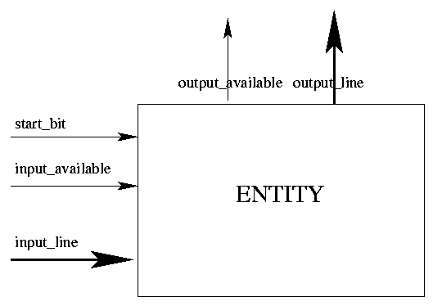
C to VHDL Converters
C program: functions; variables;
based on sequence (start to end) and the use of memory/registers operations
VHDL:
Implements an entity for the procedure
C code converted to VHDL

Slide 14
C to VHDL
Standard C
Memory-based
Variables (registers) used in performing computation
Normal C and C programs are sequential
Specialized C flavours for parallel description & FPGA programming:
Mitrion-C , SystemC , pC (IBM Parallel C) System Crafter, Impulse C
FpgaC Open-source (http://fpgac.sourceforge.net/) – does generate VHDL/Verilog but directly to bit file

Slide 15
How C → VHDL translators usually work (simplified)
Input
Often one C module at a time, no C libraries (operations like sqrt hardcoded as VHDL and H file interface, e.g. math.h)
More complete versions could use multiple user-developed modules and libraries
Output
VHDL code describing a top-level element with ports that can be hooked-up to other elements (e.g. using Altera Quartus II or LabView FPGA*) such as memory (e.g. BRAM, SDRAM), multipliers and dividers – similar to what you’ve done in Prac3
* http://www.ni.com/fpga/what_is.htm

Slide 16
Common Limitations for C → VHDL translators
No global variables
Forced to use additional parameters
E.g. to lines to control/arbitrate memory accesses, which you may need to manually account for in your code of things don’t work
Limited arguments
E.g. limited to 4
Does not support all C constructs
E.g. struct
One function at a time

Slide 17
C → VHDL Scenario
Looking at the steps a translation tool would take
Program requirements:
Implement a 4-bit up-counter in C that counts from an initial value (default of 0) and sets a reset_alarm variable once the target has been reached
Also want a reset operation and ability to set the count value

Slide 18
C Coding: Attempt 1
Let’s write it as we’d naturally write in C
Set up a few global variables
Set up a few functions
Write a main() function as starting point of the program
Please refer to the Handle-C handout that describes the style & syntax
(note this handout is a simplification of the official Handle-C syntax)
See handlec.c in: resources / class activities / handlec-example.zip

Slide 19
Program continues here
/** upcount (attempt 1): 4-bit up-counter
with reset alert.
This is a C program that we want to
translate into VHDL. */
/* Global variables */
int count = 0; // our global counter
int target = 5; // the targer value
// Reset function sets count to 0
void reset () {
count = 0;
}
/** Our upcount function. Return nonzero when target reached. */
int upcount ()
{
count=(count + 1)%7;
if (count==target) return 1;
else return 0;
}
int main () {
reset(); // reset the counter
// wait a bit...
while (!upcount());
// override with another value
count = 2;
return 0;
}

Slide 20
Concerns to deal with
VHDL program doesn’t really have a starting point
Usually more a data flows, sending signals to a port and getting signals back
We’re essentially wanting the program to become a VHDL entity
Need to make account for other entities wanting to control this one (e.g., telling this program to “reset”)
What about the clock?

Slide 21
C Code Attempt 2
Design around “lines” (shown as variable parameters) that control the upcount function (to become the upcount entity)
Parameters
Reset = reset the counter
Loadcnt = request value to load
Data = input value to load into count
Target = target to up to

Slide 22
C Interface → VHDL Port
H file for C program
VHDL Code Port
/* 4-bit up-counter
with reset alert. */
void upcount (
_in int data,
_in int target,
_in bit loadcnt,
_in bit reset );
/* Increments count until it reaches target. Returns 1 if target reached else returns 0 */
ENTITY counter_4 IS PORT(
clock, reset, loadcnt: IN BIT;
data: IN BIT_VECTOR( 3 DOWNTO 0 );
reset_alert: OUT BIT;
count: BUFFER BIT_VECTOR(3 DOWNTO 0) );
END counter_4;

Slide 23
Variables vs. signals VHDL types
The translation needs to map C variable types into VHDL signals…
VHDL standard types…
Scalar (single valued) signal types:
bit, boolean, integer
Examples:
A: in bit;
G: out boolean;
K: out integer range -2**4 to 2**4-1;

Slide 24
Variables vs. signals VHDL types
Aggregate (collection) signal types:
bit_vector – array of bits representing an unsigned binary number
signed – array of bits representing a signed binary number
Examples:
D: in bit_vector(0 to 7);
E: in bit_vector(7 downto 0);
M: in signed (4 downto 0); -- signed 5-bit vector for a binary number

Slide 25
C implementation to VHDL architecture
C implementation
Initialization of global variables
Operation of the functions
The entry point (main) and sequencing of program (i.e. main calls upcount)
VHDL translation
Initialization of registers
Clocks (to synchronize operations)
Architecture/behaviour descriptions describing what the entities do

Slide 26
C to HDL:
Large part is converting C into a VHDL behaviour description…
C Code
VHDL Code
/* 4-bit up-counter
with reset alert. */
int count = 0;
// this function runs
// all the time:
int upcount (
_in int 4 data,
_in int 4 target,
_in bit loadcnt,
_in bit reset,
_out bit reset_alert)
{
if (reset) count=0;
if (loadcnt) {
count=data;
return 0; }
count=(count + 1)%15;
if (count==target)
reset_alert=1;
else reset_alert=0;
}
ENTITY upcount IS PORT(
clock : IN BIT;
data : IN BIT_VECTOR (3 DOWNTO 0);
target: IN BIT_VECTOR (3 DOWNTO 0);
loadcnt, reset : IN BIT;
reset_alert: OUT BIT );
END counter_4;
ARCHITECTURE behavioral OF counter_4 IS
BEGIN
upcount: PROCESS( clock )
VARIABLE count: BIT_VECTOR(3 DOWNTO 0);
BEGIN
IF (clock= '1') THEN
IF (reset = '1') THEN
count <= "0000";
ELSIF (loadcnt='1') THEN count <= data;
ELSE
-- … adder here (see next slide) …
END PROCESS upcount;
END behavioral;

Slide 27
Continuation of last slide (for completeness sake)…
VHDL Code
-- full adder --
count(0) <= NOT count(0);
count(1) <= count(0) XOR count(1);
count(2) <= ( count(0) AND count(1) )
XOR count(2);
count(3) <= ( count(0) AND count(1)
AND count(2) ) XOR count(3);
IF count = target THEN
reset_alert <= '1';
ELSE
reset_alert <= '0';
END IF; -- IF count = target
END IF; -- IF reset = ‘1’
END IF; -- IF clock = '1’

Slide 28
Current C to VHDL Converters
Handles the basic C data types
ints, arrays / pointers, reference variables (e.g., int& ref)
Handles basic C constructs such as:
arithmetic operations
if-then-else and switch
Loops: for, while-do, do-while
General rule of practice: avoid using loops (esp. for) unless it’s really needed as better and more efficient code is generally produced if you keep in mind that the whole function restarts after a return / reaches the end.
Notes:
Pointers are declared as integers and their value is the index of the variable they are pointing to. All the variables whose references are used are stored in an array. The variables are aliased with one location in this array.

Slide 29
C to VHDL Mapping
if-then-else if-then-else
while-do if-then, while-do
do-while first iteration, while-do
for-do for-do
Arithmetic Arithmetic
operations operations

Slide 30
Limitations of Current Automatic Convertors
Mutual recursion not supported
Hardware to hardware communication generally not supported
For some convertors, The return statement at the end of code should return only void or integer (e.g., DimeC)
Declarative limitations for variables and procedures (e.g., not more than 4 parameters – depends on interconnect limitations of FPGA)

Slide 31
Class Activity
Implement a pattern counter:
Send a starting address (byte addressing used)
Send an ending address
Send a 2-byte (16-bit) sequence to search for (this can be a 16-bit input)
Send an enable pulse to read all the inputs and start searching (note the inputs may change later during the execution)
Returns a 16-bit integer showing the number found, and raises done to high
See lecture 20 handout on pattern counter exercise (and sample solution)

Slide 32
C → VHDL Tools
Commercial Conversion Tools

Slide 33
SystemC Example (an alternative)
#include "systemc.h"
SC_MODULE(adder) // module declaration (like class)
{
sc_in<int> a, b; // ports
sc_out<int> sum;
void do_add () // define a process...
{
sum = a + b;
}
SC_CTOR(adder) // constructor
{
SC_METHOD(do_add); // register do_add with kernel
sensitive << a << b; // sensitivity list for ‘do_add’
}
};
(lecturers comment: as the code shows, it is not easy; I recommend starting with something like handleC and delve into SystemC if you need its expressivity and additional features.)

Slide 34
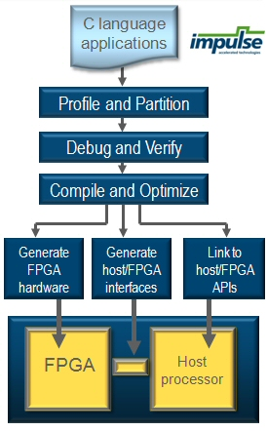
ImpulseC
Write FPGA processing applications in (fairly standard) C
Provides a sophisticated IDE
Include tools for profiling and to help you optimize your code
Generates both hardware bit files for the FPGA (s) used and an FPGA interface for custom PC-based programs
http://www.impulsec.com/products.htm

Slide 35
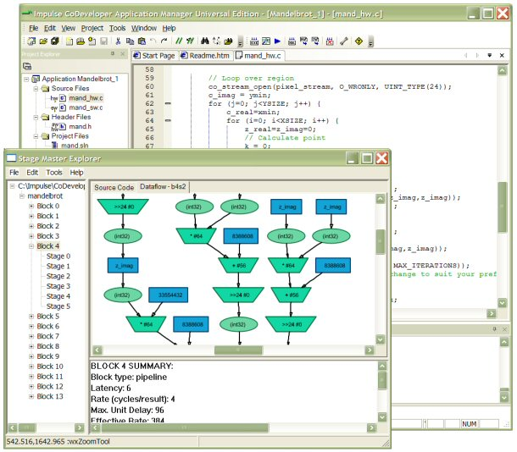
ImpulseC Screenshot
http://www.impulsec.com/products.htm

Slide 36
C → Verilog
Many of the C → VHDL also support C → Verilog as well
Free online C to Verilog translator
http://www.c-to-verilog.com/online.html

Slide 37
Example Run
http://www.c-to-verilog.com/online.html
Verilog (281 lines of code A,B 8-bit)
module _Z7my_mainPjS_ (
clk, reset, rdy,// control
// memport for: A
mem_A_out0, mem_A_in0,
mem_A_addr0, mem_A_mode0,
// memport for B:
mem_B_out0, mem_B_in0,
mem_B_addr0, mem_B_mode0,
// 2nd mem port for A for parallel proc
mem_A_out1, mem_A_in1,
mem_A_addr1, mem_A_mode1,
…);
// params input wire clk; input wire reset;
// output rdy; reg rdy; output return_value; reg return_value; input [7:0] p_A; input [7:0] p_B;input wire [31:0] mem_A_out0;output reg [31:0]
…
C CODE (6 lines)
#define ITEMS 256
// of each word of B[] in A[]
void my_main(unsigned int* A, unsigned int* B) {
for (int i=0; i<ITEMS; i++)
A[i] = A[i] + B[i];
}

