Slide 1



EEE4084F
Digital Systems
Lecture 19
Configuration architectures … & other
FPGA-based RC Building Blocks
Lecturer:
Simon Winberg

Slide 2
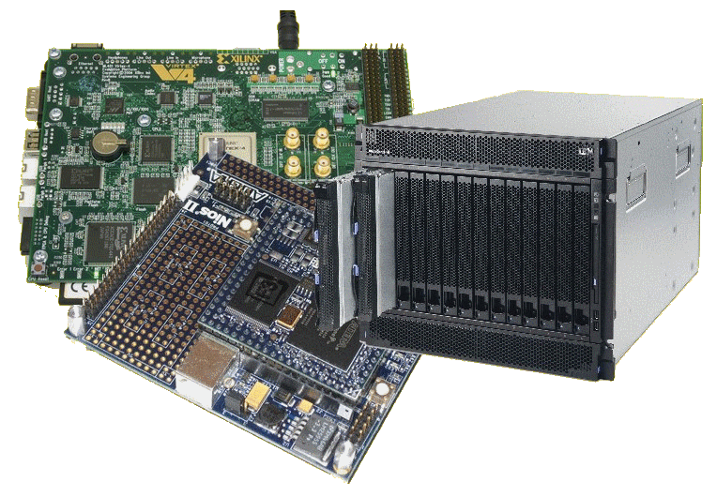
Lecture Overview
Configuration architectures
Short video on NIOS II
RC Building blocks
  Memories
  DMA
  Digital Signals
  Signal Latching

Slide 3
Configuration Architectures
RC Architecture

Slide 4
Configuration Architectures
Configuration architecture =
  Underlying circuitry that loads configuration data and keeps it at the correct locations
Could store pre-configured bitmaps in memory
on the platform without having to send it each time
from the CPU. Include hardware for programming
the hardware (instead of the slower process of e.g.,
programming devices via JTAG from the host)
CPU
Configuration
requests
Configuration
controller
FPGA
Finite State Machine
Configuration
data
ROM
Configuration
control
Adapted from Hauck and Dehon Ch4 (2008)

Slide 5
Configuration Architectures
Larger systems (e.g., the VCC) may have many FPGAs to be programmed)
Models:
  Sequentially programming FPGAs by shifting in data
  Multi-context – having a MUX choose which FPGA to program
Configuration
clock
FPGA
FPGA
FPGA
Configuration
bit
…
IN
OUT
IN
OUT
IN
OUT
Configuration
enable
Adapted from Hauck and Dehon Ch4 (2008)

Slide 6
Configuration Architectures
Partially reconfigurable systems
  Not all configurations may need entire chip
  Could leave parts of chips unallocated
  Partial configuration decreases configuration time
  Modifying part of a previously configured system
    E.g., a placement and routing configuration based on a currently configured state
Initial Configuration
Updated Configuration

Slide 7
Configuration Architectures
Block configurable architecture
  Not the same as “logical blocks” in an FPGA
  Relocating configurations to different blocks at run time also referred to as “swappable logic units” (SLUs)
Example: SCORE* relocatable architecture in which configurable blocks are handled in the same way as a virtual memory system
* Capsi & DeHon and Wawrzynek. “A streaming multithreaded model” In Third workshop on media and stream processors. 2001

Slide 8
Additional Reading
Reading
  Hauck, Scott (1998). “The Roles of FPGAs in Reprogrammable Systems” In Proceedings of the IEEE. 86(4) pp. 615-639.

Slide 9

Short Video…
Towards mobile augmented reality…
Computer Vision Accelerator.wmv

Slide 10
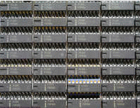
Memory types
Volatile
Non-volatile

Slide 11
Volatile memory
DRAM
  Capacitor stores “memory” that leaks away and needs to be periodically refreshed
  High memory capacity
SDRAM = Synchronous DRAM
  Runs in synch with system* clock
  DDR SDRAM = Double-data rate SDRAM, runs at 2x the system clock
* Note the system clock in this case is closer to the “motherboard” clock. Usually considerably slower than the processor clock (standard DRAM may have its own even slower clock and synchronization hassles)

Slide 12
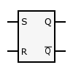
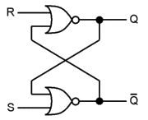
Volatile memory
SR Latch to hold
a bit of SRAM *
SRAM
  Static RAM
  Does not need refreshing
  Uses “bistable latching circuitry”
  (i.e. a flip flop) to store each bit
  Can be very fast compared to DRAM
  A small amount of SRAM (~16 Kb) is typically used within a microcontroller / FPGA to hold things such as a boot loader and interrupt vectors, and as CACHE
SR Latch implemented using two NOR gates *
* Images from http://en.wikipedia.org/wiki/Latch_(electronics)

Slide 13
Volatile Memory
BRAM or Block RAM
  This refers to a small block of RAM (a few Kilobytes) integrated within the FPGA (connected some LBs)
  Generally only found in higher-end FPGAs (e.g. 16Kb takes ~ 256K transistors if not more for connection and addressing logic)
  Block SRAM is more common and easier to use; the FPGA may include Block DRAM
  Generally can be set to RAM or ROM
  As ROM it can be used as a (big) LUT
  Usually not directly accessible form outside the FPGA (need to provide circuitry / softcore and comms protocol to access it from a PC)

Slide 14
Volatile memory
Under development
  Z-RAM : Zero-capacitor RAM
    Single transistor
    Higher density than DRAM
    Although it is called zero-capacitor, the capacitor is actually there in the form of a “floating body effect” caused by the transistor substrate
    See: http://www.innovativesilicon.com/

Slide 15
Non-Volatile memory
Trusty old ROM and EEPROM
  Still widely used as it is highly robust
  Current versions store large amounts of data
  Fairly simple technology (i.e. fused connections) and (in EEPROM ability to fuse and then program/un-fuse connections)
Usually ROM is slower than RAM
Shadowing ROM (i.e. copy to RAM) to make it faster – especially for EEPROMs
EEPROM very slow write; faster read

Slide 16
Non-Volatile Memory
Flash memory
  Can be electrically erased and programmed
  High capacity (e.g., millions of bytes/chip)
  Needs to be programmed one block at a time (~8Kb / block)
    Erased (all bits in block set to 1)
    Programmed one block at a time
  Memory wear
    Limited to about 100,000 erase – write cycles
    Usually a file system (e.g. ext3) will keep track of bad sectors (i.e., mark deteriorated blocks). But this deterioration might happen a certain time after the erase and write is complete and verified.

Slide 17
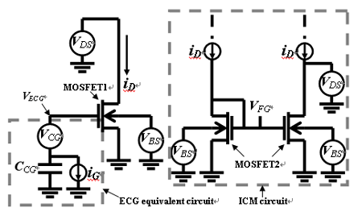
NAND Flash memory model
Image source: IEEE Electron Device Letters, Vol. 26, No. 8, AUGUST 2005, pg 564 Available at: http://koasas.kaist.ac.kr/bitstream/10203/1570/1/01468223.pdf
*
The above diagram provides a macro circuit model for a single flash memory cell, showing a Effective-Control-Gate (ECG) equivalent circuit and the Ideal-Current-Mirror (ICM) used to calculate the floating gate (FG*) voltage. MOSFET1 is the equivalent N-MOSFET model of a flash memory cell, and MOSFET2 is the model of a N-MOSFET test structure that is identical with the flash memory cell (excluding the short between FG and CG).

Slide 18
RC Building Blocks:
Digital Signals and
Data Transfers
Reconfigurable Computing

Slide 19
Overview of digital signals
Although our objective is towards parallel operations, there are still sequential issues involved, for example a device B waiting for a device A to provide input
Furthermore the input to a device A might disappear (become invalid) before device A has completed its computations.
Device A
Device B
In
Out

Slide 20
Overview of digital signals
There are other issues involved such as:
  How does device A know when new data has arrived?
  How does device B know when device A has completed?
  What if both devices need to be clocked, but aren’t active all the time?
  What if you want to share address and data lines?
Device A
handshaking
lines
Device B
In
Out

Slide 21
Digital logic modular design issues
A sequential logic system typically involves two parts:
  Storage (aka “bistable” device)
  Combinational logic (OR, AND, etc gates)
INPUTS
Combinational Logic Device
OUTPUTS
Another
combinational logic device(s)
Another
combinational logic device(s)
Data
Data
potentially shared data busses, possibly 2 separate busses for full-duplex, one for read one for write
control lines (e.g., do you want to read or write, are you done setting all the bits, etc.)
Storage

Slide 22
Digital Signals
Usually need the following
  Address bus
  Data bus
  Control lines
    Chip / Device select lines
    Write enable lines
    Read enable lines

Slide 23
RC Building Blocks:
DMA – Efficient Data Transfer
Reconfigurable Computing

Slide 24
Direct Memory Access (DMA)
Originally direct memory access (DMA) referred to a feature provided on a computer systems whereby peripherals within the computer can access the system memory for reading and/or writing independently of the central processing unit.
This is still an appropriate definition; except rather consider DMA as a more general description, whereby separate hardware can both access memory directly (without the CPU doing any work), and can request the memory subsystem (really the DMAC) to perform memory copies or transfers.

Slide 25
Typical computer design without DMA
Memory (Device 0)
In this approach, each peripheral
signals the CPU and tells it to
receive data and r/w memory
address
CS*
CS0*
CPU
address
Address Decoder
CS1*
IRQ
data
UART
(Device 1)
RD*
CS2*
WR*
…
CS*
IRQ
data
RD*
WR*
Signals:
Address : address line (e.g. 32 bits)
Data : data line (e.g., 32 bits)
IRQ : Interrupt ReQuest line
CS* : Chip select (active low)
RD* : Read enable (active low)
WR*: Write enable (active low)

Slide 26
DMA : Direct Memory Access
Memory
address
CPU
Device
(e.g., Graphics Card)
IRQ
DMA
Controller
IRQ
data
DMA Direct memory access is system in which memory is accessed without using the CPU. A certain stimulus (e.g. a device needing data sent/received) can have this data sent/received directly from/to a block of memory location via the DMA controller (DMAC). Peripherals such as ADCs, GPUs and Ethernet, which require frequent movements of memory, typically support DMA. DMA controllers can be configured to handle moving collected data from peripherals into specific memory locations (e.g., arrays directly accessible from a C program). Additional control logic is required to manage the sharing of the address and data bus.
Further reading: http://www.freebsd.org/doc/en/books/developers-handbook/dma.html

Slide 27
DMA configurations
Standard block transfer
  DMAC does sequence of memory transfers
  Load operation from source address, store operation to destination
  Initiated under software control (e.g., copying data from one memory area to another) i.e., array X = array Y
Demand-mode transfer
  Same as block transfer, but controlled by external device. I/O device requests and synchronizes the operation
Ref: Catsoulis, J. (2003). Designing Embedded Hardware. O’Reilly.

Slide 28
DMA configurations
Fly-by transfers
  High speed operation
  Memory and I/O on different bus
  E.g., I/O given read request at same time that memory is given write request
  Can simultaneously read/write I/O device and write/read memory
Data-chaining transfers
  Linked list in memory
  DMAC given pointer to descriptor
  Descriptor indicates: size, src address, dest address, next descriptor

Slide 29
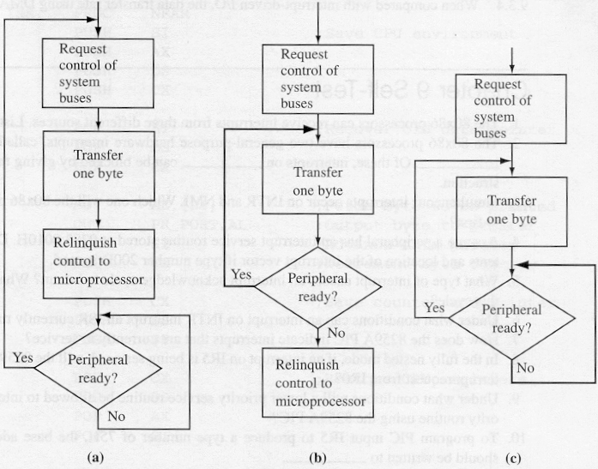
DMAC Modes of Operation
1
1
DMA Controller can support a range of modes. The three modes shown left are commonly supported.
1
2
2
2
3
w
w
w
3
Byte Mode
Burst Mode
Block Transfer Mode
123w123w123w…
12w2w2w3…
12w2w2www…
Sequence of states
CPU deactivates
Adapted from source: http://calab.kaist.ac.kr

Slide 30
RC Building Blocks:
Latching
(capturing Signals)
Reconfigurable Computing

Slide 31
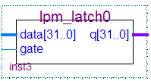
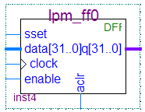
Digital Signal Capture and Storage
In order to capture the signals, you need some storage
Two basic types of storage:
Latches
Flip-flops

Slide 32
Difference between latch and flip-flop
Latches Q = D
  Changes state when the input states change (referred to as “transparency”)
  Can include an enable input bit – in which case the output (Q) is set to D only when the enable input is set.
Flip-flop Q = D (Q changes when clocked)
  A flip-flop only change state when
  the clock is pulsed.

Slide 33
When to use a latch or a flip-flop
Latches are used more in asynchronous designs
Flip-flips are used in synchronous designs
A “synchronous design” is a system that contains a clock
You can of course mix synchronous and asynchronous, and this is particularly applicable to parallel systems in which different parts of the system may run at different speeds (e.g., the main processor working at 1GHz and specialized hardware possibly operating asynchronously as fast as their composite pipelined operations are able to complete)

Slide 34
SR Latch
A | B | X | Y
0 | 0 | 1 | 1
0 | 1 | 1 | 0
1 | 0 | 0 | 1
1 | 1 | X | X
S-R Latch (set / reset latch)
Symbol
A basic latch has two stable states:
State 1 Q = 1 not Q = 0
State 2 Q = 0 not Q = 1
And an unstable state in which both S and R are set (which can
cause the Q and not Q lines to toggle)

Slide 35
Gated SR Latch: a latch with enable
Combinational logic circuit with a clock (or enable) input connected
Usually the type used in digital systems.
It of course costs more in transistors!!
or “gate” input
Example signals
Gated SR-Latch
Symbol
Only changed on clock pulse

Slide 36
Flip-flop
The standard JK flip-flop is much the same as a gated SR latch, modified so that Q toggles when J = K = 1
JK flip-flop
The D-type flip flop (which you may want to use in Prac3 to store data) is a JK flop flop modified (see left) to hold the state of input D at each clock pulse.
clock | D | Q
0 | 0 | X
1 | 1 | 0
2 | 1 | 1
3 | 0 | 1
… | … | …
D flip-flop

Slide 37
T-type Flip-flop
Clock | T | Q
0 | 1 | 0
1 | 0 | 1
2 | 1 | 1
3 | 0 | 0
… | … | …
The T-type flip-flops toggle the input. Q = not Q each time T is set to 1 when the clock pulses
T flip-flop
The D-type flip flop (which you may want to use in Prac3 to store data) is a JK flop flop modified (see left) to hold the state of input D at each clock pulse.
D flip-flop

Slide 38
Preset and Clocking
Preset line (PR) and clear line (CL) are asynchronous inputs used to set (to 1) or clear the value stored by the flip-flop.

Slide 39
Edge triggered devices
A note on notation:
Edge-triggered inputs are shown using a triangle.
Negative edges triggered inputs are shown without a circle on the incoming line.
in
in
Positive edge triggered
Negative edge triggered

Slide 40
End of Lecture
Any Question??

