Slide 1



EEE4084F
Digital Systems
Lecture 18
Amdahl’s Law &
YODA Blog & Design Review
Lecturer:
Simon Winberg

Slide 2
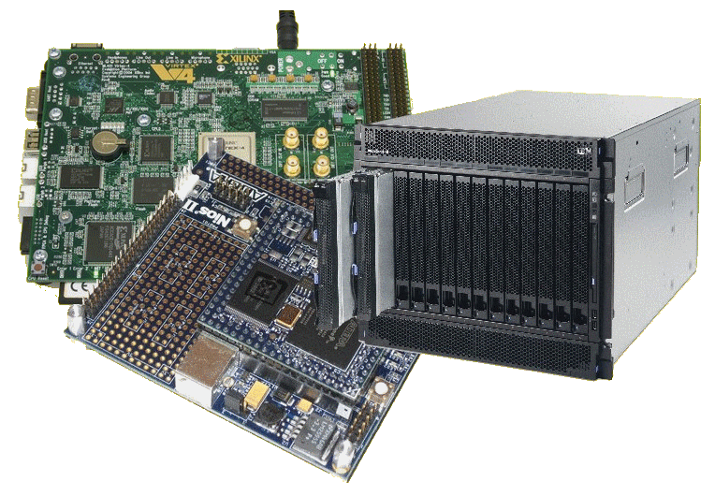
Lecture Overview
Yoda phase 1 & 2
Amdahl’s Law

Slide 3
Yoda Phase 1 & 2
Phase 1: Blog assignment
  Due today (24 April)
Phase 2: Design Review:
  10 May (fixed due date!)

Slide 4
Benefits & Drawbacks to this revised approach…

Slide 5
Main Drawbacks:
Have to spend more time sooner to get this done for the project…
Less implementation work and more design work
Advantages (lots):
The report will be implemented as: revised version of design review documents + some results from trials on simulator (or on hardware if you manage to get it working)
Implementations running on a FPGA aren’t needed for the design review.
Due to time considerations the final project may have to be mostly simulated (e.g. using ISIM) instead of getting anything running on the hardware (this would be acceptable – but try to make to get a good demo together that shows graphs)
Why? ECSA evaluations need to be in by 24 May.

Slide 6
Phase 1
This blog must:
Define the problem and suggested solution.
Describes the chosen design problem and digital accelerator product concept that could potentially solve the indicated problem. Briefly described the digital application accelerator that you propose to solve the problem with.
Problem list/design questions to be solve.
Provide a short list of design problems relevant to the digital application accelerator you have chosen to develop. Reason about the engineering problem, components and processes needed to formulate the solution (provide a point form list in your blog that documents these considerations).
Identify suitable criteria for an acceptable solution. Specify (e.g. list of points) what will constitute an acceptable solution to this proposed design project. Examples of criteria include performance (e.g. speed, latency, throughput) and resources used.

Slide 7
Phase 1
This blog must:
Define the problem and suggested solution.
Describes the chosen design problem and digital accelerator product concept that could potentially solve the indicated problem. Briefly described the digital application accelerator that you propose to solve the problem with.
Problem list / design questions to be solve.
Provide a short list of design problems relevant to the digital application accelerator you have chosen to develop. Reason about the engineering problem, components and processes needed to formulate the solution (provide a point form list in your blog that documents these considerations).
Identify suitable criteria for an acceptable solution. Specify (e.g. list of points) what will constitute an acceptable solution to this proposed design project. Examples of criteria include performance (e.g. speed, latency, throughput) and resources used.

Slide 8
Phase 1
This blog must:
Define the problem and suggested solution.
Describes the chosen design problem and digital accelerator product concept that could potentially solve the indicated problem. Briefly described the digital application accelerator that you propose to solve the problem with.
Problem list / design questions to be solve.
Provide a short list of design problems relevant to the digital application accelerator you have chosen to develop. Reason about the engineering problem, components and processes needed to formulate the solution (provide a point form list in your blog that documents these considerations).
Identify suitable criteria for an acceptable solution.
Specify (e.g. list of points) what will constitute an acceptable solution to this proposed design project. Examples of criteria include performance (e.g. speed, latency, throughput) and resources used.

Slide 9
Phase 2: Design Review
Identify information sources
used in coming up with the proposed design. This can be presented as a list of references using a bibliography referencing standard such as Harvard or APA. At least 10 references should be provided. [1.1b]
Example:
[1] Bloggs, J. [2010]. “How to do references” In Journal of Writing Styles. 1(2). June 2010. pp 10-20.

Slide 10
Phase 2: Design Review
Identify the important skills needed to complete the YODA project (e.g., schematic design, HDL programming, C programming, using Linux, etc). Think broadly (no need to be very specific, e.g. understanding bubble sort is too specific). Provide ±200 words of description for this. [1.1b]

Slide 11
Phase 2: Design Review
Describe the methodology that you will follow to develop the proposed YODA product.
Your description needs to show two approaches: the second approach can be a modified (or simplified) version of the first approach (i.e. think of this in terms of a Plan A and Plan B, where Plan A presents a potentially more involved and time-costly approach, and Plan B a risk-reduced approach that could be used if Plan A fails).
Presented in the form:
project objective → identified design problems
→ proposed solution → evaluation process.
Add a process diagram to illustrate the steps of this methodology. [1.1c]

Slide 12
Phase 2: Design Review
Modelling and analysis. Present a (draft) model of your YODA product design. This can be in the form of a paper-based (or digital) block diagram or UML model. Prepare a PC-based golden measure for your YODA accelerator: this can be implemented using MatLab, Octave, Python, C or C++, or a combination of these languages.

Slide 13
Phase 2: Design Review
Evaluate your design solutions
using paper-based calculations, such as algorithm complexity calculations (e.g. big-O execution time performance of your solutions) and estimations of other performance criteria.
These calculations need to be documented in your design review report submitted for this phase of the project. This must be done for both the PC-based golden measure and your proposed FPGA-based YODA design. Write a description of the evaluation steps that will be carried out to evaluate the performance.

Slide 14
Amdahl’s Law
Speed-up
Number of processors
EEE4084F

Slide 15
Amdahl’s Law: History
The guy: Gene Amdahl
  Was chief architect for IBM's first mainframe series of computers
  Founder of Amdahl Corporation
Amdahl found stringent restrictions on the speedup possible for given parallelized tasks.
Thee observations packaged as: Amdahl's Law

Slide 16

Video Clip…
Linux Magazine Video: Understanding Parallel Computing: Amdahl's Law

Slide 17
Amdahl’s Law
Classic version
Define f as: fraction of computation that can be parallelized (ignoring scheduling overhead)
Then (1 - f ) is the fraction that is sequential
Define n = no. processors for parallel case
The maximum speed-up achievable is:
1
Speedup_{parallel} =
f
( 1 – f ) +
n
Should be able to remember this formula for exams

Slide 18
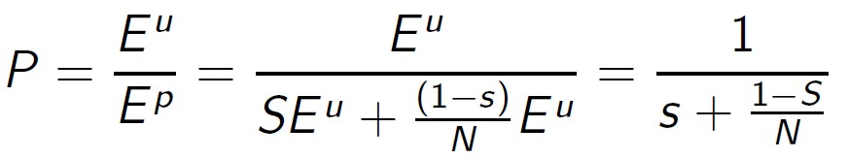
Amdahl’s Law:
Alternate Representation
P = expected performance improvement
E^{u} = Execution time on a uniprocessor (serial)
E^{p} = Execution time on a number of processors (parallel)
n = number of processors
S = fraction of time spent in the sequential time

Slide 19
Calculating using the BCE
A great many papers on the subject of Amdahl’s law
Many mention the term BCE
BCE = Base Core Equivalent
  A single processing core in a multicore processor design

Slide 20
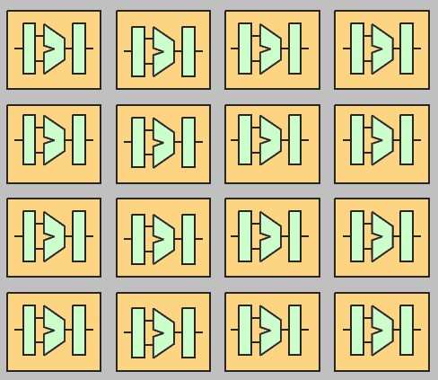
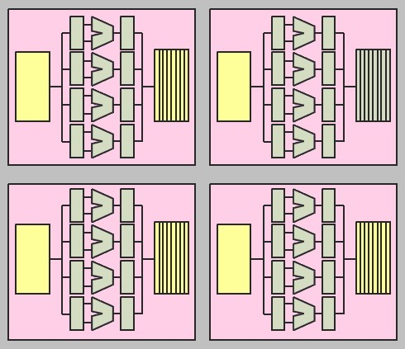
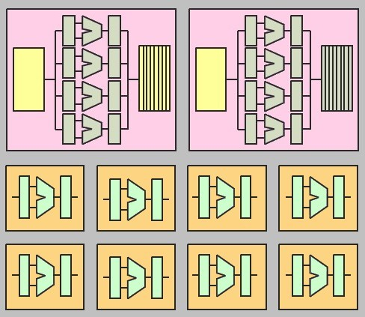
Example proc. structures
Symmetric multicore 16 one-BCE cores
Symmetric multicore 4 x 4-BCE cores
Asymmetric multicore comprising 2 x 4-BCE cores + 8 x 1-BCE cores

Slide 21
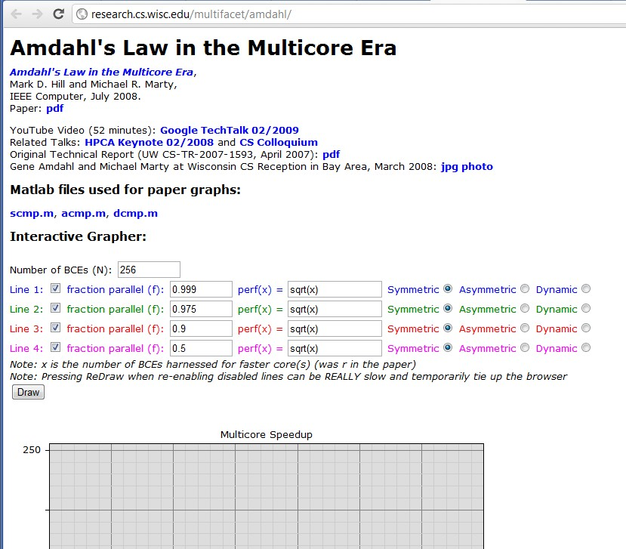
Amdahl’s Law Calculator
Check out Hill and Marty’s Amdahl’s interactive grapher at:
http://research.cs.wisc.edu/multifacet/amdahl/
You can also download the OCTAVE / Matlab code to do these graphs!
Quiz example of
resultant graph…

Slide 22
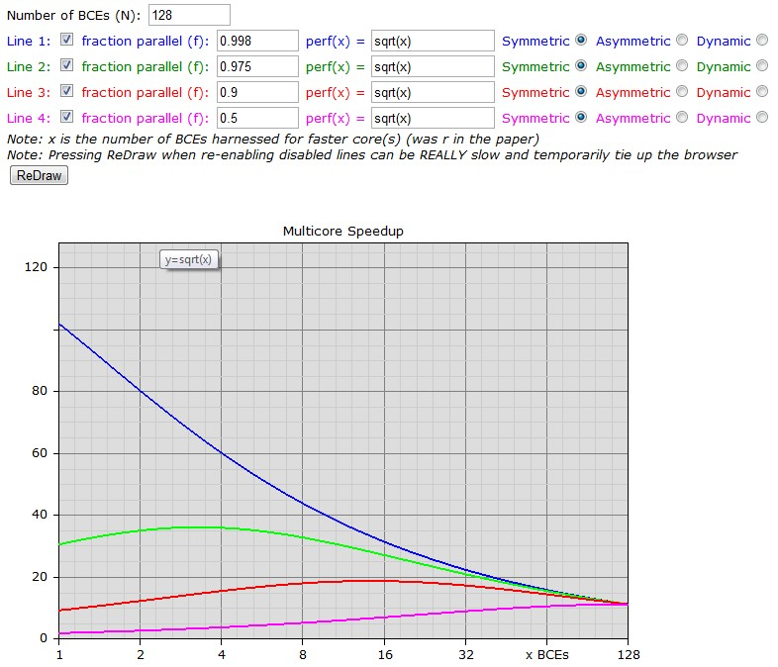
Example run of Hill and Marty’s Amdahl’s interactive grapher:

Slide 23
Reading
Hill and Marty 2008: “Amdahl’s Law in the Multicore Era” Available: http://research.cs.wisc.edu/multifacet/papers/ieeecomputer08_amdahl_multicore.pdf (see Vula)
Good article on Wikipedia look over: http://en.wikipedia.org/wiki/Amdahl's_law

