Slide 1



EEE4084F
Digital Systems
Lecture 17
RC Architectures Case Studies
Microprocessor-based:
Cell Broadband Engine Architecture
FPGA-based:
PAM, VCC, SPLASH …
Lecturer:
Simon Winberg
Attribution-ShareAlike 4.0 International (CC BY-SA 4.0)

Slide 2
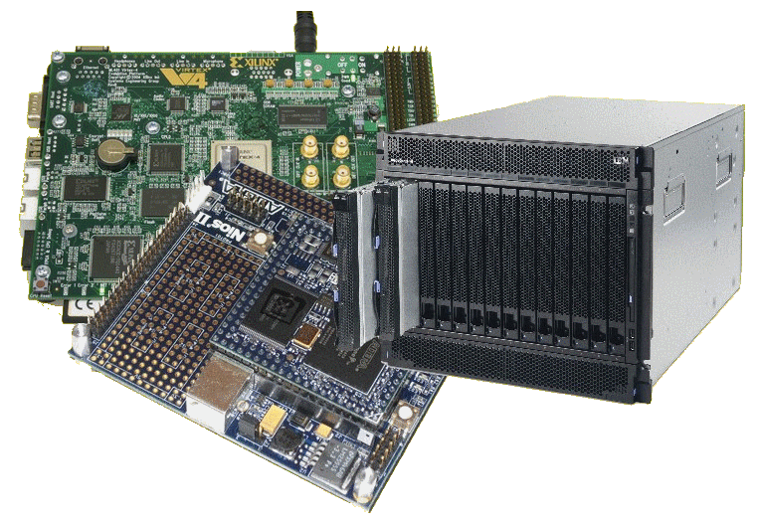
Lecture Overview
Case study of RC computers
  IBM Blade & Cell Processor
  Programmable Active Memories (PAM)
  Virtual Computer Corporation (VCC)
  Super Computer
  Research Center
  Splash System
  Small RC Systems

Slide 3
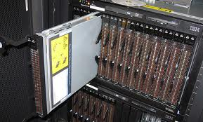
IBM Blade &
The Cell Processor
CASE STUDY:
IBM Blade rack
  Cell (or Meta-) processors
  Changeable in smaller parts – the ‘Strategic Processing Units’ (SPUs) and their interconnects

Slide 4
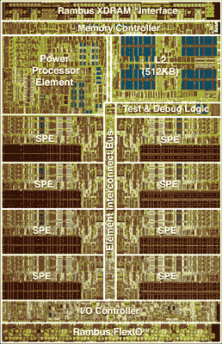
The “Cell Processor” :
Cell Broadband Engine Architecture Processor
Developed by STI alliance, a collaboration of Sony,
Sony Computer Entertainment, Toshiba, and IBM.
Why Cell?
  Actually “Cell” is a shortening for “Cell Broadband Engine
  Architecture”
  Technically abbreviated as CBEA in full, alternatively “Cell BE”.
The design and first implementation of the Cell:
  Performed at STI Design Center in Austin, Texas
  Carried out over a 4-year period from March 2001
  Budget approx. 400 million USD
Image of the Cell processor
Information based mainly on http://en.wikipedia.org/wiki/Cell_(microprocessor)

Slide 5
The Cell Processor Milestones
2005 Feb^{[1,2]}
  IBM’s technical disclosures of cell processors quickly led to new platforms & toolsets ^{[2]}
Oct 05: Mercury Cell Blade
Nov 05: Open Source SDK & Simulator
Feb 06: IBM Cell Blade
Resources / further reading
  http://www-128.ibm.com/developerworks/power/cell/
  http://www.research.ibm.com/cell/
    (see copy of condensed article: Lect17 - The Cell architecture.pdf)
[1] IBM press release 7-Feb-2005: http://www-03.ibm.com/press/us/en/pressrelease/7502.wss
[2] http://www.scei.co.jp/corporate/release/pdf/051110e.pdf

Slide 6
Cell Processor Hardware
Rambus XRAM ™ Interface
9 cores
  1 x Power Processor
  8 x Synergistic Processor
  Element (SPE)
  10 threads
  (2x PPE threads + 8x SPE threads)
Transistors: 241x10⁶
Size: 235 mm²
Clock: 3.2 GHz
Cell ver. 1: 64-bit arch
Memory Controller
Power
Processor
Element
L2 Cache
(512 Kb)
Element interconnect bus
Test&Debug
SPE
SPE
SPE
SPE
SPE
SPE
SPE
SPE
IO Controller
Layout of Cell processor adapted from
  http://www.research.ibm.com/cell/
Rambus FlexIO™

Slide 7
Synergistic Processing Element (SPE)
Cells: heterogeneous multi-core system architecture
  Power cell element for control tasks
  Synergistic Processing Elements for data-intensive processing
Each SPE
  Synergistic Processor Unit (SPU)
  Synergistic Memory Flow Control (MFC)
    Data movement and synchronization
    Interface to high-performance Element Interconnect Bus (EIB)

Slide 8
Cell Broadband Architecture Design
SPE
SPE
SPE
SPE
SPE
SPE
SPE
SPE
SPU
SPU
SPU
SPU
SPU
SPU
SPU
SPU
MFC
MFC
MFC
MFC
MFC
MFC
MFC
MFC
EIB
PPU
MIC
MIC
L2 Cache
PPU
XRAM ™
FLEX™ IO
  Synergistic Processor Unit (SPU)
  Synergistic Memory Flow Control (MFC)

Slide 9
Programming Extensions
Application Binary Interface (ABI) Specifications
  Defines: data types, register usage, calling conventions, and object formats to ensure compatibility of code generators and portability of code.
Examples
  IBM SPE (Strategic Processor Elements) ABI
  Linux Cell ABI

Slide 10
IBM SPE for Cell Processors
SPE C/C++ Language Extensions
  Defines: standardized data types, compiler directives, and language extensions used to make use of SIMD capabilities in the core

Slide 11
Cell Processor Programming Models
Reconfigurable Computing

Slide 12
Cell Processor Programming Models
Cell Processor change SPEs according to application
Models
  Application-specific accelerators
  Function offloading
  Computation acceleration
  Heterogeneous multi-threading

Slide 13
Application Specific Accelerators
Example
3D Visualization Application
Software
PPE
DATA
Stores
Hardware
FLEX™ IO
EIB
SPE 1
SPE 2
SPE 3
SPE 4
SPE 5
SPE 6
SPE 7
SPE 8
3D Graphics Acceleration
Texture
mapping
Data
decompression
Data comparison and classification
3D Scene Generation
Software

Slide 14
Function offloading models…
  Multi-staged pipeline
PPE
SPE
SPE
SPE
  Example:
  LZH_compress(‘data.dat’)
  Parallel stage of processing
  sequence
PPE
  Example:
  Matrix X,Y
  Y = quicksort(X)
  m = Max(X)
  X = X + 1
SPE
  Remember:
  All the SPEs can access the
  shared memory directly via the
  EIB (element interconnect bus)
SPE
SPE

Slide 15
Computation Acceleration
  Similar to model for functional offloading, except each SPE can be busy with other forms of related computation, but tasks not necessarily directly dependent (i.e. the main task isn’t always blocked, waiting for the others to complete)
PPE
Task
#3
Processing
resource
usage
  Set of specific computation tasks scheduled optimally, each possibly needing multiple SPEs and PPE resources
SPE1
SPE2
SPE3
SPE4
SPE1 configured for tasks of type #1
SPE2 configured for tasks of type #2
SPE3 and SPE4 configured for tasks of type #3
Task
#1
Task
#2

Slide 16
Heterogeneous multi-threading
PPE
Processing resource
usage
Thread
#1
Thread
#4
Spawn new threads as needed
SPE1
SPE2
SPE3
SPE4
SPE5
SPE6
SPE7
SPE8
waiting
disabled processing resources
Thread
#3
Thread
#5
PPE configured for thread types #1 and #2
SPE1 configured for threads of type #6
SPE2 configured for threads of type #3
SPE3 and SPE4 for threads of type #5
No threads of type #6 currently exist
Thread
#3
(this thread is blocked)
All SPEs configured to handle general types of tasks required by the application
Combination of PPE threads and SPE threads
Certain SPEs configured to speed certain threads, but able to handle other threads also

Slide 17
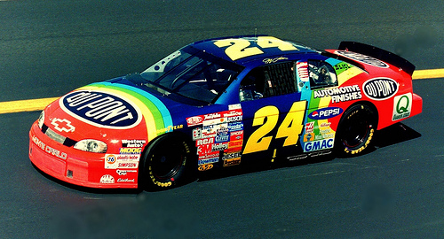

Designing for performance
Three-step approach for
application operation
Step 1 : Staging
  Telling the SPEs what they are to do
  Applying computation parameters
Main Memory
PPE
assigning tasks
L2 Cache
SPE
SPE
SPE
SPE
SPE
SPE
SPE
SPE
todo
todo
todo
todo
todo
todo
todo
todo

Slide 18
Designing for performance
Step 1 : Staging
  Each SPE can use a different block of memory
Step 2 : Processing
  Each SPE does its assigned task
Main Memory
PPE
1
3
5
7
Each SPE uses its allocated
part of memory
2
4
6
8
L2 Cache
SPE
SPE
SPE
SPE
SPE
SPE
SPE
SPE

Slide 19

Designing for performance
Step 1 : Staging
Step 2 : Processing
Step 3 : Combination
Main Memory
PPE
Power PC combines results that
were left by the SPEs in memory,
using its L2 cache to speed it up
1
3
5
7
2
4
6
8
L2 Cache
SPE
SPE
SPE
SPE
SPE
SPE
SPE
SPE

Slide 20
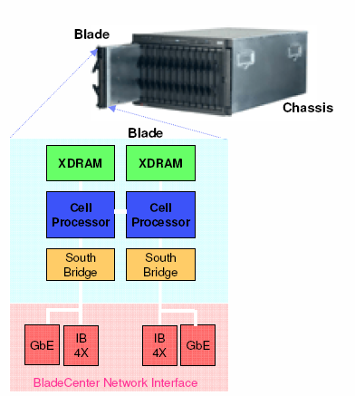
IBM Blade
Each blade contains
  Two cell processors
  IO controller devices
  XDRAM memory
  IBM Blade center interface

Slide 21
RC Systems
A look at platforms architectures

Slide 22
Large RC System - PAM
Programmable Active Memories (PAM)
  Produced by Digital Equipment Corp (DEC)
  Used Xilinx XC3000 FPGAs
  Independent banks of fast static RAM
SRAM
SRAM
SRAM
SRAM
Host
CPU
FPGA
FPGA
FPGA
FPGA
FPGA
FPGA
FPGA
FPGA
DRAM
SRAM
SRAM
SRAM
SRAM
Digital Equipment Corp. PAM system (1980s)
Image adapted from Hauck and Dehon (2008) Ch3

Slide 23
Large RC System - VCC
Virtual Computer Corporation (VCC)
First commercially commercial RC platform*
Checkerboard layout of
  Xilinx XC4010 devices and
  I-Cube programmable interconnection devices
  SRAM modules on the edges
SRAM
FPGA
FPGA
FPGA
FPGA
…
FPGA
FPGA
SRAM
SRAM
FPGA
I-Cube
FPGA
I-Cube
…
I-Cube
FPGA
SRAM
…
…
…
…
…
…
…
…
SRAM
FPGA
I-Cube
FPGA
I-Cube
…
I-Cube
FPGA
SRAM
VCC Virtual Computer
* Hauck and Dehon (2008)

Slide 24
Large RC System - Splash
Dev. by Super Computer Research (SCR) Center ~1990
Well utilized (compared to previous systems).
Comprised linear array of FPGAs each with own SRAM *
Summary of the Splash system
Developed initially to solve the problem of mapping the human genome and other similar problems. Design follows a reconfigurable linear logic array. The SPLASH aimed to give a Sun computer better than supercomputer performance for a certain types of problems. At the time, the performance of SPLASH was shown to outperform a Cray 2 by a factor of 325. FPGAs were used to build SPLASH, a cross between a specialized hardware board but more flexible like a supercomputer. The SPLASH system consists of software and hardware which plugs into two slots of a Sun workstation. **
Illustration of the
SPLASH design
(adapted from *)
FPGA
FPGA
…
FPGA
SRAM
SRAM
SRAM
…
SRAM
FPGA
Crossbar
Dedicated
controller
FPGA
FPGA
…
FPGA
SRAM
SRAM
…
SRAM
* Hauck and Dehon (2008)
SRC Splash version 2
**Adapted from: Waugh, T.C., "Field programmable gate array key to reconfigurable array outperforming supercomputers," Custom Integrated Circuits Conference, 1991., Proceedings of the IEEE 1991 , vol., no., pp.6.6/1,6.6/4, 12-15 May 1991 doi: 10.1109/CICC.1991.164051

Slide 25
Small RC Systems
Brown University’s PRISM
  Single FPGA co-processor in each computer in a cluster
  Main CPUs offloading parallelized functions to FPGA
Algotronix
  Configurable Array Logic (CAL) – FPGA featuring very simple logic cells (compared to other FPGAs)
  Later become XC6200 (when CAL bought by Xilinx)
* Hauck and Dehon (2008)

Slide 26
Reconfigurable Supercomputers
Cray Research
  XD1: 12 processing nodes
  6x ADM Opteron processors
  6x Reconfigurable nodes built from Xilinx Vertex 4
  Each XD1 in own chassis, can connect up to 12 chassis in a cabined (i.e. 144 processing nodes)
SRC
  Traditional processor + reconfig. processing unit
  Based on Xilinx Virtex FPGAs
Silicon Graphics
  RASP (reconfigurable application-specific processor)
  Blade-type approach of smaller boards plugging into larger ones
Ref: Hauck and Dehon Ch3 (2008)

Slide 27
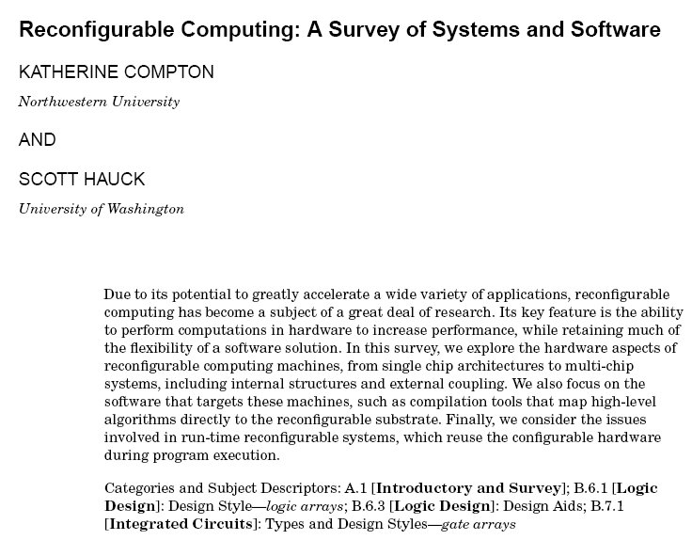
Additional Reading
Reading
  Reconfigurable
  Computing: A Survey of
  Systems and Software
  (ACM Survey) *
  (not specifically examined, but can help you develop insights that help you demonstrate a deeper understanding to problems)
-- End of the Cell Processor case study --
* Compton & Hauck (2002) .“Reconfigurable Computing: A Survey of Systems and Software” In ACM Computing Surveys, Vol. 34, No. 2, June 2002, pp. 171–210.

Slide 28
Conclusion & Plans
Reading
  Hauck, Scott (1998). “The Roles of FPGAs in Reprogrammable Systems” In Proceedings of the IEEE. 86(4) pp. 615-639.
Next lecture:
  Amdahl’s Law
  Discussion of YODA phase 1

Slide 29
Disclaimers and copyright/licensing details
I have tried to follow the correct practices concerning copyright and licensing of material, particularly image sources that have been used in this presentation. I have put much effort into trying to make this material open access so that it can be of benefit to others in their teaching and learning practice. Any mistakes or omissions with regards to these issues I will correct when notified. To the best of my understanding the material in these slides can be shared according to the Creative Commons “Attribution-ShareAlike 4.0 International (CC BY-SA 4.0)” license, and that is why I selected that license to apply to this presentation (it’s not because I particulate want my slides referenced but more to acknowledge the sources and generosity of others who have provided free material such as the images I have used).
Image sources:
IBM Blade rack (slide 3), IBM blade, Checkered flag – Wikipedia open commons
NASCAR image – flickr CC2 share alike

