Slide 1



EEE4084F
Digital Systems
Lecture 14
Reconfigurable Computing Basics
Lecturer:
Simon Winberg

Slide 2
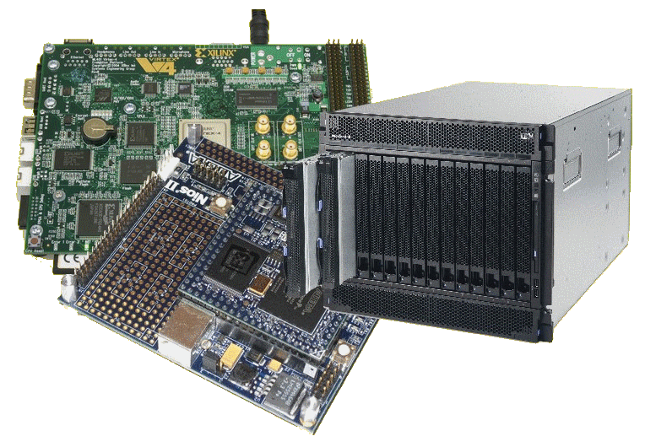
Lecture Overview
Reconfigurable Computing Basics
Brainstorming exercise
Introduction to Verilog

Slide 3

Early Notice:
Quiz 2 next Tuesday (16 Apr)
Held 9am, 45 minutes
Covers:
Lecture 5 - Lecture 12
Chapters 9, 10 and 13 of the textbook (i.e. seminars 6 and 5).
Quiz next
Thursday!

Slide 4
RC Basics
EEE4084F

Slide 5

Why does
RC = Trendy?

Slide 6
Why RC = Trendy
Software processors aren’t delivering:
  The speed of temporal instruction execution no long seems to be increasing
  General-purpose multi-core processors need coarse grain thread-level parallelism (tricky; may need massive rewrites of code)
Why RC is seen as a possible solution:
  FPGAs becoming able to implement more complex, integrated functions
  A means to implement spatial computation, and to perform massively-parallel computations directly in hardware

Slide 7
Terminology moment…
RC platform
RC application
RC application development
RC platform development
Dual processing
Correlations

Slide 8
RC application vs. platform development
RC platform development =
  Developing an infrastructure for doing RC
  E.g., developing an IBM Blade platform
RC application development =
  Using an existing RC platform
  Developing custom hardware and software for deployment on an RC platform
Focus of this course

Slide 9

Dual Processing?
A technique to verify operation
Essentially performing the
same operation twice (if not
more times) to check for
consistency.
Often uses correlations.

Slide 10
Dual Processing & Simulation
Used to verify computation
Run on target hardware (e.g., Nexus2)
Run on PC (C program of simulator)
Compare results
Main issue:
  Do the results match closely
  “Feel good” – at least both sides are close
When this approach is used…
  Unsure of the target hardware operation
  Investigating differences in computation

Slide 11


Brainstorming activity
Work in groups of two or three
Discussion Point 1: What would you say is the greatest challenge that RC developers face nowadays?
Discussion Point 2: What sort of technologies or ideas do you think would assist developers and in overcoming these challenges?
Discussion Point 3: What do you think are major benefits, and major disadvantages to reconfigurable computing? Consider what kinds of application to which RC is – and is not – suited.

Slide 12

Review of Brainstorm Activity
Greatest challenges:
  Knowing how to go from a “doorstop” to
  a useful and usable computer
  Conceptualizing parallelized algorithms and parallelizing sequential algorithms (e.g., the Quick Sort algorithm)
Technologies to assist developers:
  Model Integrated Computing*
  Languages designed for parallel programming
  Better knowledge management
* http://www.isis.vanderbilt.edu/research/MIC

Slide 13
Review of Brainstorm Activity
RC suited to
  Ranges of applications that need some high-speed filtering of digital (or analogue) data which can then be fed into a processing pipe line (e.g., sample data + filter data + process + send on results).
  Course grained problems, breaking a problem into parts, working on the parts in parallel, and joining results of the parts.

Slide 14

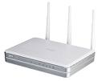




RHINO* platform: Example and Case Study of a Reconfigurable Computing Platform and proposed Applications
Wifi Router
3G / WiMAX
relay
Radar signal
Processing
Font-end
Rhino: a platform design and built at UCT by the
Software Defined Radio Research Group (SDRRG)
SDRRG focuses on using the same reconfigurable computing platform as a substantial component of the underlying RF sampling and digital processing in multiple system, and for experimental radio and reconfigurable computing related research and training.
Long-term to save substantially in prototyping costs
How SDRRG uses FPGAs + Rhino
* RHINO = Reconfigurable Hardware Interface for computIng and radiO

Slide 15


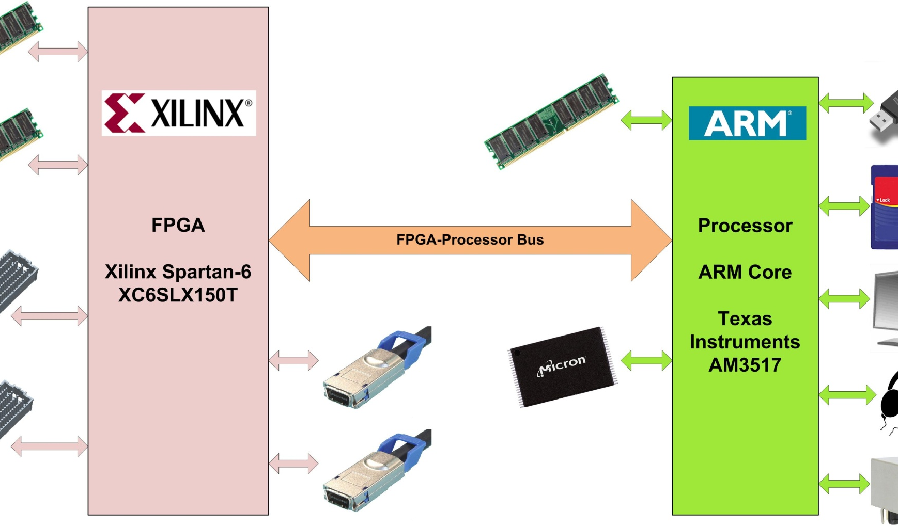
Rhino Architecture:
A Case Study
Software Defined Radio Research Group
USB, SD Card, 100Mbps Ethernet, audio and video
2x 256MB DDR3 SDRAM
2x 128MB DDR2 SDRAM
2x FMC Connectors
256MB NAND Flash
2x CX4 (10Gbps ethernet)

Slide 16
Conclusion & Plans for Next lecture
Next lecture:
  Programming in Verilog
  RC Architectures

