Slide 1



EEE4084F
Digital Systems
Lecture 13
YODA Project &
Discussion of FPGAs
Lecturer:
Simon Winberg

Slide 2
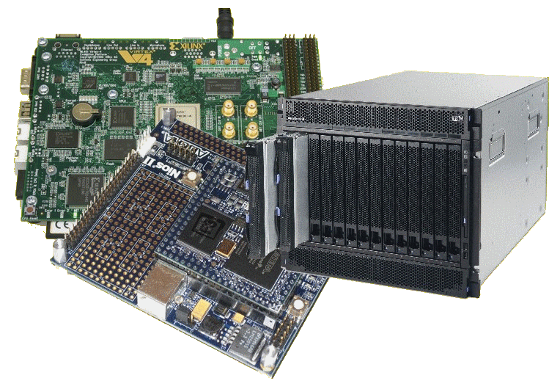
Lecture Overview
YODA Project
FPGA Families

Slide 3

Early Notice:
Quiz 3 next Thursday (11 Apr)
Held 2pm, 45 minutes
Covers
Lecture 5 - Lecture 12
Chapters 9, 10 and 13 of the textbook (i.e. seminars 6 and 5).
Quiz next
Thursday!

Slide 4
Reconfigurable Computing
A Scenario…
EEE4084F

Slide 5

The Reconfigurable Hardware Platform
More colloquially, at the start
of the mission: “The Doorstop”
In the not too distant future,
There was a device…
Indeed, your own galaxy…
Very close to home…
In a galaxy

Slide 6

The Reconfigurable Hardware Platform
More colloquially, at the start
of the mission: “The Doorstop”
Like most doorstops, this one starts out being a
lump that is in the way; although it may have
all sorts of potential if you…
… apply your mind, you must!

Slide 7


Scenario:
Reconfigurable platform
Jabba says:
I need a
MP3 player!
LCD
MP3
player
Doorstop
(you may need some additional
external items in order to make
use of the reconfigured system)

Slide 8

The Hutt says:
MP3
player
Now I need an IP phone!
IP phone
Yak yak

Slide 9
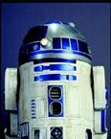
But I (beep beep) need a
data stream
compressor
(click squeak)
IP phone
Compressor
110100
110111001101

Slide 10

But what is this “doorstop” of which you speak?
Your Doorstop
A “doorstop” for your enlightenment and education…
But first patience you must have as this knowledge will be
revealed once you are ready…

Slide 11
Evaluation Kit: Nexys2 or Nexys3
Getting ready for your “doorstop”…
Reconfigurable Computing EEE4084F
A brief overview of Reconfigurable Computing operation…

Slide 12
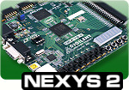
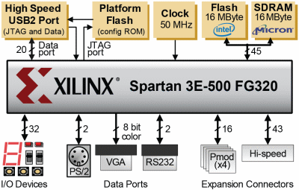
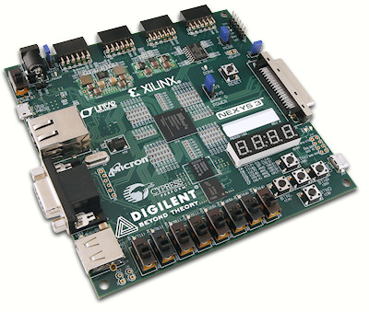
Nexys2:
The evaluation board to be used
in the laboratories…
Source: http://www.digilentinc.com/Products/Detail.cfm?NavPath=2,400,789&Prod=NEXYS2

Slide 13
Nexys2:
The evaluation board to be used
in the laboratories…
Simplified Model
16 bit Pmods (4x)
Flash 16MByte
DATA
PORT BUS
(USB, JTAG)
45 bit memory ADDRESS
BUS
FPGA
43 bit extra IO
32 bit LEDs, PB PIO
SRAM

Slide 14
Nexys2:
Simplified Model
16 bit Pmods (4x)
USB
DEVICE
Flash 16MByte
ETHERNET
DEVICE
Soft
Processor
Logic
USB
45 bit memory ADDRESS
BUS
DATA
PORT BUS
(USB, JTAG)
FPGA
BLOCK
RAM
Your own
peripheral
43 bit extra IO
32 bit LEDs, PB PIO
SRAM

Slide 15
Want your own Nexys?
If you want your own Nexys2 or Nexys3 you can order one from the DigilentInc website. These are $99 USD (about R700) each at the academic price. There are plenty to go round for labs. If enough students would like their own Nexys board it’s a good idea to group all into one order to save on the postage costs (the postage is about $50 or R350, only courier options are available).
If you do decide to get your own Nexys, I recommend getting the Nexys3 which has the bigger and more fancy Spartan6 FPGA.
http://www.digilentinc.com/Products/Detail.cfm?NavPath=2,400,789&Prod=NEXYS2
http://www.digilentinc.com/Products/Detail.cfm?NavPath=2,400,897&Prod=NEXYS3

Slide 16


YODA Project:
Your Own Digital Accelerator
About YODA
Reconfigurable Computing
Final Hand-in date: 23 May

Slide 17
What’s A Digital Application Accelerator?
An add-on card (or reconfigurable co-processor) used to speed up processing for a particular solution
‘Digital’ - comprises digital logic/circuitry to speed-up computation
A GPU could be considered an example (except GPUs often have analogue circuitry as well to connect to monitors)

Slide 18
YODA Example and Scenario
Delta modulator that grabs set of 8 bytes and outputs 1 byte
  128 | 200 | 220 | 201 | 201 | 201 | 127 | 108
  => 100 = 01100100₂
Application 1
  Flash LEDs according to data send from PC
Application 2
  Perform delta compression on data sent from PC, send compressed steam back to PC

Slide 19

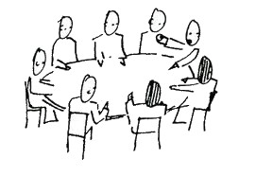
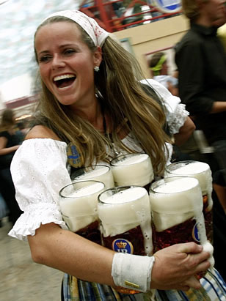
YODA Project Structure
Blog
blogging
Design Review
Demo
Final report + code hand-in
(Celebrate
)

Slide 20
Project Teams & Marking
Projects done as teams of 2 or 3
  (confirm team of 3 members with lecturer)
Milestone Dates
  Blog (due 24 Apr)
  Design review (to do by 10 May)
  Demo (21-25 May)
  Code and final report (25 May)

Slide 21
Project Teams & Marking
Important: final report counts the most !
Breakdown of marking
  Blog: 10%
  Code: 10%
  Demo: 30%
  Report: 50%
YODA Project counts 13% of final mark

Slide 22
YODA – Purpose
At the end of the course you should have developed an FPGA-based application accelerator for a PC using either a Xilinx-based Digilent Nexys2 or other evaluation board

Slide 23
YODA Design Strategy
In order to trial the reconfigurable aspect, your YODA prototype should support two applications
  Application 1: something very simple (i.e., for testing your setup, send/receive data)
  Application 2: more sophisticated / meaningful application (e.g., parallel pattern searches)

Slide 24
YODA Plan
Offloads
processing to
PC
(Lab computer)
Windows / Ubuntu
Soft processor
YODA
Your Own
Digital Accelerator
YODA
Form 1
Application 1
Supports
YODA
Form 2
Supports
Application 2
Custom logic defined using
Public / freely available VHDL or Verilog HDL code
Peripherals
(e.g. Ethernet device)
Your VHDL or Verilog HDL code
Adapted
from

Slide 25
YODA Demo plan
The demo is just to give me and/or the tutors a conclusive proof that you know what you’re doing, and to explain to us what you’ve done
The demo should be close to the final version, but doesn’t necessarily need to be the final final version.

Slide 26

YODA Report
Introduction that recaps your topic
Design
  High level design
  Finite State Machine (FSM) documenting your digital accelerator operation
  Pseudo code (if relevant)
  VHDL / Verilog snippets (indicating how your FSM was implemented)
Experimentation and Testing procedure
Conclusion and discussion

Slide 27
FPGA Families
EEE4084F

Slide 28
The Manufacturers
The ‘Big 2’ (most commonly used)
  Xilinx – Capital $8.52B, 2984 employees
  Altera – Capital $12B, 2555 employees
The others pretty big ones…
  Actel (Microsemi Corp) – $2B capitalizations, 2250 employees
  Lattice Semiconductor Corp – $700M capitalizations, 708 employees
Sources: “100 Power Tips for FPGA Designers”

Slide 29
About the FPGA Families
Xilinx
  Focusing on highest performance and highest capacity: Vertex family (e.g. Vertex 6)
  Provides lower-cost options with high capacity (e.g. Spartan 6 family)
  Range of variations, e.g. low power options, economy (lower capacity) models.

Slide 30
About the FPGA Families
Altera
  Stratix: higher performance and density models (e.g. Stratix-V)
  Arria: mid-range, lower-power, but also lower performance and denisity compared to Stratix.
  Cyclone: lowest cost option, also aimed at low power, cost sensitive and mobile applications

Slide 31
About the FPGA Families
Actel
  Focuses on providing the lowest power, and widest range of small packages
  IGLOO : low power, small footprint
  SmartFuson : Mixed FPGA and ARM processor
  RTAX/RTSX : radiation tolerant and very high reliability.

Slide 32
About the FPGA Families
Lattice
  Range of options (low power; high performance; small package)
  Own specialized development tools
  (of these four, this one is the only firms not in California; they are currently in Oregon)

Slide 33
About the FPGA Families
Others
  Achronix – focusing on building the fastest FPGAs (not necessarily highest capacity)
  Tabula – unique FPGA technology ‘SpaceTime’, focusing on highest capacity and memory capabilities

Slide 34
Memory jogger…
Q: What is Xilinx’s highest-capacity FPGA family?
A: Vertex (currently Vertex 6)
Q: Which FPGA manufacturer is focusing on developing the fastest FPGAs?
A: Achronix

Slide 35
Next lecture
RC Basics:
  Microprocessor-based vs. FPGA-based solutions
  Application development for FPGA-based RC system
  FPGA and computer board architectures
  Practical techniques
Introduction to Verilog

