Slide 1



EEE4084F
Digital Systems
Lecture 12:
Programmable Logics, HDL & VHDL Quick Recap
Lecturer:
Simon Winberg

Slide 2
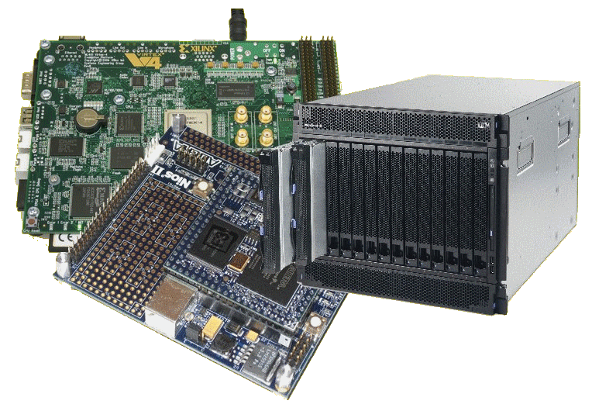
Lecture Overview
Review of short exercise re digital accelerator
Programmable logic & HDL

Slide 3
Programmable Logic Chips
EEE4084F

Slide 4
Programmable Chips
In comparison to hard-wired chips, a programmable chip can be reconfigured according to application or user needs
Provides a means to use the same chip(s) for a variety of different applications.
Makes programmable chips attractive for use in many products, e.g. prototyping products.
Further benefits are:
  Low starting cost (e.g. Web pack+ FPGA dev kit)
  Risk reduction
  Quick turnaround time

Slide 5
ASICs vs. Programmable Chips
Application Specific Integrated Circuit (or ASICs) have a longer design cycle and higher engineering cost than using programmable chips.
Still a need for ASIC: faster performance and lower cost for high volume
Generally, programmable chips are suited to low to medium product production. (e.g. product runs needing under 10,000 chips)

Slide 6
PLAs, CPLDs and FPGAs
Programmable logic chips variety in terms
simple→complex cheap→expensive
PLA = Programmable Logic Array
  Simple: just AND and OR gates; but Cheap
CPLA = Complex PLA
  Midrange: compose interconnected PLAs
FPGA = Field Programmable Gate Array
  Complex: programmable logic blocks and
  programmable interconnects; but Expensive
FPGA orders of magnitude larger than CPLD

Slide 7
So what?
What is so special about FPGAs?
?

Slide 8

So what?
What is so special about FPGAs?
FPGA
A sea of possibilities…
01001010101000100101001010010100
10010010010100100101101001
100100110101011010011101

Slide 9
FPGAs –
“A sea of possibilities”
The huge number of logic elements (LEs) within these chips, and their many PIO pins, makes it possible to implement large & complex digital systems in them.
The ease and speed of programming them provides the ability to rapidly change the hardware (within ms timing) to adapt to application needs.
Greater potential for testing and tweaking designs before fabricating them as ICs

Slide 10

Any Drawbacks?
Here’s
just a few
drawbacks
Only does the digital part – still need analogue components, user interface, and circuitry that interacts with the outside world.
Has a limited number of IO
pins that can connect up with external signals.
Susceptible to EM disturbances, PCB and other components needs to be suitably placed to avoid interfering with functioning of FPGA.
Typically a slower clock than most fast CPUs nowadays (e.g. 100MHz clock speed).
Eeek!
Often can’t achieve full utilization of PLBs
Typically has lots of pins that need to be soldered on, needing small track width and multilayer PCBs
Limitations of internal interconnects
Place & route can take a long time to complete
A specialized form of development, combines the challenges of both s/w and h/w
Things can get rather… muddy!

Slide 11
HDL & VHDL Recap
EEE4084F

Slide 12
Why use a Hardware Description Language (HDL)?
Major reasons for using a HDL:
Towards better and more reliable designs
Avoid design errors
Reduce costs and time
General benefits of the HDL approach:
Rapidly model and test a functional system/subsystem
Means of modeling, testing, refining requirements and specification for a system
Formal verification (and an ‘interface’ to such mechanisms)
Testing designs options through use of simulation
Synthesis of ICs / digital logic systems

Slide 13
Summary of Elements of the VHDL Paradigm
Entity : A part of the system (can be a subsystem)
Ports : Connections (or interfaces) between
Behavior : What an entity does
Structure : What an entity comprises
Analysis : Checks syntax, etc. Does various automated tests and simulations on the design to verify that it can be synthesized and deployed on a particular programmable device / IC.
Test Bench : How entities or a whole design is tested
Synthesis : Deciding gates and how to connect them / generating the bitstream to configure the hardware.

Slide 14
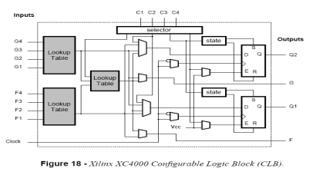
PLD/FPGA Development Flow
Design
Specification
Design and RTL Coding
- Behavioral or Structural Description of Design
- Writing VHDL, deciding i/o, formulating tests
RTL Simulation
- Functional Simulation
- Verify Logic Model & Data Flow
- View model-specified timing
LE
M512
Synthesis
- Translate Design into Device Specific Primitives
- Optimization to Meet Required Area & Performance Constraints
M4K
I/O
Place and Route (PAR)
- Map primitives to specific locations inside
FPGA with reference to area & performance
constraints
- Specify routing resources to use
… PTO …
This development cycle diagram is an adaptation of that
prepared by Dr. Junaid Ahmed Zubairi,
Avail: http://www.cs.fredonia.edu/zubairi/training/fpga.ppt

Slide 15
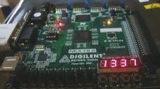
Development Flow
Place and Route (PAR)
t_{clk}
Timing Analysis
- Verify performance specifications
- Static timing analysis
Gate Level Simulation
- Timing simulation
- Verify design will work on target platform
Program and test on hardware
- Generate bit file
- Program target device
- Activate the system

Slide 16




Development Flow:
Where is most time spent?
Every development project is different. In my own experience,
most of the time is probably spent…
Eish!
Design and RTL Coding
- Behavioral or Structural Description of Design
- Writing VHDL, deciding i/o, formulating tests
t_{clk}
Timing Analysis
- Verify performance specifications
- Static timing analysis
Engineer’s
time
Eish!
Place and Route (PAR)
- Map primitives inside FPGA
- Specify routing resources to use
PC’s time

Slide 17

VHDL Basics
What VHDL stands for….
VHSIC =
Very-High-Speed Integrated Circuit
VHDL =
VHSIC Hardware Description Language
VHDL =
Very High-level Description Language
+
VHDL =
Very Hard Development Language
*
+
(although you would be kind of right to say VHDL has these properties)
*

Slide 18
VHDL Terms and Keywords
Entity: designs are expressed in terms of entities, these are components that are interfaced together via ports and maps
Architecture: Describes the behaviours of the entity. Each entity can have multiple architectures.
Configuration: binds a component instance to a entity-architecture pair
Architecture
Entity
(black box)
← Configuration ←
Ports
Source: Perry, D. 2002. VHDL Programming by Example. 4th ed. McDraw-Hill.

Slide 19
Important Terms
Top-level module: module at the top of the hierarchy
Package: collection of commonly used data types, subroutines, for implementing architectures
Driver: source on a signal
Bus: a signal that can have its sources turned off
Signal vector: what we usually think of as a bus
Attribute: data attached to VHDL objects (e.g., event status)
Generic: a parameter to pass information to an entity
Process: a basic unit of execution. Multiple processes are usually active at a time.
Source: Perry, D. 2002. VHDL Programming by Example. 4th ed. McDraw-Hill.

Slide 20
VHDL Example
Let’s implement this combinational logic circuit:
A
AND2
C
B
1-bit output
1-bit inputs
AND2 operation: C = A AND B

Slide 21
VHDL Example
Start by defining the entity:
-- Here’s a comment
library IEEE;
use IEEE.STD_LOGIC_1164.ALL;
entity AND2 is
port ( A : in STD_LOGIC;
B : in STD_LOGIC;
C : out STD_LOGIC );
end AND2;

Slide 22
VHDL Example
Then add an architecture:
…
architecture AND2bhv of AND2 is
begin
C <= A and B; -- The <= links signals and ports
end AND2bhv;
Name of this architecture
Name of architecture
As is the program should compile in Xilinx ISE; the system will create an
instance of AND2 as it is the top level module, so no need to add an explicit configuration statement.

Slide 23
Concurrent operation
Each statement in a VHDL architecture block executes concurrently, whenever there is a change / event
e.g.
  C <= A and B; -- executes when A or B changes
  D <= A or B; -- executes when A or B changes
If A were to change (e.g. A changes from 0 to 1) then both the lines will execute at once)

Slide 24
Sequential operation
Sequential operation is described within a PROCESS block. Example:
library ieee; use ieee.std_logic_1164.all;
entity fulladder is
port (A1, A2, Cin: in std_logic;
sum, Cout : out std_logic );
end fulladder;
architecture arch1 of fulladder is
begin
process(A1,A2,Cin) -- define a sequential operation
begin
sum <= Cin xor A1 xor A2;
Cout <= (A1 and A2) or (Cin and (A1 xor A2));
end process;
end arch1;
General rule for end: if the structure has a name say ‘end name’, if it doesn’t ‘use structure_keyword’.
Sensitivity list (note not sensitive to Cout)
This line runs first
Then this line runs
Note: two process blocks in the same architecture
block run concurrently
A process doesn't have a name so you have to say ‘end process’

Slide 25


VHDL coding
Best way to learn VHDL is to practice coding with it.
General thing to remember to get the syntax right:
Outside a PROCESS:
COMPONENT declaration
SELECT statement
WHEN – conditional assignment
Inside a PROCESS:
IF-THEN-ELSE
CASE statement
But if you haven’t done VHDL then note…
See the VHDL Cheat Sheet on VULA

Slide 26
VHDL coding
?
Note that: we will dive into Verilog next term for Prac4.
So if you haven’t done VHDL, focus on Verilog.
But take note:
Computer engineers often end up having to manage with both flavors of HDL to save time by reusing designs.
The YODA project can be done in either VHDL, Verilog or a combination of the two.
Many large projects end up being a combination of the two just because: engineers might not know the other, or the one HDL might be better suited to solving a problem than the other.

Slide 27
Recommended Steps for
VHDL coding
Plan dataflow and code entities
Implement behaviours
Structural modelling (build complex entities using lower level ones)
Recommended online VHDL support:
http://esd.cs.ucr.edu/labs/tutorial/
This site provides a collection of useful VHDL example code and tutorials

Slide 28
Next lecture
The YODA Project
Intro to reconfigurable computers
Reconfigurable computing case studies
Verilog coding

