Slide 1
EEE4084F
Digital Systems
Lecture 11:
Parallel Design Patterns,
Where to in Term 2 …
Lecturer:
Simon Winberg

Slide 2
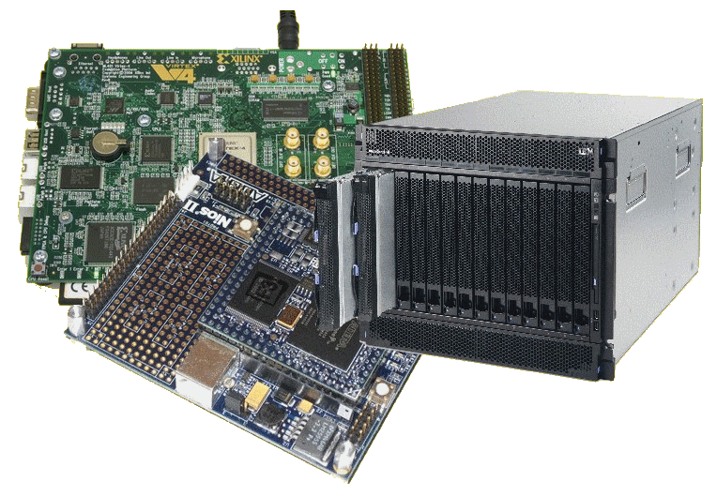
Lecture Overview
Parallel design patterns
Terms
Where to in Term 2
11 April:
2pm: Quiz 2
3pm: Presentation on RRSG 4th year topics &

Slide 3
Parallel programming design patterns
Program design pattern
A general, reusable solution to a commonly occurring software design problem.
A design pattern is usually not a complete design that is directly transformed into code.
A design pattern is more a description or template describing how a design problem can be solved for a wide range of instances.
Object-oriented design patterns (i.e. C++ and Java) often involve classes, possibly class templates, which comprise initial attributes, methods and relationships between classes. These can be inherited and incorporated into a new application using a little additional code, and without re-implementing the entire pattern.

Slide 4
Commonly used design patterns
Pipeline
Replicate & Reduce
Repository
Divide & conquer
Master/slave
Work queues
Producer/consumer flows
Other patterns and details: http://www.cs.uiuc.edu/homes/snir/PPP/

Slide 5
Assigned reading
“Parallel Programming Patterns” (PowerPoint presentation) by Eun-Gyn Kim, 2004. Available at: http://www.cs.uiuc.edu/homes/snir/PPP/patterns/patterns.ppt
Copy has been placed on Vula, see Readings folder in resources

Slide 6
Quick overview of Common patterns
EEE4084F

Slide 7
Master/Slave
master
slaves
Master dispatches processing jobs to slaves. Slaves either store results (locally or to communal storage) or send results back to master.

Slide 8
Work queues
Producer
Consumer
Shared
Queue
Producer
Consumer
work
work
work
work
Producer
Consumer
Producers create new work jobs that need to be performed at a later stage. These jobs are removed from the queue by consumers, on a first come first served basis, and completed by the consumer. Results may be dispatched to further processing or somehow integrated towards the end of the program.

Slide 9
Produce/consumer flows
Producer
Consumer
Parallel tasks:
Producer
Consumer
Producer
Consumer
The producer consumer flows pattern is similar to the work queues, except each procedure is coupled with a consumer, without going through a queue. This approach may work better if the producer and consumer need some form of collaboration (e.g., making decisions, etc) before the consumer starts work. For example the producer may ‘discuss’ with the consumer where its results are going to be stored and negotiate the process speed and QoS required.

Slide 10
Replicate & reduce
Initiator
Master/global storage
Local storage
REPLICATE
Local storage
…
Task
A
Task
B
Task
X
REDUCE
Starts by copying the data to local storage for each node, which is then operated on by the tasks. Results are collected to form the solution.
Solution

Slide 11
Repository pattern
Various computations applied to and/or saved to data in a central repository. Repository controls access and maintains consistency, e.g. same task cannot work on same data items at the same time.
Task
A
Communal repository
Task
X
Task
B
asynchronous
access
…
Task
C
Task
C

Slide 12
Divide and conquer
Task 1.1
(handles
sub-problem)
Task 1
(handles
sub-problem)
divide
Task 1
(merging
solutions)
Task 1.2
(handles
sub-problem)
merge
Initiator /
Main
problem
divide
Task 2.1.1
(handles
sub-problem)
Solution
(problem
Conquered!)
merge
Task 2.1
(handles
sub-problem)
Task 2
(handles
sub-problem)
divide
divide
…
Task 2.1.1
(handles
sub-problem)
Task 2.2
(handles
sub-problem)
Many ways this can be implemented. A common method: any task(e.g., Task 1) that has too much work to do splits into two or more subtasks (e.g., Task 1.1 and Task 1.2) which then do the work in parallel, send the results back to Task 1 and then Task 1 merges the results and either sends its result back the initiator or to a task that it has been commanded to return its results to. Note, often Task 1.1 would actually be Task 1 (i.e. it spans off helpers but also done some of the work itself).

Slide 13
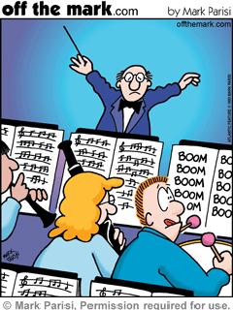
Where to in term 2
EEE4084F Digital Systems

Slide 14
Where to in Term 2
Term 2 involves:
The YODA Project (design, implement and test Your Own Digital Accelerator)
FPGA-based application accelerators
Reconfigurable computing
More hardware & HDL issues

Slide 15
Some terminology…
EEE4084F

Slide 16
Application Accelerator?
An add-on card (or reconfigurable co-processor) used to speed up processing for a particular solution
A GPU is a typical example

Slide 17
Application Accelerator?
An application accelerator may well be a type of computer system itself – possibly a stand-alone network-linked computer
Generally, it is assumed to be an add-on card or peripheral that software on a host PC wants to connect to in order to delegate processing operations

Slide 18
Other Important Terms
Verification
Validation
Testing
Correctness proof
These terms are not merely theoretical terms to remember, but relate directly to your project.
Not something done in the project (but if you want to, you can experiment with doing a correctness proof if you are keen)

Slide 19
Verification and Validation (V&V)
Two terms you should already know…
Verification
“Are we building the product right?”
Have we made what we understood we wanted to make?
Does the product satisfy its specifications?
Validation
“Are we building the right product?”
Does the product satisfy the users’ requirements
Verification before validation (except in duress)…
While it would be nice to be able to validate before verifying, doing so would mean your specifications and design may be wrong in the final version (obviously this sometimes happens in practice due to insufficient time for proper validation)
Sommerville, I. Software Engineering. Addison-Wesley, 2000.

Slide 20
Verification before validation
The RC engineer (i.e., you) are effectively designing both custom hardware and custom software for the RC platform
Before attempting to make claims about the validity of your system, it’s usually best practice to establish your own (or team’s) confidence in what your system is doing, i.e. be sure that:
The custom hardware working;
The software implementation is doing what it was designed to do; and
The custom software runs reliably on the custom hardware.

Slide 21
Verification
Checking plans, documents, code, requirements and specifications
Is everything that you need there?
Algorithms/functions working properly?
Done during phase interval (e.g., design => implementation)
Activities:
Review meetings, walkthroughs, inspections
Informal demonstrations
Focus of
project
Focus of project

Slide 22
Commonly used verification methods
Duel processing, producing two result sets
One version using PC & simulation only;
Other version including RC platform
Assume the PC version is the correct one (i.e., the gold measure)
Correlate the results to establish correlation coefficients
(complex systems may have many different sets of possibly multidimensional data that need to be compared)
The correlation coefficients can be used as a kind of ‘confidence factor’

Slide 23
Validation
Focus of project
Testing of the whole product / system
Input: checklist of things to test or list of issues that need to have been provided/fixed
Towards end of project
Activities:
Formal demonstrations
Factory Acceptance Test

Slide 24
Testing and Correctness proofs
Testing
Generally refers to aspects of dynamic validation in which a program is executed and the results analysed
Correctness proofs / formal verification
More a mathematical approach
Exhaustive test => specification guaranteed correct
Formal verification of hardware is especially relevant to RC. Formal methods include:
Model checking / state space exploration
Use of linear temporal logic and computational tree logic

Slide 25
Correlation
General definition of “correlation”:
Correlation determines whether values of one variable are related to another
Variables: PC/gold program; RC program
Obviously, its probably still a good idea, before going to the effort of correlation results, to visually inspect the target system (RC platform) results to see if they look sufficiently close to what is expected.

Slide 26
Dependent and Independent variables
Independent variables:
Can be controlled or manipulated (i.e., the software and custom RC hardware)
Input data for your program
Processing tasks to perform
Dependent variables
Variables that you cannot manipulate
Value of these variables are dependent on the independent variables

Slide 27
Performing Correlations
A correlation is performed by a set of comparisons (seeing how one variable changes as others variables change) *
Correlation coefficient (r):
A measure for the direction and strength of a relation between two variables (say x and y)
r is a value between -1 and +1
Positive vs. negative correlation…
* Made easier if you know which are dependent and independent variables

Slide 28
Performing Correlations
Correlation coefficient (r):
x correlated with y
r = +1 : perfect correlation. As x changes, y changes in the same proportionate magnitude and direction
r = -1 : total negative correlation. As x changes, y changes in same proportionate magnitude but opposite direction
r = 0 : no correlation. Week or non-existent relationship between x and y
| r | < 1 → varying degrees of correlation
r( x , y )

Slide 29
Short Exercise
Think of designing an application accelerator for calculating Fibonacci numbers.
4
PC
Fib device
4,5
What sort of design pattern would suite such a device? Considering there would be a PC sending requests 1000s of requests and receiving paired results (input:output) in an unblocking manner (as illustrated above).
If you went the way of a designing a processor core to do this and
have multiple of these cores on the digital accelerator, what instructions would each core execute? What other parts would be needed to make it a functional system?
Do some rough diagrams and discuss with your class mates.

Slide 30
Next lecture
The Project and
Intro to reconfigurable computers
11 April : presentation on RRSG 4th year topics
& Quiz 2

