Slide 1







EEE4084F
Digital Systems
Lecture 9:
GPUs & CUDA
(intended as a
double period lecture)
What is
‘elementary’,
my dear…?
Lecturer:
Simon Winberg
Attribution-ShareAlike 4.0 International (CC BY-SA 4.0)

Slide 2
Notice!
Quiz 2 Next Thursday
27 March 2014

Slide 3
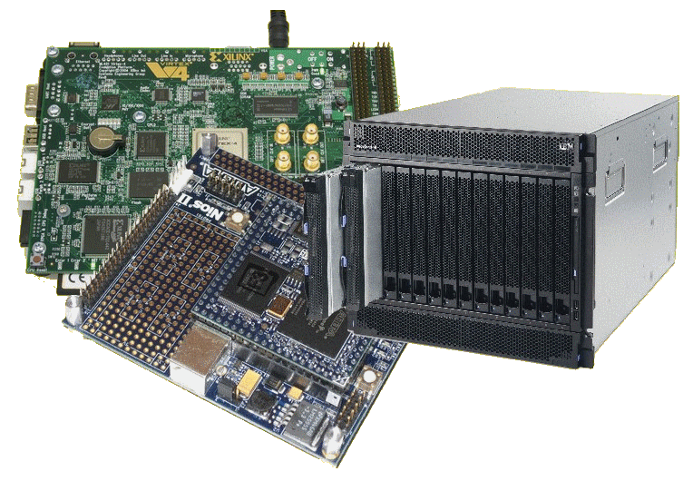
Lecture Overview
Aside: IBM Watson (a mega ‘game console’ case study)
Seminar reminder
CUDA & Prac2
Parallel Programming cont.
  Identifying Data
  Dependencies
  Synchronization

Slide 4

A short case study of a high performance computing system
DeepQA project and
The Watson machine
A seriously expensive
game console!?

Slide 5

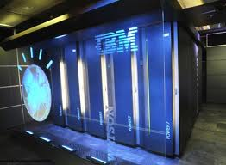
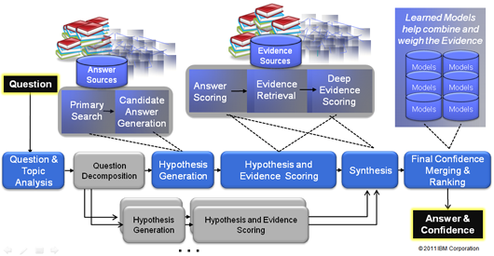
IBM DeepQA
DeepQA (as in Question and Answer)*
  A natural language processing system
  Can precisely answer questions expressed over a broad range of knowledge areas.
DeepQA Machine
DeepQA Architecture
Image sources: http://researcher.ibm.com/researcher/view_page.php?id=2159

Slide 6
IBM DeepQA
Motivation for the DeepQA project
  Current computers store and deliver much digital content, but can’t operate on it in human terms.
  A quest for building a computer system that can do Open-domain Question Answering…
*Read more at: http://www.research.ibm.com/deepqa/deepqa.shtml

Slide 7
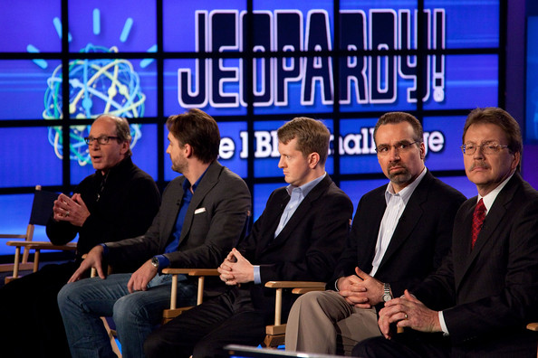
IBM DeepQA
Ultimately driven by a broader vision:
  Get computers to operate more effectively in human terms rather in computer terms.
Surely not! I
think it’s a
stupid game.
Spoil sport,
you lost as
You didn’t ask
something.
  Get computers to
  function in ways that understand complex information requirements (as people would express them), e.g. responding to natural language questions or requests.
What is a game
that you can
only respond in
questions?
Is there a game
other than Jeopardy that is
played in that way?
Say what?
*Read more at: http://www.research.ibm.com/deepqa/deepqa.shtml

Slide 8

IBM Watson… a short film
Putting DeepQA to the test

Slide 9
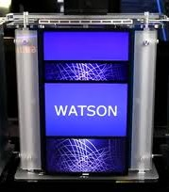
The IBM Watson
Jeopardy was chosen as a game that
makes significant cognitive demands on its payers.
It involves questions and answers, but structuring
both in a specific manner that makes sense beyond
the surface level of the question/answer text given.
What has this shown us?
  A computer can be designed to pose meaningful answers to questions in a natural language.
  Watson as the supreme champion of Jeopardy*
Beyond Jeopardy
  IBM is planning to apply the Watson system design in areas such as healthcare, customer service, finance… etc etc.
I wonder how great this will be in reality…
* http://www.geek.com/articles/geek-cetera/how-ibms-watson-could-have-been-beaten-in-jeopardy-20110226/

Slide 10
IBM DeepQA :
where could it lead?...

Slide 11
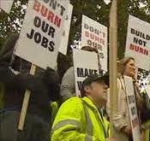


Future aftermath of DeepQA??
How may I help you today? ☺ ☺
I’d like to check my bank balance.
Scenario…
When was the first bank in England opened?
I don’t know. Please, I need to check my balance!
What the $&%# !! Bring back the touch-tone menu options!
The famous Battle of Waterloo tipped the balance of power for what emperor in 1815?

Slide 12
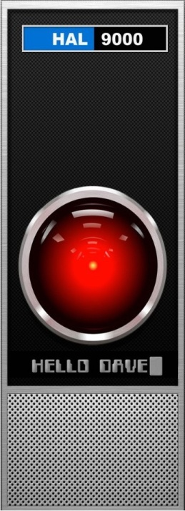

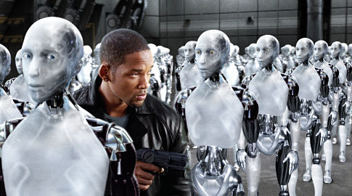
IBM DeepQA : where could it lead?
“Can a robot
write a symphony? Can a robot turn a... canvas into a beautiful masterpiece?”
<< I am putting myself to the fullest possible use, which is all I think that any conscious entity can ever hope to do. >>
<< Can you? >>
<< Well, I can act without a conscious. >>
No! But I can act.
… and I have a
conscious (I think)

Slide 13

Ok, back to more serious stuff…
GPUs…
Which were inspired by computer games…
☺

Slide 14
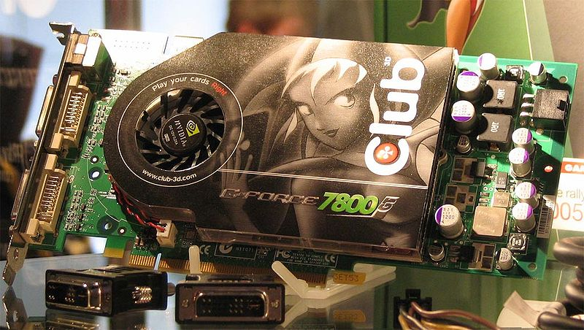
Graphics Processing Unit (GPUs)
A graphics processing unit (GPU or VPU for ‘visual processing unit’) is a specialized processor that the main processor can offload graphics processing to (e.g., 3D rendering)
In a personal computer or notebook, the GPU is often directly on the motherboard (but there are usually less powerful than those on dedicated video cards)
GPUs are not restricted to PCs – but are also in embedded systems, mobile phones and game consoles, among other platforms.

Slide 15

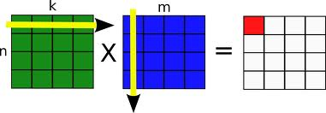
GPUs
GPUs are very efficient
at manipulating computer
graphics, but are not limited
to this type of application…
The highly parallel structure of modern GPUs often make them more effective than general-purpose CPUs for various types of algorithms
(e.g., vector and matrix
processing).

Slide 16

CUDA
CUDA = ‘Compute Unified Device Architecture’
Developed by NVIDIA see:
  http://www.nvidia.com/object/cuda_home_new.html
Programmers use C for CUDA (a flavor of C with special nVidia extensions), compiled using the PathScale Open64 C compiler
Visit CudaZone for interesting examples of CUDA applications
http://developer.nvidia.com/category/zone/cuda-zone

Slide 17
CUDA
CUDA kernel the (_kernel.cu file) is executed as an array of threads
  All threads run the same code (SIMD)
  Each thread has a different ID (used to indicate the memory location or partition it should use)
Each block is an array of threads (each block has the same number of threads)
threadDim: The number of
threads in each block.
threadID
One block in CUDA:
threadDim = 8 for this example
blockID = 0
0
1
2
3
4
5
6
7

Slide 18
CUDA: threads
threadID
One block in CUDA:
0
1
2
3
4
5
6
7
// C kernel program
int* x = &data[threadID*N];
int i, sum=0;
for (i=0; i<N; i++)
sum+= data[i];
output[threadID] = sum;
Private local
vars
Shared global vars
Each local variable in the kernel function is instantiated separately for each thread

Slide 19
CUDA: blocks of threads
threadID
threadID
threadID
0
1
2
3
4
5
6
7
0
1
2
3
4
5
6
7
0
1
2
3
4
5
6
7
// C kernel program
int* x = &data[threadID*N];
int i, sum=0;
for (i=0; i<N; i++)
sum+= data[i];
output[threadID] = sum;
// C kernel program
int* x = &data[threadID*N];
int i, sum=0;
for (i=0; i<N; i++)
sum+= data[i];
output[threadID] = sum;
// C kernel program
int* x = &data[threadID*N];
int i, sum=0;
for (i=0; i<N; i++)
sum+= data[i];
output[threadID] = sum;
blockID.x = 0
blockID.x = 1
blockIDx = blockDim.x -1
Note: the above visual depicts only one row in the array of blocks!!
Only threads in the same block can cooperate, e.g., via atomic operations, shared memory, or barrier synchronization.
The __shared keyword indicates a local variable shared between all threads in the same block (i.e., declared in the kernel function).
All threads can access the global memory, which is copied over to the GPU from the CPU (using cudaMemcpy(cpu_p, gpu_p, size, cudaMemcpyHostToDevice)).

Slide 20
CUDA block dimensions
It’s a massive 2D collection of CPUs!
BlockID.x = 0,
BlockID.y = 0
( BlockDim.x , BlockDim.y )
…
…
…
…
…
…
…
…
…
…
…
…
…
…
…
…
…
…
…
…
BlockID : a coordinate structure indicating the current block ID
BlockID.x = BlockDim.x-1,
BlockID.y = BlockDim.y-1
BlockDim : a coordinate structure indicating the number of block IDs

Slide 21
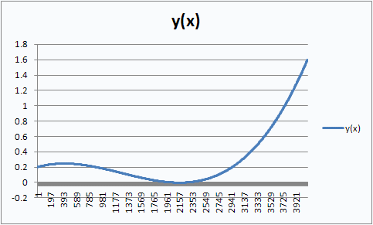
Prac2 – Using CUDA
Part A: sample application that does vector scalar product
Part B: your task
  Parallelize the
  sampling of a
  function

Slide 22
Prac2 – the files
prac02b_gold.cpp :
  Sequential implementation for use in establishing a performance baseline (you can compile this as is in DevC++ / GCC)
Prac02b.cu :
  CUDA C code has main() (can’t compile with GCC) – for compiler see common.make:
  NVCC := (CUDA_INSTALL_PATH)/bin/nvcc )
prac02b_kernel.cu: CUDA C code, implements the parallel vector operation

Slide 23
Installing CUDA
You can install CUDA on your own PCs with ease – install the SDK at least (avail for both Linux and Windows)
Even if you don’t have a compatible nVIDIA card, you can use the emulator that comes with the SDK

Slide 24
Forum
Please consider using the VULA forum topic for Prac2 CUDA to post questions, particularly about installing and using CUDA (obviously no sharing of solutions to the prac is permitted).

Slide 25
Design of Parallel Programs (CONT)
EEE4084F

Slide 26

Step 5: Identify Data Dependencies
EEE4084F

Slide 27
Data dependencies
A dependency exists between statements of a program when the order of executing the statements affects the results of the program.
A data dependency is caused by different tasks accessing the same variables (i.e., memory addresses).
Dependencies are a major inhibition to developing parallel programs.

Slide 28
Data dependencies
Common approaches to working around data dependencies:
  For distributed memory architectures: tend to use synchronization points (periods when sets of shared data is communicated between tasks).
  Shared memory architectures: make use of read/write synchronize operations (no sending of data, just temporarily block other tasks from reading/writing a variable).

Slide 29
Common data dependencies
Loop carried data dependence
  dependence between statements in different iterations
Loop independent data dependence
  dependence between statements in the same iteration
Lexically forward dependence:
  source precedes the target lexically
Lexically backward dependence:
  opposite from above
Right-hand side of an assignment precede the left-hand
side
Source: http://sc.tamu.edu/help/power/powerlearn/html/ScalarOptnw/tsld036.htm

Slide 30
Step 6: Synchronization
Design of Parallel Programs
EEE4084F

Slide 31
Types of Synchronization
Barrier
Locking / Semaphores
Synchronous communication operations

Slide 32
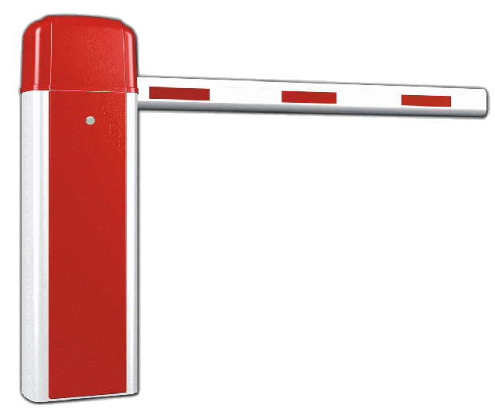
Barrier
All tasks are involved
Each task does work until it reaches the barrier, and then blocks.
When the last task reaches the barrier all the tasks are synchronized.
What happens next?…
  Section of work is done or
  Tasks are automatically released to continue their work… programmer usually decides.

Slide 33

Locking / Semaphores
May concern any number of tasks
Usually used to serialize / protect access to global data or critical section of code.
Only one task at a time may have the lock / semaphore.
Tasks can attempt to get the lock need to wait for the task that has the lock to release it, granted on a FCFS basis.
Usually blocking, could be non-blocking (i.e., do other work until lock is available)

Slide 34
Synchronous communication operations
Concerns only tasks executing a communication operation (or coms op)
When a task performs a coms op, some form of coordination is required with other task(s) involved with this communication.
  For example, before a task can do a send operation, it needs to first receive a clear to send (CTS) signal from the task it wants to send to.

Slide 35
Questions?
?
?
?
?
?
?
?
?
?
?
?
?
?

Slide 36

Next lecture
Load balancing (step 7)
Performance Benchmarking (step 8)
Heading towards... end of parallel programming series

Slide 37
Disclaimers and copyright/licensing details
I have tried to follow the correct practices concerning copyright and licensing of material, particularly image sources that have been used in this presentation. I have put much effort into trying to make this material open access so that it can be of benefit to others in their teaching and learning practice. Any mistakes or omissions with regards to these issues I will correct when notified. To the best of my understanding the material in these slides can be shared according to the Creative Commons “Attribution-ShareAlike 4.0 International (CC BY-SA 4.0)” license, and that is why I selected that license to apply to this presentation (it’s not because I particulate want my slides referenced but more to acknowledge the sources and generosity of others who have provided free material such as the images I have used).
Image sources:
Camera real - open commons
Boom barrier - Wikipedia (open commons)
IBM Watson images – from both Wikipedia and www.ibm.com (minor edits made)
Film real – Pixabay http://pixabay.com/
HAL - Wikipedia (open commons)
Computer graphics collage – various sources
Geforce7800gt GPU - Wikipedia (open commons)
Lock and key, Checked Flag - Open Clipart (http://openclipart.org)

