Slide 1



EEE4084F
Digital Systems
Lecture 8:
Design of Parallel Programs
Part III
Lecturer:
Simon Winberg

Slide 2

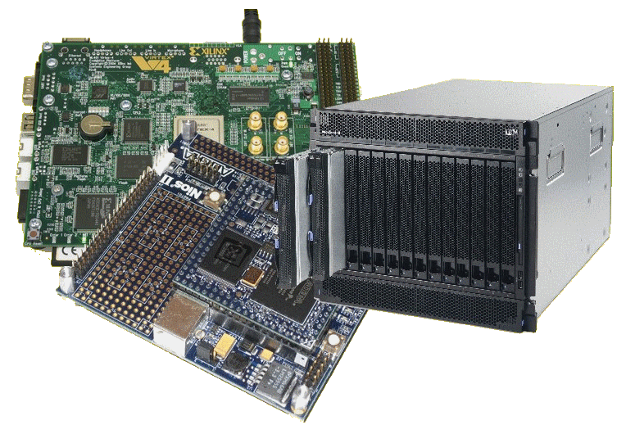
Lecture Overview
Step 4: communications (cont)
Cloud computing
Step 5: Identify
data dependencies

Slide 3

Steps in designing parallel programs
The hardware may come first or later
The main steps:
Understand the problem
Partitioning (separation into main tasks)
Decomposition & Granularity
Communications
Identify data dependencies
Synchronization
Load balancing
Performance analysis and tuning

Slide 4


Step 4: Communications (CONT)
EEE4084F

Slide 5
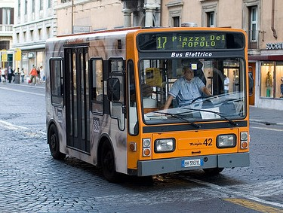

Latency vs. Bandwidth
Communication Latency =
  Time it takes to send a minimal length (e.g., 0 byte) message from one task to another. Usually expressed as microseconds.
Bandwidth =
  The amount of data that can be sent per unit of time. Usually expressed as megabytes/sec or gigabytes/sec.

Slide 6
Latency vs. Bandwidth
Many small messages can result in latency dominating communication overheads.
If many small messages are needed:
  It can be more efficient to package small messages into a larger ones, to increasing the effective bandwidth of communications.

Slide 7
Effective bandwidth
Total latency =
Sending overhead + Transmission time + time of flight + Receiver overhead
Effective bandwidth = Message size / total latency
Sending overhead
Transmission time
Time of flight
Transmission time
Receive overhead
Transport latency
Total latency
time of flight is also referred to as ‘propagation delay’ – it may depend on how many
channels are used. E.g. a two-channel path will give an effective lower propagation.
With switching circuitry, the propagation delay can increase significantly.

Slide 8
Effective bandwidth calc.
Message 10,000 bytes
Sending overhead 200us
Receiving overhead 300us
Example:
Distance 100m
Raw bandwidth 10Mbit/s
Solution:
Transmission time = 100,000 bits
=
100,000 bits
=
10,000 us
10Mbits/s
10bits/us
Time of flight =
100m
=
1m
=
0.33 us
3 x 10⁸ m/s
3 x 10⁶ m/s
Total latency =
Sending overhead + Transmission time + time of flight + Receiver overhead
Total latency =
200us + 10,000us + 0.33us + 300us = 10,500.33 us
Effective bandwidth = Message size / total latency
Effective bandwidth = 100,000bits / 10,500us = 9.52 Mbits/s

Slide 9
Visibility of Communications
Communications is usually both explicit and highly visible when using the message passing programming model.
Communications may be poorly visible when using the data parallel programming model.
For data parallel design on a distributed system, communications may be entirely invisible, in that the programmer may have no understanding (and no easily obtainable means) to accurately determine what inter-task communications is happening.

Slide 10

Synchronous vs. asynchronous
Synchronous communications
  Require some kind of
  handshaking between tasks that
  share data / results.
  May be explicitly structured in the code, under control of the programmer – or it may happen at a lower level, not under control of the programmer.
  Synchronous communications are also referred to as blocking communications because other work must wait until the communications has finished.

Slide 11

Synchronous vs. asynchronous
Asynchronous communications
  Allow tasks to transfer data between one another independently. E.g.: task A sends a message to task B, and task A immediately begin continues with other work. The point when task B actually receives, and starts working on, the sent data doesn't matter.
  Asynchronous communications are often referred to as non-blocking communications.
  Allows for interleaving of computation and communication, potentially providing less overhead compared to the synchronous case

Slide 12
Scope of communications
Scope of communications:
  Knowing which tasks must communicate with each other
Can be crucial to an effective design of a parallel program.
Two general types of scope:
  Point-to-point (P2P)
  Collective / broadcasting

Slide 13
Scope of communications
Point-to-point (P2P)
  Involves only two tasks, one task is the sender/producer of data, and the other acting as the receiver/consumer.
Collective
  Data sharing between more than two tasks (sometimes specified as a common group or collective).
  Both P2P and collective communications can be synchronous or asynchronous.

Slide 14
Collective communications
Typical techniques used for collective communications:
BROADCAST
SCATTER
Task
Task
Task
Task
Task
Task
Same message sent to all tasks
Different message sent to each tasks
Initiator
Initiator
REDUCING
GATHER
Task
Task
Task
Task
Task
Task
Only parts, or reduced form, of the messages are worked on
Messages from tasks are combined together
Task
Task

Slide 15

Efficiency of communications
There may be a choice of different communication techniques
  In terms of hardware (e.g., fiberoptics, wireless, bus system), and
  In terms of software / protocol used
Programmer may need to use a combination of techniques and technology to establish the most efficient choice (in terms of speed, power, size, etc).

Slide 16

Cloud Computing
EEE4084F

Slide 17

Cloud Computing: a short but
informative marketing clip…
“Salesforce : what is cloud computing”

Slide 18

Cloud Computing
Cloud computing is a style of computing in which dynamically scalable and usually virtualized computing resources are provided as a service over the internet.
Cloud computing use:
Request resources or services over the internet (or intranet)
Provides scalability and reliability of a data center

Slide 19

Characteristics
On demand scalability
  Add or subtract processors, memory, network bandwidth to your cluster
  (Be billed for the QoS / resource usage)
Virtualization and virtual systems & services
  Request operating system, storage, databases, databases, other services

Slide 20
Key Technology for Cloud Computing: Virtualization
App
App
App
App
App
App
OS
OS
OS
Operating System
Hypervisor
Hardware
Hardware
Traditional Computing Stack
Virtualized Computing Stack

Slide 21
Cloud Computing Models
Driving philosophy:
Why buy the equipment, do the configuration and maintenance and yourself,
if you can contract it out? Can work out much more cost effectively.
Utility computing
  Rent cycles
  Examples: Amazon’s EC2, GoGrid, AppNexus
Platform as a Service (PaaS)
  Provides user-friendly API to aid implementation
  Example: Google App Engine
Software as a Service (SaaS)
  Just run it for me
  Example: Gmail

Slide 22
Amazon Web Services
Elastic Compute Cloud (EC2)
  Rent computing resources by the hour
  Basic unit of accounting = instance-hour
  Additional cost for bandwidth usage
Simple Storage Service (S3)
  Persistent storage
  Charge by the GB/month
  Additional costs for bandwidth

Slide 23
Prac3
Using MP and Chimera cloud computing management system
Cloud system hosted by Chemical Engineering
Electrical Engineering essentially renting cycles… for free ☺ Thanks Chem Eng!
Scheduled time for use:
  8am – 12pm Monday
  12pm – 5pm Thursday
  (You can run anytime you like, but the system is likely to be less loaded by users outside EEE4084F at the above times)

Slide 24

Next lecture
Next Lecture
  GPUs and CUDA
  Data Dependencies (Step 5)
Later Lectures
  Synchronization (step 6)
  Load balancing (step 7)
  Performance Analysis (step 8)
End of parallel programming series

