Slide 1



EEE4084F
Digital Systems
Lecture 7:
Design of Parallel Programs
Part II
Lecturer:
Simon Winberg

Slide 2
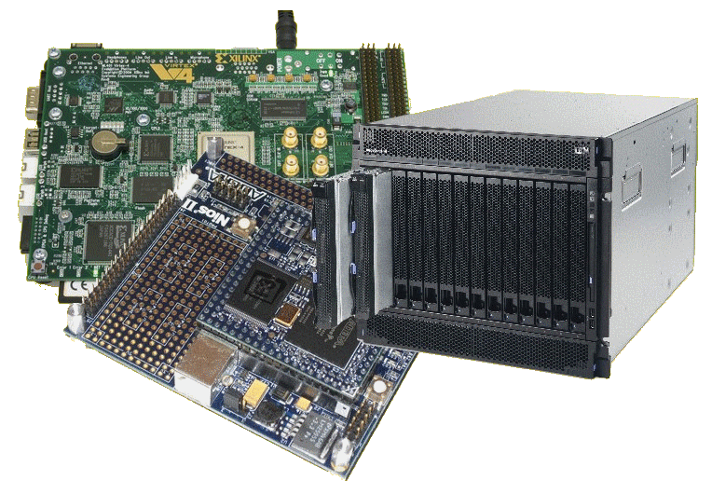
Lecture Overview
Aside: Saturn5 – one giant leap for digital computer engineering
Step 3: decomposition and granularity
  Class activity
Step 4: communications

Slide 3
A short case study of a (yesteryear) high performance embedded computer
The Apollo Saturn V
Launch Vehicle Digital Computer (LVDC)
You all surely know what the Saturn V is…

Slide 4
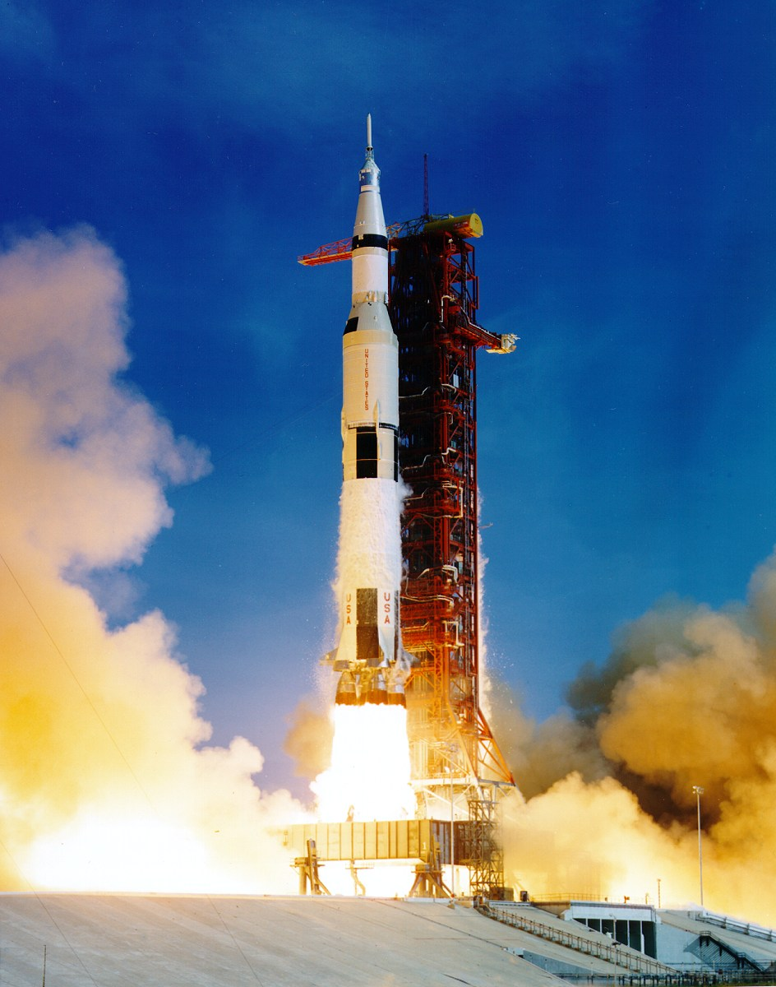
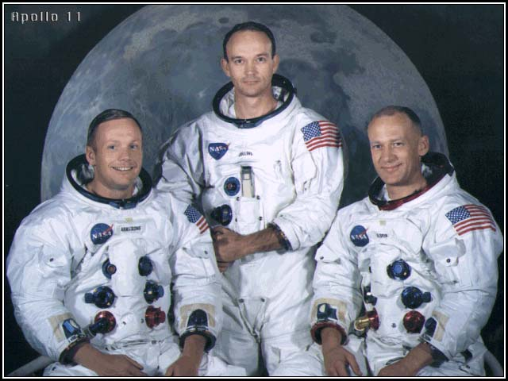
The Apollo 11 on a Saturn V
Safety abort rocket
Apollo 11
Uncomfortable but eager flight crew:
Neil Armstrong (Commander)
Buzz Aldrin (Lunar Module Pilot)
Michael Collins (Command Module Pilot)
Neil Collins Buzz
Saturn V
Launch Vehicle
(i.e. the rocket)
About 3,200 °C
produced by F-1 rocket
engines, all together giving
±160 million horsepower

Slide 5
We all know that Apollo 11, and many thanks to Saturn V, resulted in:
“That's one small step for [a] man, one giant leap for mankind”
-- Niel Amstrong, July 21, 1969
But the success launch of Saturn V has much to attribute to:
…
The LVDC (Launch Vehicle Digital Computer)
The LVDC was of course quite a fancy circuit back in those days.
Here’s an interesting perspective on the LVDC, giving some concept
of how an application (i.e. launching a rocket) can lead to significant
breakthroughs in technology, and computer design in particular.

Slide 6

The Apollo Saturn V Launch Vehicle Digital Computer (LVDC) Circuit Board

Slide 7
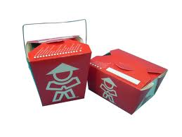
Most significant
Take-home points
of the video?
To go…

Slide 8
Design of parallel Programs
EEE4084F

Slide 9
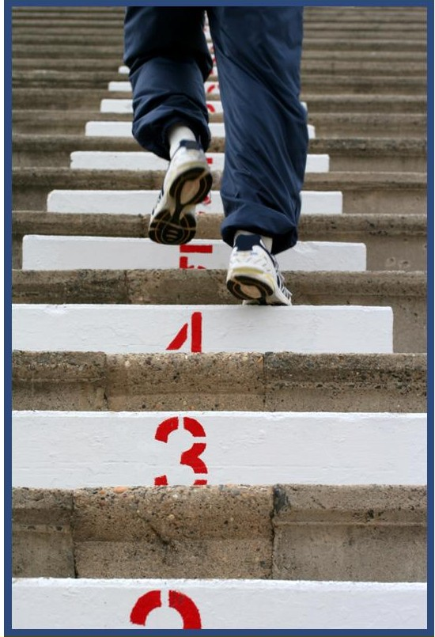
Steps in designing parallel programs
The hardware may come first or later
The main steps:
Understand the problem
Partitioning (separation into main tasks)
Decomposition & Granularity
Communications
Identify data dependencies
Synchronization
Load balancing
Performance analysis and tuning

Slide 10
Step 3: Decomposition and Granularity
EEE4084F

Slide 11
Step 3: Decomposition and Granularity
Decomposition – how the problem can be divided up; looked at earlier:
  Functional decomposition
  Domain (or data) decomposition
Granularity
  How big or small are the parts that the problem has been decomposed into?
  How interrelated are the sub-tasks

Slide 12


The Ratio of
Computation : Communication
This ratio can help to decide is a problem is fine or course grained.
  1 : 1 = Each intermediate result needs a communication operation
  100 : 1 = 100 computations (or intermediate results) require only one communication operation
  1 : 100 = Each computation
  needs 100 communication
  operations

Slide 13

Granularity
Fine Grained:
  One part / sub-process requires a great deal of communication with other parts to complete its work relative to the amount of computing it does (the ratio computation : communication is low, approaching 1:1)
course grained …

Slide 14
Granularity
Fine Grained:
  One part / sub-process requires a great deal of communication with other parts to complete its work relative to the amount of computing it does (the ratio computation : communication is low, approaching 1:1)
Course Grained:
  A coarse-grained parallel task is largely independent of other tasks. But still requires some communication to complete its part. The computation : communication ratio is high (say around 100:1).

Slide 15
Granularity
Fine Grained:
  One part / sub-process requires a great deal of communication with other parts to complete its work relative to the amount of computing it does (the ratio computation : communication is low, approaching 1:1)
Course Grained:
  A coarse-grained parallel task is largely independent of other tasks. But still requires some communication to complete its part. The computation : communication ratio is high (say around 100:1).
Embarrassingly Parallel:
  So course that there’s no or very little interrelation between parts/sub-processes

Slide 16
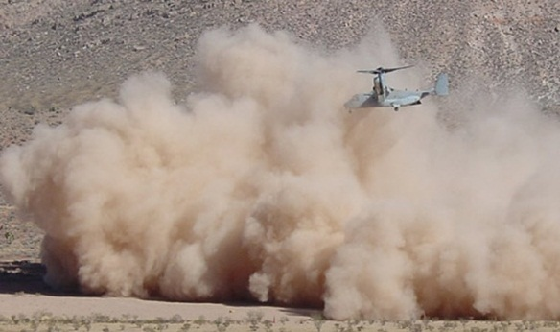
Decomposition and Granularity
Fine grained:
  Problem broken into (usually
  many) very small pieces
  Problems where any one piece is highly interrelated to others (e.g., having to look at relations between neighboring gas molecules to determine how a cloud of gas molecules behaves)
  Sometimes, attempts to parallelize fine-grained solutions increased the solution time.
  For very fine-grained problems, computational performance is limited both by start-up time and the speed of the fastest single CPU in the cluster.

Slide 17
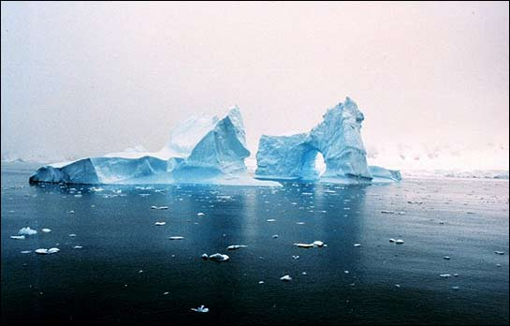
Decomposition and Granularity
Course grained:
  Breaking the problems into
  larger pieces
  Usually, low level of interrelations (e.g., can separate into parts whose elements are unrelated to other parts)
  These solutions are generally easier to parallelize than fine-grained, and
  Usually, parallelization of these problems provides significant benefits.
  Ideally, the problem is found to be “embarrassingly parallel” (this can of course also be the case for fine grained solutions)

Slide 18
Decomposition and Granularity
Many image processing problems are suited to course grained solutions, e.g.: can perform calculations on individual pixels or small sets of pixels without requiring knowledge of any other pixel in the image.
Scientific problems tend to be between coarse and fine granularity. These solutions may require some amount of interaction between regions, therefore the individual processors doing the work need to collaborate and exchange results (i.e., need for synchronization and message passing).
  E.g., any one element in the data set may depend on the values of its nearest neighbors. If data is decomposed into two parts that are each processed by a separate CPU, then the CPUs will need to exchange boundary information.

Slide 19
Class Activity: Discussion
Which of the following are more fine-grained, and which are course-grained?
  Matrix multiply
  FFTs
  Decryption code breaking
  (deterministic) Finite state machine validation / termination checking
  Map navigation (e.g., shortest path)
  Population modelling

Slide 20
Class Activity: Discussion
Which of the following are more fine-grained, and which are course-grained?
  Matrix multiply - fine grain data, course funct.
  FFTs - fine grained
  Decryption code breaking - course grained
  (deterministic) Finite state machine validation / termination checking - course grained
  Map navigation (e.g., shortest path) - course
  Population modelling - course grained

Slide 21
Step 4: Communications
EEE4084F

Slide 22
Step 4: Communications
The communications needs between tasks depends on your solution:
Communications not needed for
  Minimal or no shared data or results.
    E.g., an image processing routine where each pixel is dimmed (e.g., 50% dim). Here, the image can easily be separated between many tasks that act entirely independently of one other.
  Usually the case for embarrassingly parallel solutions4

Slide 23
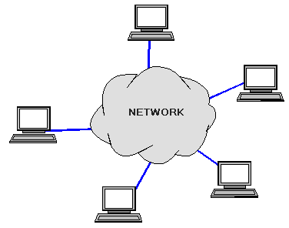
Communications
The communications needs
between tasks depends on
your solution:
Communications is needed for…
  Parallel applications that need to share results or boundary information. E.g.,
    E.g., modeling 2D heat diffusion over time – this could divide into multiple parts, but boundary results need to be shared. Changes to an elements in the middle of the partition only has an effect on the boundary after some time.

Slide 24
Factors related to Communication
Cost of communications
Latency vs. Bandwidth
Visibility of communications
Synchronous vs. asynchronous communications
Scope of communications
Efficiency of communications
Overhead and Complexity

Slide 25
Cost of communications
Communication between tasks has some kind of overheads, such as:
  CPU cycles, memory and other resources that could be used for computation are instead used to package and transmit data.
  Also needs synchronization between tasks, which may result in tasks spending time waiting instead of working.
  Competing communication traffic could also saturate the network bandwidth, causing performance loss.

Slide 26
Next lecture
Cloud computing
Step 4: Communications (cont)
Step 5: Identify data dependencies
Post-lecture (voluntary) assignment:
Refer back to slide 24 (factors related to communication)
Use your favourite search engine to read up further on these factors,
and think how the hardware design aspects of a computing platform
can benefit or impact these issues.

