Slide 1
EEE4084F
Digital Systems
Lecture 6:
Design of Parallel Programs
Part I
Lecturer:
Simon Winberg
Attribution-ShareAlike 4.0 International (CC BY-SA 4.0)

Slide 2
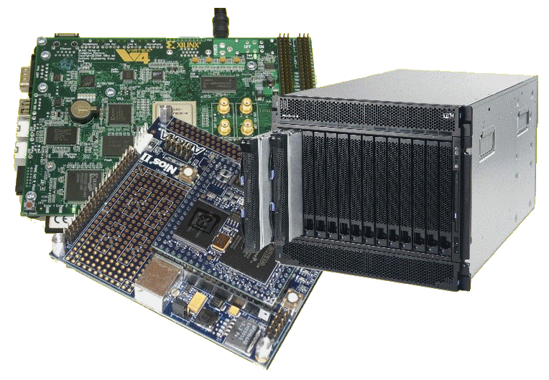
Lecture Overview
Seminar this afternoon 3pm
Recap of memory architectures
Steps in designing parallel programs
Step 1: understanding the problem
Step 2: partitioning
Step 3: decomposition & granularity

Slide 3
Recap Memory Architectures
EEE4084F
The more detailed slides on memory architectures in the previous lectures was assigned as a reading task last week.

Slide 4
Brief recap of memory architectures
Shared memory architecture
Uniform access memory (UAM) vs. Non-uniform access memory (NAM)
Distributed memory
Similar to shared memory, but needs comms network to share memory (NB not always same as MPI)
Distributed shared memory (hybrid)
Best & worst of both ‘worlds’

Slide 5
Steps in Designing Parallel Programs
…

Slide 6
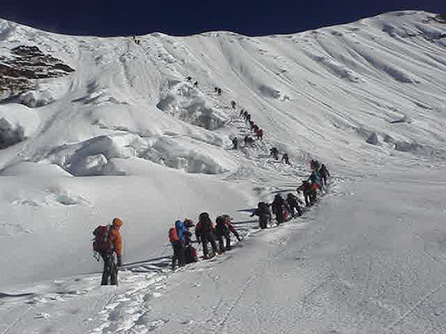
Steps in Designing Parallel Programs
Hardcore competent parallel programmers
(leading the way to greater feats)
Starting the somewhat long and arduous trek on the topic of designing parallel programs
EEE4084F
Sequential programmers in their comfort zone.

Slide 7
Steps in designing parallel programs
The hardware may be done first… or later.
The main steps:
Understand the problem
Partitioning (separation into main tasks)
Decomposition & Granularity
Communications
Identify data dependencies
Synchronization
Load balancing
Performance analysis and tuning
this lecture
…

Slide 8
Step 1: Understanding the problem
Make sure that you understand the problem, that is the right problem, before you attempt to formulate a solution
Some problems aren’t suited to parallelization – it just might not be parallelizable
(i.e. ‘problem validation’)
Example of non-parallelizable problem:
Calculating the set of Fibonacci series (e.g., Fib(10²⁰) as quickly as possible.
Fib(n) = n } if n < 2
= Fib(n – 1) + Fib(n – 2) } otherwise

Slide 9
Step 1: Understanding the problem
Many problems may have obvious parallel solutions.
Others may need some concerted effort to discover the parallel nature.
Easily parallel example:
Given two tables, client (clientname,clientnum) and orders (clientnum,ordernum,date) find the name of clients who ordered something on 1 March 2010.
Obvious solution: divide orders into smaller parts, each task checks the dates in its partition, it it matches the clientnum is added to a temporary list, at the end all the temporary lists are combined and clientnum replaced by clientname.

Slide 10
Step 1: Understanding the problem
Identify: Critical parts or ‘hotspots’
Determine where most of the work needs to be done. Most scientific and technical programs accomplish the most substantial portion of the work in only a few small places.
Focus on parallelizing hotspots. Ignore parts of the program that don’t need much CPU use.
Consider which profiling techniques and performance analysis tools (‘PATs’) to use

Slide 11
Step 1: Understanding the problem
Identify: bottlenecks
Consider communication, I/O, memory and processing bottlenecks
Determine areas of the code that execute notably slower than others.
Add buffers / lists to avoid waiting
Attempt to avoid blocking calls (e.g., only block if the output buffer is full)
Try to rearrange code to make loops faster

Slide 12
Step 1: Understanding the problem
General method:
identify hotspots, avoid unnecessary complication, identify potential inhibitors to the parallel design (e.g., data dependencies).
Consider other algorithms…
This is an most important aspect of designing parallel applications.
Sometimes the obvious method can be greatly improved upon though some lateral thought, and testing on paper.

Slide 13
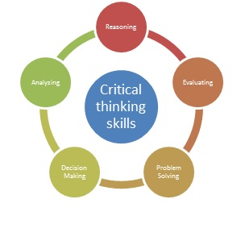
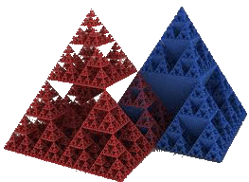
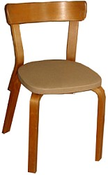
Different perspectives: Gaining a better understand of the problem
General Systems Thinking (GST)
Critical Analysis
(& Critical Thinking)
Applying rational and logical thinking while deconstructing texts or subject matter studied.*
How does the problem of focus relate to more general problems?
What other systems are being depended on or are affected?
Has a systems approach been considered in addition to the usual divide and simplify approach?
Let’s consider what happens, in a logical scientific / deductive manner, if we discard or replace some of the traditions or ‘conditioned choices’.
Reflecting on choices and descriptions
Considering ‘what if…’ scenarios (e.g. what if a chair had only one leg instead of four)
See last page for suggested sites to learn more about critical analysis
* Adapted from: Browne, M & Keeley, S 2001, Asking the right questions: a guide to critical thinking, 6th edn, Prentice-Hall, Upper Saddle River, N.J.

Slide 14
Step 2: Partitioning
This step involves breaking the problem into separate chunks of work, which can then be implemented as multiple distributed tasks.
Two typical methods to partition computation among parallel tasks:
Functional decomposition or
Domain decomposition

Slide 15
Functional decomposition
Functional decomposition focuses on the computation to be done, rather than the way data is separated and manipulated by tasks.
The problem is decomposed into tasks according to the work that must be done.
Each task performs a portion of the overall work.
Tends to be closer to message passing and MIMD systems

Slide 16
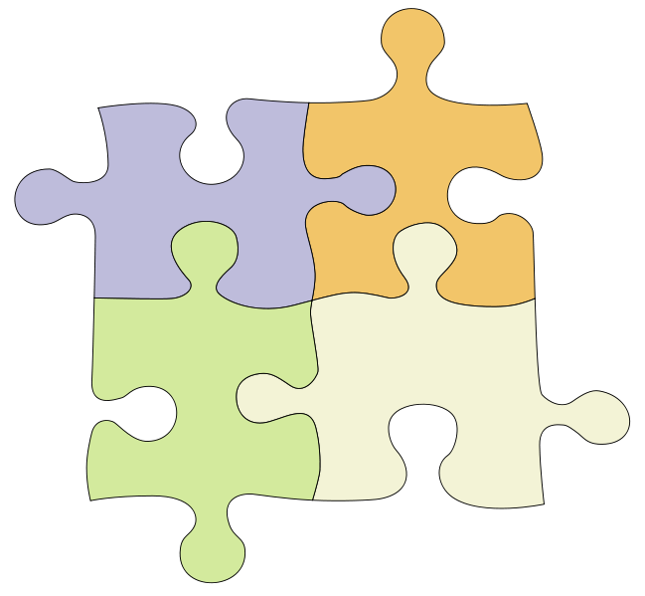
Functional decomposition
Task #2:
1.
2.
3.
Task #1:
1.
2.
3.
4.
The Problem
Task #3:
1.
2.
3.
4.
5.
Task #4:
1.
2.
Functional decomposition is suited to problems that can be split into different tasks

Slide 17
Functional decomposition
Example applications
Environment modelling
Simulating reality
Signal processing, e.g.:
Pipelined filters: in → P1 → P2 → P3 → out
Here P1 is filled first, its result is sent to P2 while simultaneously P1 starts working on a block of new input, and so on.
Climate modelling (e.g., simultaneously running simulations for atmosphere, land, and sea)

Slide 18
Domain decomposition
Involves separating the data, or taking different ‘views’ of the same data. E.g.
View 1 : looking at frequencies (e.g. FFTs)
View 2 : looking at amplitudes
Each parallel task works on its own portion of the data, or does something different with the same data
The Data
The Data
Task1
Task2
Task3
View 1
View 2
Task1
Task2
Result
Result

Slide 19
Domain decomposition
Good to use for problems where:
Data is static (e.g., factoring; matrix calculations)
Dynamic data structures linked to a single entity (where entity can be made into subsets) (e.g., multi-body problems)
Domain is fixed, but computation within certain regions of the domain is dynamic (e.g., fluid vortices models)

Slide 20
Domain decomposition
Many possible ways to divide things up. If you want to look at it visually…
continuous
Blocked (same-size partitions)
Blocked
Interlaced
Interleaved or
cyclic
Other methods can be done

Slide 21
Next lecture
Practice example
Continuation of the steps:
Step 3 Granularity
Class activity
Step 4 Communications …
Some resources related to critical analysis and critical thinking:
An easy introduction to critical analysis:
http://www.deakin.edu.au/current-students/study-support/study-skills/handouts/critical-analysis.php
An online quiz and learning tool for understanding critical thinking:
http://unilearning.uow.edu.au/critical/1a.html

Slide 22
Disclaimers and copyright/licensing details
I have tried to follow the correct practices concerning copyright and licensing of material, particularly image sources that have been used in this presentation. I have put much effort into trying to make this material open access so that it can be of benefit to others in their teaching and learning practice. Any mistakes or omissions with regards to these issues I will correct when notified. To the best of my understanding the material in these slides can be shared according to the Creative Commons “Attribution-ShareAlike 4.0 International (CC BY-SA 4.0)” license, and that is why I selected that license to apply to this presentation (it’s not because I particulate want my slides referenced but more to acknowledge the sources and generosity of others who have provided free material such as the images I have used).
Image sources:
Book clipart drawing - Wikipedia (open commons)
Beach chairs, Himalayan Climbers - www.flickr.com (public domain)
Picture of running going up stairs – Wikimedia open commons
Sierpinski pyramid (slide 13) – Wikimedia open commons
3-legged chair (slide 13) – Adapted (modification permitted) from Wikimedia

