Slide 1
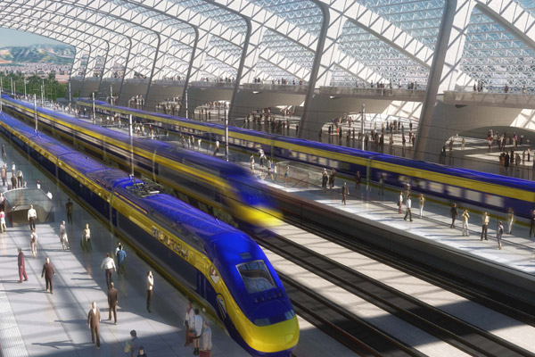
EEE4084F
Digital Systems
Lecture 5: Parallel Architecture
Lecturer:
Simon Winberg
Attribution-ShareAlike 4.0 International (CC BY-SA 4.0)

Slide 2
Quiz on Thursday!
2pm
Lectures 1-4
Seminar 1

Slide 3
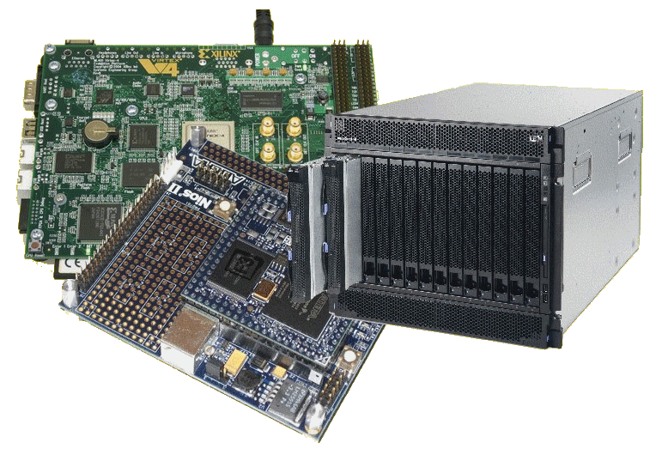
Lecture Overview
Processor Architecture types
Von Neumann; Flynn’s taxonomy
Class activity
Memory access architectures

Slide 4
Types of Processor Architecture
EEE4084F

Slide 5
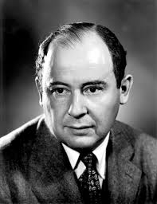
von Neumann Architecture
Named after John von Neumann
A Hungarian mathematician. He was the first to write about requirements for an electronic computer (done in 1945).
The ‘von Neumann computer’ differed from earlier computers that were programmed by hard wiring.
Most computers since then have followed this design

Slide 6
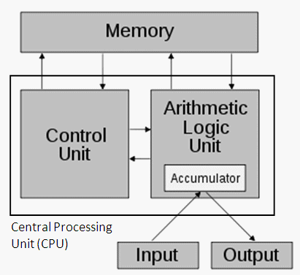
von Neumann Architecture
The von Neumann computer comprises the following four components:
Memory
Control Unit
Arithmetic Logic Unit (ALU)
Input/Output
See 1-page reading in Resources on VULA
Figure 1: The Von Neumann architecture*
(* image adapted from http://en.wikipedia.org/w/index.php?title=Von_Neumann_architecture)

Slide 7
von Neumann Architecture: Memory
Random access, read/write memory stores both programs and data
Program comprises instructions (von Neumann termed ‘machine instructions’) that tells the computer what do.
Data is simply information to be used by the program

Slide 8
von Neumann Architecture: Operation
Control unit fetches instruction or data from memory, decodes and executes the instruction, sequentially completes sub-operations for the instruction
Arithmetic Unit performs basic arithmetic operations (earlier CPUs didn’t have multiply or divide; had few instructions, e.g. LOAD, STORE, ADD, IN, OUT and JUMP on flags)
Input/Output is interface to other systems and human operator

Slide 9
Suggested further learning
Simple recap of Von Neumann Arch:
http://www.youtube.com/watch?v=DMiEgKZ-qCw
Some history of Von Neumann leading towards his machine: (not examined!)
“The Greatest Computer Programmer Was Its First”
http://www.youtube.com/watch?v=Po3vwMq_2xA

Slide 10
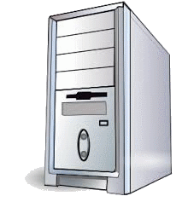
Flynn’s taxonomy
Flynn’s (1966) taxonomy was developed as a means to classify parallel computer architectures
Computer system can be fit into one of the following four forms:
SISD
Single Instruction Single Data
SIMD
Single Instruction Multiple Data
MISD
Multiple Instructions Single Data
MIMD
Multiple Instructions Multiple Data
Flynn’s
Taxon.
MI
MD
Not to be confused with the terms of “Single Program Multiple Data (SPMD)” and “Multiple Program Multiple Data (MPMD)”.

Slide 11
Single Instruction Single Data (SISD)
This is (obviously) the classic von Neumann Computer: serial (not parallel) computer, e.g.:
Old style single core PC CPUs, e.g. i486
Single instruction →
One instruction stream acted on by the CPU during any one clock cycle
Single data →
Only one input data stream for any one clock cycle
Deterministic execution
x = 2 * (y + z);
0x1000
LD A,[0x2002]
0x1003
LD B,[0x2004]
0x1006
ADD A,B
0x1007
SHL A,1
0x1008
ST A,[0x2000]

Slide 12
Single Instruction Multiple Data (SIMD)
A form of parallel computer
Early supercomputers used this model first
Nowadays it has become common – e.g., used in modern computers on GPUs
Single instruction →
All processing units execute the same instruction for any given clock cycle
Multiple data →
Each processing unit can operate on a different data element
y= [1 2 3 4]
z = [2 3 4 5]
x = 2 * (y + z)
LD AX,[DX+0]
LD AX,[DX+3]
LD BX,[EX+0]
LD BX,[EX+3]
ADD AX,BX
…
ADD AX,BX
SHL AX,1
SHL AX,1
ST AX,[CX+0]
ST AX,[CX+3]
…
…
CPU 1
CPU 4

Slide 13
Single Instruction Multiple Data (SIMD)
Runs in lockstep (i.e., all elements synchronized)
Works well for algorithms with a lot of regularity; e.g. graphics processing.
Two main types:
Processor arrays
Vector pipelines
Still highly deterministic (know the same operation is applied to specific set of data – but more data to keep track of per instruction)

Slide 14
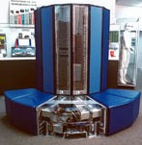
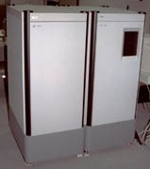
Single Instruction Multiple Data (SIMD) Examples
Vector pipelines
IBM 9000, Cray X-MP, Fujitsu vector processor, NEC SX-2, Hitachi S820, ETA10
Processor arrays
Thinking Machine CM2, MasPar MP-1 & MP-2, ILLIAC IV
Graphics processor units usually use SIMD
←Cray X-MP
←MasPar MP-1

Slide 15
Multiple Instruction Single Data (MISD)
Single data stream fed into multiple processing units
Each processing unit works on data independently via independent instruction streams
Few actual examples of this class of parallel computer have ever existed

Slide 16
Multiple Instruction Single Data (MISD) Example
Possible uses? Somewhat intellectual?
Maybe redundant! (see next slide)
Possible example application:
Different set of signal processing operations working the same signal stream
Example:
Simultaneously find the min and max input, and do a sum of inputs.
A = input
x = +MAXINT
x = -MAXINT
x = 0
If A<x then x = A
If A>x then x = A
x = x + A
…
…
…
CPU 1
CPU 2
CPU 3

Slide 17
Multiple Instruction Multiple Data (MIMD)
The most common type of parallel computer (most late model computers, e.g. Intel Core Duo, in this category)
Multiple Instruction →
Each processor can be executing a different instruction stream
Multiple Data →
Every processor may be working with a different data stream
Execution can be asynchronous or synchronous; non-deterministic or deterministic

Slide 18
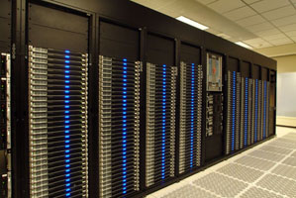
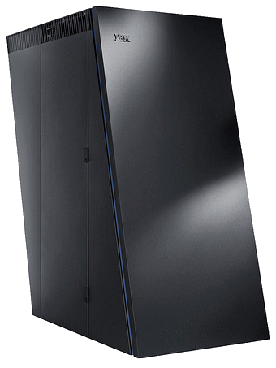
Multiple Instruction Multiple Data (MIMD)
Examples
Many of the current supercomputers
Networked parallel computer clusters
SMP computers
multi-core PCs
MIMD architectures could include all the other models. e.g.,
SISD – just one CPU active, others running NOP
SIMD – all CPUs load the same instruction but apply to different data
MISD – all CPUs load different instructions but apply it to the same data
AMD Opteron
IBM BlueGene

Slide 19
Class Activity
Step 1: choose an application
Consider an application:
Transaction processing
Face recognition
3D graphics rendering
Pattern search (or string search)
Radar
Database queries
Types of architecture models
SISD
Single Instruction Single Data
SIMD
Single Instruction Multiple Data
(1)
(2)
MISD
Multiple Instructions Single Data
MIMD
Multiple Instructions Multiple Data
(3)
(4)
Step 2: which programming model would you like to use?
Step 3: which computer architecture would you use?
Consider the types of programming models:
Sequential / non-parallel
Data parallel model
Message passing model
Shared memory model
Hybrid models
TODO: Work in groups. Follow steps 1-3 shown for a selection of the applications listed in step 1.
We will them vote on the choices.
Your task

Slide 20
Voting for Flynn’s
SQ = Sequential / non-parallel
DP = Data parallel model
MP = Message passing model
SM = Shared memory model
HM = Hybrid models
SISD
Single Instruction Single Data
SIMD
Single Instruction Multiple Data
(1)
(2)
MISD
Multiple Instructions Single Data
MIMD
Multiple Instructions Multiple Data
Click to see my suggested answers…
(3)
(4)
Program | SISD(1) | SIMD(2) | MISD(3) | MIMD(4)
Transaction processing
Face recognition
3D graphics rendering
Pattern search
Radar
Database queries
SQ
MH: SM+MP
SM
DP
MP
(MP)
DP
Many of these are somewhat debatable. In a quiz situation it would probably be a good idea to add comments to your answer motivating your choices.

Slide 21
Thursday planning
2pm : Quiz
3pm : Presentation and discussion of Conceptual Assignment (mini project 1)

Slide 22
Memory Access Architectures
Reading assignment
The remaining slides should be considered a reading assignment. Much of this information mirrors the programming models presented in Lecture 4. The slides that follows are examinable in quizzes/exams.
EEE4084F

Slide 23
Parallel computer memory architectures
The choice of memory architecture is not necessarily dependent on the ‘Flynn classification’
For a SISM computer, this aspect is largely irrelevant (but consider a PC with GPU and DMA as not being in the SISM category)

Slide 24
Shared Memory Architectures
Generally, all processors have access to all memory in a global address space.
Processors operate independently, but they can share the same global memory.
Changes to global memory done by one processor are seen by the other processors.
Shared memory machines can be divided into two types, depending on when memory is accessed:
Uniform Memory Access (UMA) or
Non-uniform Memory Access (NUMA)

Slide 25
Uniform Memory Access (UMA)
Common today in form of Symmetric Multi-Processor (SMP) machines
Identical processors
Equal access and access times to memory
Cache coherent
Cache coherent =
When one processor writes a location in shared memory, all other processors are updated.
Cache coherency is implemented at the hardware level.
CPU
MEMORY
CPU
CPU
CPU

Slide 26
Non-Uniform Memory Access (NUMA)
Not all processors have the same access time to all the memories
Memory access across link is slower
If cache coherency is maintained, then may also be called CC-NUMA - Cache Coherent NUMA
This architecture has two SMPs
connected via a bus. When a CPU on SMP1 needs to access memory connected to SMP2, there will be some form of lag which may be a few times slower than access to SMP1’s own memory.
MEMORY
CPU
CPU
MEMORY
CPU
Interconnect bus
CPU
SMP 1
SMP 2

Slide 27
Shared memory pros & cons
Advantages
Global address space gives a user-friendly programming approach (as discussed in shared memory programming model)
Sharing data between tasks is fast and uniform due to the proximity of memory to CPUs
Disadvantages:
Major drawback: lack of scalability between memory and CPUs.
Adding CPUs can increases traffic on shared memory-CPU path (for cache coherent systems also increases traffic associated with cache/memory management)

Slide 28
Shared memory pros & cons
Disadvantages
Programmer responsible for implementing/using synchronization constructs to make sure that correct access of global memory is done.
Becomes more difficult and expensive to design and construct shared memory machines with ever increasing numbers of processors.

Slide 29
Distributed memory
Similar to shared memory, but requires a communications network to share memory
Local Memory
CPU
Local Memory
CPU
…
Local Memory
CPU
Communications network
Each processor has its own local memory (not directly accessible by the other processors’ memory addresses)
Processors connected via a communication network – the communication network fabric varies; could simply be Ethernet.
Cache coherency does not apply (when a CPU changes its local memory, the hardware does not notify the other processors – if needed the programmer needs to provide this functionality)
Programmer responsible for implementing methods by which one processor can access memory of a different processor.

Slide 30
Distributed Memory: Pros & Cons
Advantages:
Memory scalable with number of processors
Each processor can access own memory quickly without communication overheads or maintaining cache coherency (for UMA).
Cost benefits: use of commercial off-the-shelf (COTS) processors and networks

Slide 31
Distributed Memory: Pros & Cons
Disadvantages:
Programmer takes on responsibility for data consistency, synchronization and communication between processors.
Existing (legacy) programs based on shared global memory may be difficult to port to this model.
May be more difficult to write applications for distributed memory systems than it is for shared memory systems.
Restricted by non-uniform memory access (NUMA) performance (meaning a memory access bottle neck that may be many times slower than shared memory systems)

Slide 32
Distributed Shared Memory (i.e. Hybrid) System
Simply a network of shared memory systems (possibly in one computer or a cluster of separated computers)
Use in many modern supercomputer designs today
Shared memory part is usually UMA (cache coherent)
Pros & Cons? – Best and Worst of two worlds.

Slide 33
End of Lecture

Slide 34
Disclaimers and copyright/licensing details
I have tried to follow the correct practices concerning copyright and licensing of material, particularly image sources that have been used in this presentation. I have put much effort into trying to make this material open access so that it can be of benefit to others in their teaching and learning practice. Any mistakes or omissions with regards to these issues I will correct when notified. To the best of my understanding the material in these slides can be shared according to the Creative Commons “Attribution-ShareAlike 4.0 International (CC BY-SA 4.0)” license, and that is why I selected that license to apply to this presentation (it’s not because I particulate want my slides referenced but more to acknowledge the sources and generosity of others who have provided free material such as the images I have used).
Image sources:
Title slide: California High-Speed Rail - Wikipedia (open commons)
Von Neumann photo - Wikipedia (open commons)
Computer and box clipart – open commons
Chat icon clipart - http://openclipart.org/tags/chat (public domain)
Computer photos - Wikipedia (open commons)
Book clipart drawing slide 22 onwards - Wikipedia (open commons)

