Slide 1




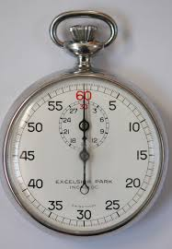
EEE4084F
Digital Systems
Lecture 4:
Timing & Programming Models
Lecturer:
Simon Winberg
Attribution-ShareAlike 4.0 International (CC BY-SA 4.0)

Slide 2
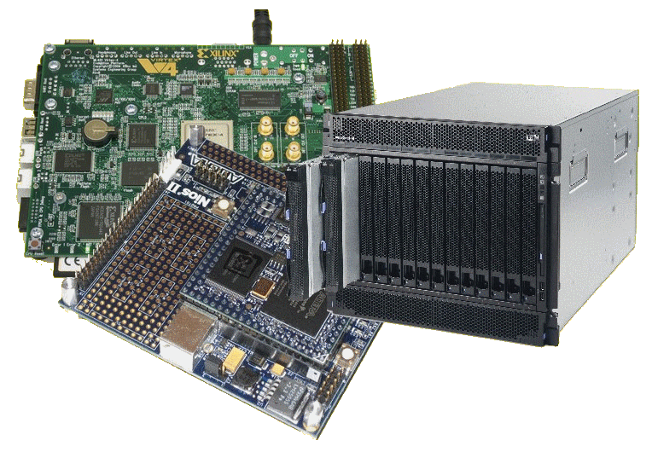
Lecture Overview
Timing in C
Review of homework (scalar product)
Important terms
Data parallel model
Message passing model
Shared memory model
Hybrid model

Slide 3
Prac 1 issues
Makefile: For compiling the program.
blur.c: The file that has the pthreads radial blur code.
serial.c: This file just has the file IO and timing code written for you. You need to implement the median filter.
Develop a para.c version of serial.c to develop your parallel solution.
Report issues…

Slide 4
Prac report
Write a short report (it can be one or two pages) discussing your observations and results.
Show some of the images produced, demonstrating your understanding of the purpose and method of the median filter.
Give a break down of the different timing results you got from the method.
The timing data needs to be shown in a table, with the number of threads on the y-axis and the different processing types on the x-axis.
Also, there needs to be a graph plotting the speed up factor observed versus the ideal speed up.
The ideal speed up would have the speed up factor being perfectly proportional to the processing resource allocation. So if two processors are being used, then the ideal speed up factor would be 200%.
Comment on the results you got, and why you think you got them. Please reference technical factors in justifying your results.
Hand in: Submit report using the Prac01 VULA assignment.
Working in a team of 2? Submit only one report / zip file, name file according to both student numbers.

Slide 5
Seminar
Tue@3pm
Groups
Meeting Title | Date | Status
Seminar Group 2 | Tue, 2014/03/04 | Full
Seminar Group 3 | Tue, 2014/03/11 | Full
Seminar Group 4 | Tue, 2014/03/18 | Full
Seminar Group 5 | Tue, 2014/03/25 | Available
Seminar Group 6 | Tue, 2014/04/01 | Full
Seminar Group 7 | Tue, 2014/04/15 | Available
Seminar Group 8 | Tue, 2014/04/22 | Full
Seminar Group 9 | Tue, 2014/05/06 | Full
Seminar Group 10 | Tue, 2014/05/13 | Full
Thus far…
Looks like everyone has signed up to present a seminar!

Slide 6
Next Seminar Tue@3pm (4-Mar)
Chapters covered
CH1: A Retrospective on High Performance Embedded Computing
CH2: Representative Example of a High Performance Embedded Computing System
Seminar Group:
Arnab, Anurag
Kammies, Lloyd
Mtintsilana, Masande
Munbodh, Mrinal

Slide 7
Review of:
Lecture 3 Class Activity
Sample implementations:
  scalarprod.dev – scalar product sequential implementation
  matmul.dev – matrix multiply sequential implementation
See: TimingCode\TimingExamples
See: ParallelProd

Slide 8

Scalarprod.c
t0 = CPU_ticks(); // get initial tick value
// Do processing ...
// first initialize the vectors
for (i=0; i<VECTOR_LEN; i++) {
a[i] = random_f();
b[i] = random_f();
}
sum = 0;
for (i=0; i<VECTOR_LEN; i++) {
sum = sum + (a[i] * b[i]);
}
// get the time elapsed
t1 = CPU_ticks(); // get final tick value
Golden measure / sequence solution

Slide 9
Parallelizing
There’s obvious concurrency here.
Ideally, it would be nice to do all
these multiplies simultaneously
a₁
b₁
a₁ x b₁
a₂
b₂
a₂ x b₂
a₃
b₃
a₃ x b₃
a₄
b₄
a₄ x b₄

Slide 10
Parallel code program…
Example runs on Intel Core2 Duo, each CPU 2.93GHz
Parallel solution: 3.88
Serial solution: 6.31
Speedup = 6.31/3.88 = 1.63

Slide 11
Scalar product parallel solutions…
&
Introduction to some important terms

Slide 12
Pthreads (partitioned)
Vectors in
global / shared
memory
[a₁ a₂ a₁ a₂ … a_{m-1}]
[b₁ b₂ b₁ b₂ … b_{m-1}]
Thread 1
main()
starts
main()
sum = sum1+sum2
sum1
[a_{m} a_{m+1} a_{m+2} … a_{n}]
[b_{m} b_{m+1} b_{m+2} … b_{n}]
a
b
Thread 2
1
1
sum2
2
2
Assuming a 2-core machine

Slide 13
Pthreads (interlaced*)
Vectors in
global / shared
memory
[a₁ a₃ a₅ a₇ … a_{n-2}]
[b₁ b₃ b₅ b₇ … b_{n-2}]
Thread 1
main()
starts
main()
sum = sum1+sum2
sum1
[a₂ a₄ a₆ … a_{n-1}]
[b₂ b₄ b₆ … b_{n-1}]
a
b
Thread 2
sum2
Assuming a 2 core machine
* Data striping, interleaving and interlacing can mean the same or
quite different approaches depending on your data.

Slide 14
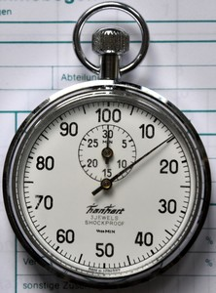
Benchmarking tips
Timing methods have been included in the sample files (alternatively see next slides for other options)
Avoid having many programs running (this may interfere slightly with the timing results)

Slide 15
Windows & Linux Timing
Additional sample code has been providing for high performance timing on Windows and on Linux – tried to find something fairly portable that doesn’t need MSVC++
I’ve only been able to get the Intel high performance timer working on Cygwin (can’t seem to get better than ms on Cygwin)

Slide 16
Some Important Terms
Contiguous
Partitioned (or separated or split)
Interleaved (or alternating)
Interlaced

Slide 17
Programming Models
EEE4084F
Data parallel model
Message passing model
Shared memory model
Hybrid model
Some more terms

Slide 18
Data parallel model
Set of tasks work in parallel on separate parts of a data structure
Sequential version usually a loop, iterating through arrays
Example:
Multiply each element by 2
Initialize:
prepare division of data (may include programming application co-processors)
Communicate:
(Engage threads and/or co-processors, give instructions)
Perform parallel computations on ‘own’ data
Combine results
Possible parallel implementation

Slide 19
Data parallel characteristics
Most of the parallel work focused on doing operations on a data set.
Data set is organized into a ‘common structure’, e.g., multidimensional array.
Group of tasks (threads / co-processors) work concurrently on the same data structure, but each works on a different partition of the data structure.
Tasks perform the same operation on ‘their part’ of the data structure.

Slide 20
Data parallel characteristics
For shared memory architectures, all tasks often have access to the same data structure through global memory.
(you probably did this with Pthreads in Prac1!!)
For distributed memory architectures the data structure is split up and resides as ‘chunks’ in local task/machines
(OpenMP programs tends to use this method together with messages indicating which data to use)

Slide 21
Data parallelism pros & cons
Can be difficult to write, to identify how to divide up the input and later join up the results…
  Consider for i = 1..n: x[i]=x[i] + 1
    Simple for shared mem. machine, difficult (if not pointless) for distributed machine
But can also be very easy to write – even embarrassingly parallel
Can be easy to debug (all threads running the same code)

Slide 22
Data parallelism pros & cons
Communication aspect often easier to deal with, as each process has the same input and output interfaces
Each thread/task usually runs independently without having to wait on answers (synchronization) from others.

Slide 23
Message Passing (MP) model
Involves a set of tasks that use their own local memory during computations
Multiple tasks can run on the same physical machine, or they could run across multiple machines
Tasks exchange data by sending and receiving communication messages
Transfer of data usually needs cooperative or synchronization operations to be performed by each process, i.e., each send operation needs a corresponding receive operation.

Slide 24
Message Passing (MP) model
Parallelized software applications using MP usually make use of a specialized library of subroutines, linked with the application code.
Programmer is entirely responsible for deciding and implementing all the parallelism.
Historically, a variety of message passing libraries have been available since the 1980s. These implementations differed substantially from each other making it difficult for programmers to develop portable applications.

Slide 25
Message passing implementations
The MPI Forum was formed in 1992, with the goal of establishing a standard interface for message passing implementations, called the “Message Passing Interface (MPI)” – first released in 1994

Slide 26
Message passing implementations
MPI is now the most common industry standard for message passing, and has replaced many of the custom-developed and obsolete standards used in legacy systems.
Most manufacturers of (microprocessor-based) parallel computing platforms offer an implementation of MPI.
For shared memory architectures, MPI implementations usually do not use the network for inter-task communications, but rather use shared memory (or memory copies) for better performance.

Slide 27
Shared Memory Model
Tasks share a common address space, read from and written to asynchronously.
Memory control access is needed (e.g., to cater for data dependencies), such as:
  Locks and semaphores to control access to shared memory.
In this model, the notion of tasks ‘owning’ data is lacking, so there is no need to specify explicitly the communication of data between tasks.

Slide 28
Shared Memory Model pros and cons
Adv: often allows program development to be simplified (e.g. compared to MP).
Adv: Keeping data local to processor working on it conserves memory accesses (reducing cache refreshes, bus traffic and the like that occurs when multiple processors use the same data).
Disad: tends to become more difficult to understand and manage data locality, which may detract from the overall system performance.

Slide 29
Hybrid model
This simple involves a combination of any two or more of the parallel programming models described.
A commonly used hybrid model is the combination of message passing with either POSIX threads. This hybrid model is well suited to the increasingly popular clustering of SMP machines.

Slide 30
Hybrid model
Another increasingly used hybrid model is the combination of data parallelism and message passing. E.g., using a cluster of SMPs each with their own FPGA-based application accelerator or co-processor.

Slide 31
Classic techniques
Single Program Multiple Data (SPMD)
  Consider it as running the same program, on different data inputs, on different computers (possibly) at the same time
Multiple Program Multiple Data (MPMD)
  Consider this one as running the same program with different parameters settings, or recompiling the same code with different sections of code included (e.g., uisng #ifdef and #endif to do this)

Slide 32

Some terms
Observed speedup =
Parallel overhead:
  Amount of time to coordinate parallel tasks (excludes time doing useful work).
  Parallel overhead includes operations such as: Task/co-processor start-up time, Synchronizations, communications, parallelization libraries (e.g., OpenMP, Pthreads.so), tools, operating system, task termination and clean-up time
Wallclock time initial version
Wallclock time sequential (or gold)
=
Wallclock time refined version
Wallclock time parallel version

Slide 33
Some terms
Embarrassingly Parallel
  Simultaneously performing many similar, independent tasks, with little to no coordination between tasks.
Massively Parallel
  Hardware that has very many processors (execution of parallel tasks). Can consider this classification of 100 000+ parallel tasks.

Slide 34
Next lecture…
Parallel architectures
Reminder – Quiz 1 Next Thursday

Slide 35
Disclaimers and copyright/licensing details
I have tried to follow the correct practices concerning copyright and licensing of material, particularly image sources that have been used in this presentation. I have put much effort into trying to make this material open access so that it can be of benefit to others in their teaching and learning practice. Any mistakes or omissions with regards to these issues I will correct when notified. To the best of my understanding the material in these slides can be shared according to the Creative Commons “Attribution-ShareAlike 4.0 International (CC BY-SA 4.0)” license, and that is why I selected that license to apply to this presentation (it’s not because I particulate want my slides referenced but more to acknowledge the sources and generosity of others who have provided free material such as the images I have used).
Image sources:
Stop watch slides 1 & 14, Gold bar: Wikipedia (open commons)
books clipart: http://www.clker.com (open commons)

