Slide 1




EEE4084F
Digital Systems
Lecture 3:
Towards Prac1, Golden Measure, Temporal and Spatial Computing, Benchmarking
Lecturer:
Simon Winberg
Attribution-ShareAlike 4.0 International (CC BY-SA 4.0)

Slide 2
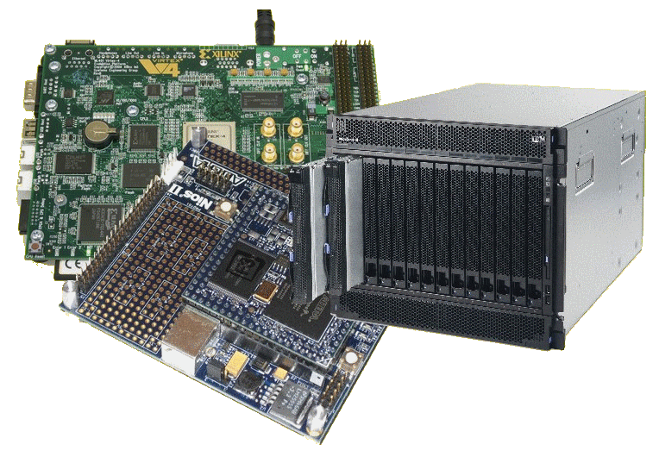
Lecture Overview
Prac Issues
Seminar planning
Temporal & spatial computing
Benchmarking
Power
BTW: Quiz 1 NEXT Thursday!
Licensing details last slide

Slide 3

Seminar Planning
Each seminar run by a seminar group
Everyone to read each assigned reading
  Recommend: make notes to self (or underlining/highlight important points – if you want to resell your book, don’t do this)
  Write down questions or comments (classmates running the seminar would probably welcome these)

Slide 4


Seminar Planning
Your seminar needs to include:
  3x important take-home messages (of which students will hopefully remember at least 1)
  1x point did you
  collectively decided was most interesting
message
Extra Seasoning: you’re by all means welcome to do tasks or surveys, handouts, etc, that may encourage participation and/or benefit your classmates’ learning experience.

Slide 5
Seminar presentation timing & marking guide
Structure of Seminar Presentation | Mark
Introduction of group and topic (~1 min) | 5
Summary presentation (~10 min) | 20
Visual aids / use of images / mindmaps / etc. | 20
Reflections (5 – 10 min) Including group’s viewpoints / comments / critique | 15
Facilitation and direction of class discussion & response to questions (10 min) | 15
Quality of questions posed by the presenters | 10
Wrapping up / conclusion (2 min) | 5
Participation of all members | 10
TOTAL: | 100
Look for the Seminar Marking Guide under resources

Slide 6
Forming Seminar Groups
30 students
  About 10 seminars (excl. tomorrow’s)
  Groups to be determined
Use Sign-Up in Vula to specify your group members (prefer 3 students per group, max. 4)

Slide 7
Prac 1 Issues
EEE4084F Digital Systems

Slide 8
Prac 1
Procedure:
  Develop / study algorithm
  Implementation
  Performance test
    Initially “feel-good” conformation (graphs, etc)
    Then speed, memory, latency, etc comparisons with the “golden measure”

Slide 9
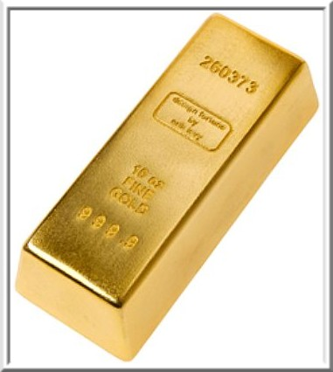
Terms
Golden measure:
  A (usually) sequential solution that you develop as the ‘yard stick’
  A solution that runs slowly, isn’t optimized, but you know it gives an excellent result
  E.g., a solution written in OCTAVE or MatLab, verify it is correct using graphs, inspecting values, checking by hand with calculator, etc.

Slide 10
Terms
Sequential / Serial (serial.c)
  A non-parallized code solution
Generally, you can call your code solutions parallel.c (or para1.c, para2.c if you have multiple versions)
You can also include some test data (if it isn’t too big, <1Mb), e.g. gold.csv or serial.csv, and paral1.csv

Slide 11
Part A and B of the Pracs
Part A
  Example program that helps get you started quicker
  e.g., PartA of Prac1 gives a sample program using Pthreads and loading an image
Part B
  The main part, where you provide a parallelized solution

Slide 12
Prac Reports
Reports should be short!
  Pref. around one or two pages long (could add appendices, e.g., additional screenshots)
  Discussing your observations and results.
  Prac num, Names & student num on 1st page
Does not need to be fancy (e.g. point-form OK for prac reports)
Where applicable (e.g. for Prac1), you can include an image or two of the solution to illustrate/clarify the discussion

Slide 13

Prac Reports
Very important:
  Show the error stats and timing results you got.
  Use standard deviation when applicable
    You may need to be inventive in some cases (e.g., stddev between two images)
  I want to see the real time it took, and
  The speedup factor for the different methods and the types of tests applied
u = average X
speedup =
T_{p1} / T_{p2}
T_{p1} = Original non-parallel program
T_{p2} = Optimized or parallel program

Slide 14
Temporal and Spatial Computation
Temporal Computation
Spatial Computation
The traditional paradigm
Typical of Programmers
Things done over time steps
Suited to hardware
Possibly more intuitive?
Things related in a space
A = input(“A= ? ”);
B = input(“B =? ”);
C = input(“B multiplier ?”);
X = A + B * C
Y = A – B * C
Y !
A?
-
C?
+
*
Which do you think is easier to make sense of?
X !
B?
Can provide a clearer indication of relative dependencies.

Slide 15
“Extracting concurrency”
Being able to comprehend and extract the parallelism, or properties of concurrency, from a process or algorithm is essential to accelerating computation
The Reconfigurable Computing (RC) Advantage:
  The computer platform able to adapt according to the concurrency inherent in a particular application in order to accelerate computation for the specific application

Slide 16
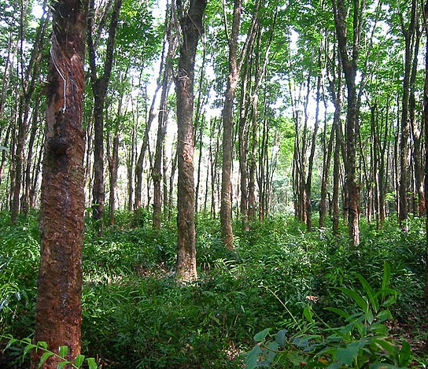
Performance Benchmarking
“Don’t loose sight of the forest for the trees…”
Generally, the main objective is to make the system faster, use less power, use less resources…
Most code doesn’t need to be parallel.
Important questions are…

Slide 17

Important questions
Should you bother to design a parallel algorithm?
Is your parallel solution better than a simpler approach, especially if that approach is easier to read and share?
Major telling factor is:
Real-time performance measure
Or “wall clock time”

Slide 18
Wall clock time
Generally most accurate to use built in timer, which is somehow directly related to real time (e.g., if the timer measures 1s, then 1s elapsed in the real world)
Technique:
  unsigned long long start; // store start time
  unsigned long long end; // store end time
  start = read_the_timer(); // e.g. time()
  DO PROCESSNG
  end = read_the_timer(); // e.g. time()
  .. Output the time measurement (end-start), or save it to an array if printing will interfere with the times. Note: to avoid overflow, used unsigned vars.
See file:
Cycle.c

Slide 19

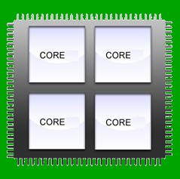
Power concerns
(a GST perspective)

Slide 20
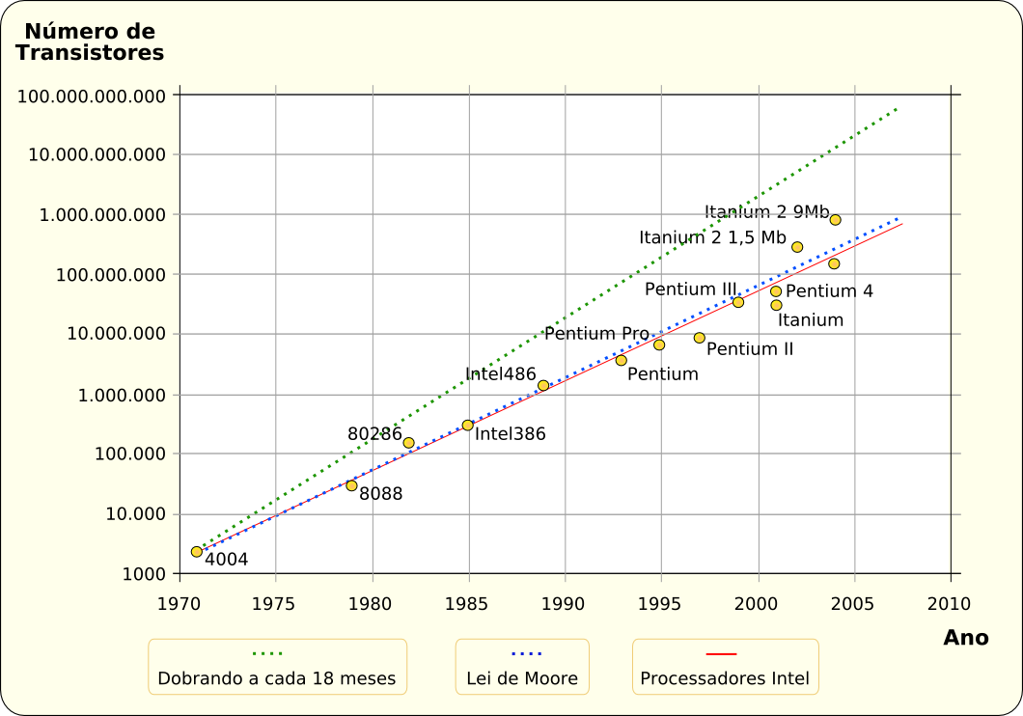
Computation Design Trends
For the past decades the means to increase computer performance has been focusing to a large extent on producing faster software processors.
This included packing more transistors into smaller spaces.
Moore’s law has been holding pretty well… when measured in terms of transistors (e.g., doubling number of transistors)
But this trend has drawbacks, and seems to be slowing…
Intel performance graph

Slide 21
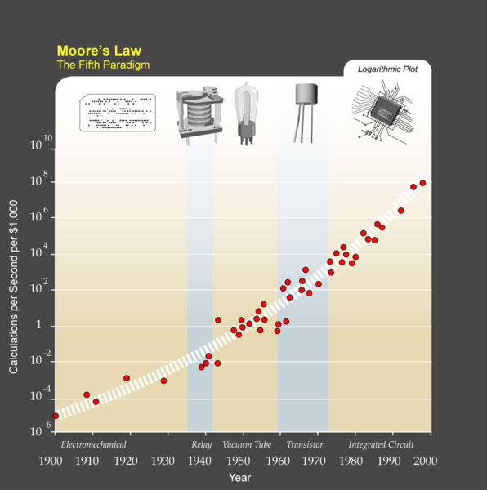
Calculation
per seconds per 1k$
Over time trend

Slide 22
Illustration of demand for computers (Intel perspective)
Source:
alphabytesoup.files.wordpress.com/2012/07/computer-timeline.gif
slide 22 - demand for computers.jpg
(unknown license)

Slide 23
Computation Design Trends – Power concerns
Processors are getting too power hungry! There’s too many transistors that need power.
Also, the size of transistors can't come down by much – it might not be possible to have transistors smaller than a few atoms! And how would you connect them up?
A dual core Intel system with GPU, LCD monitor
draws about 220 watts
Slide 22 - Power over time.jpg
Projections obviously we’ve seen the reality isn’t as bad
Now tending to multi-core processors.. Sure it can double the transistors every 2-3 years (and the power). But what of performance?

Slide 24
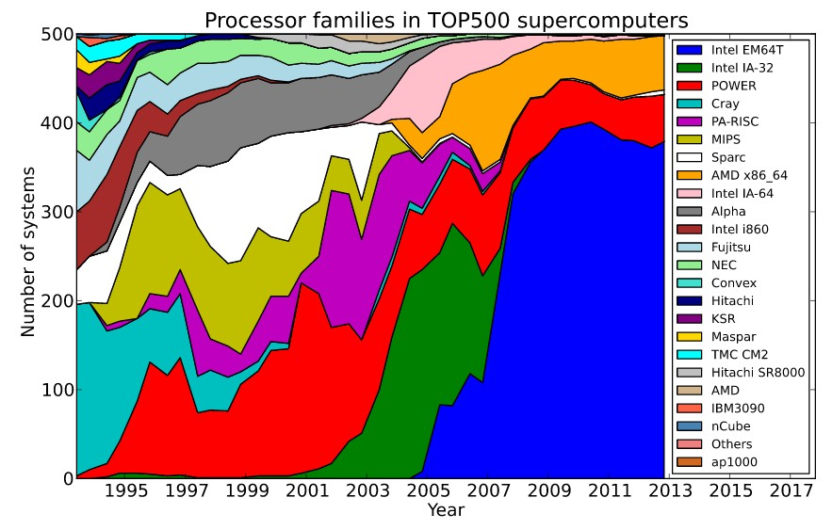
Image source: http://commons.wikimedia.org/wiki/File:Processor_families_in_TOP500_supercomputers.svg

Slide 25
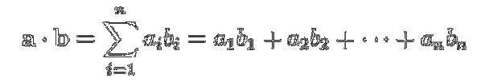
Class activity / take-home assignment
Matrix operations are commonly used to demonstrate and teach parallel coding
The scalar product (or dot product) and Matrix multiply are the ‘usual suspects’
Vector scalar product
Matrix multiplication
C_{i,j} =  A_{i,k} B_{k,j}
Both of these operations can be successfully
Implemented as deeply parallel solutions.
k

Slide 26
Class activity / take-home assignment
Attempt a pseudo code solution for parallelizing both the:
  Scalar vector product algorithm and the
  Matrix multiplication algorithm
Assume you would want to implement your solution in C (i.e. your pseudo code should follow C-type operations)
Next consider how you would do it in hardware on a FPGA (draw schematic)
If time is too limited, just try the scalar product. If you have more time, and are
real keen, the by all means experiment with writing and testing real code to see
that your suggested solution is valid.

Slide 27
Suggested function prototypes
Scalar product:
  float scalarprod (float* a, float* b, int n)
  {
  // a,b = input vectors of length n
  // Function returns the scalar product
  }
Matrix multiply:
  void matrix_multiply (float** A, float** B, float** C, int n)
  {
  // A,B = input matrices of size n x n floats
  // C = output matrix of size n x n floats
  }

Slide 28

Scalarprod.c
t0 = CPU_ticks(); // get initial tick value
// Do processing ...
// first initialize the vectors
for (i=0; i<VECTOR_LEN; i++) {
a[i] = random_f();
b[i] = random_f();
}
sum = 0;
for (i=0; i<VECTOR_LEN; i++) {
sum = sum + (a[i] * b[i]);
}
// get the time elapsed
t1 = CPU_ticks(); // get final tick value
Golden measure / sequence solution

Slide 29
Next lecture
Thursday lecture
  Timing
  Programming Models

Slide 30
Disclaimers and copyright/licensing details
I have tried to follow the correct practices concerning copyright and licensing of material, particularly image sources that have been used in this presentation. I have put much effort into trying to make this material open access so that it can be of benefit to others in their teaching and learning practice. Any mistakes or omissions with regards to these issues I will correct when notified. To the best of my understanding the material in these slides can be shared according to the Creative Commons “Attribution-ShareAlike 4.0 International (CC BY-SA 4.0)” license, and that is why I selected that license to apply to this presentation (it’s not because I particulate want my slides referenced but more to acknowledge the sources and generosity of others who have provided free material such as the images I have used).
Image sources:
Gold bar: Wikipedia (open commons)
IBM Blade (CC by 2.0) ref: http://www.flickr.com/photos/hongiiv/407481199/
Takeaway, Clock, Factory and smoke – public domain CC0 (http://pixabay.com/)
Forrest of trees - NonCommercial-ShareAlike 2.0 Generic (CC BY-NC-SA 2.0)
Moore’s Law graph, processor families per supercomputer over years – all these creative commons, commons.wikimedia.org

