Slide 1


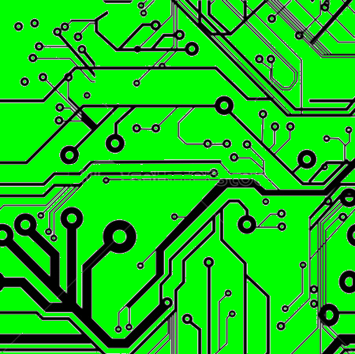
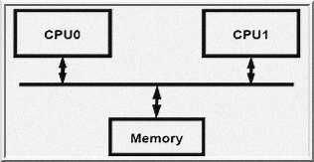
EEE4084F
Digital Systems
Lecture 2:
Parallel Computing Fundamentals
Presented by
Simon Winberg
(planned for double period)

Slide 2
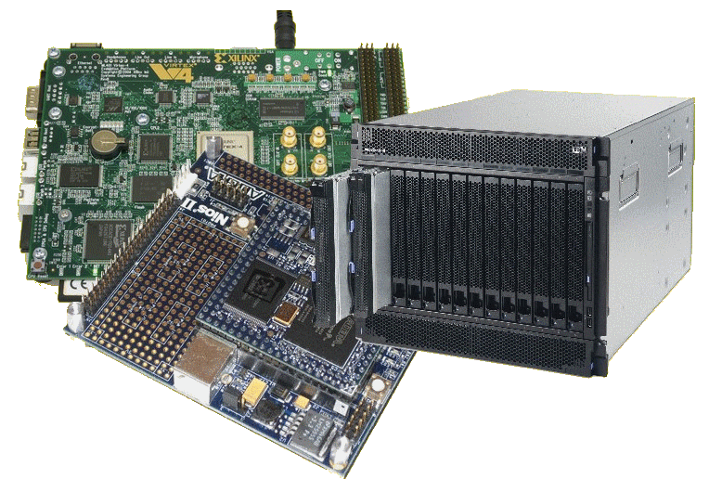
Lecture Overview
Review of quiz 0
UML blurb
Parallel computing fundamentals
Automatic parallelism
Performance
benchmarking
Trends

Slide 3

Quiz 0 Review…
29 students wrote the quiz

Slide 4
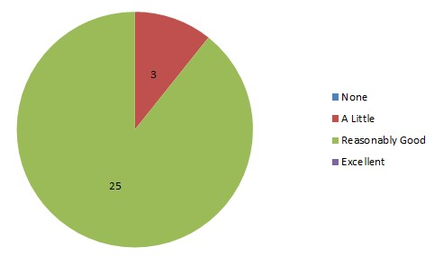
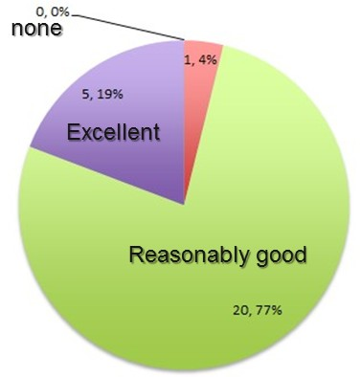
Quiz0 review: Q1
How good is your VHDL? (tick answer)
[1] None [2] A little [3] Reasonably good [4] Excellent
A little
None: 0%
Excellent: 0%
11%
Reasonably good
89%
This year
2013
2012

Slide 5
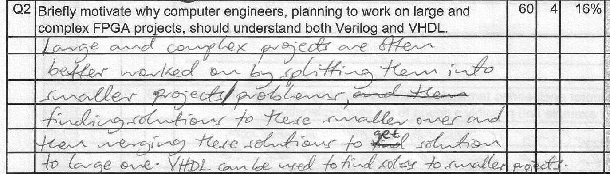
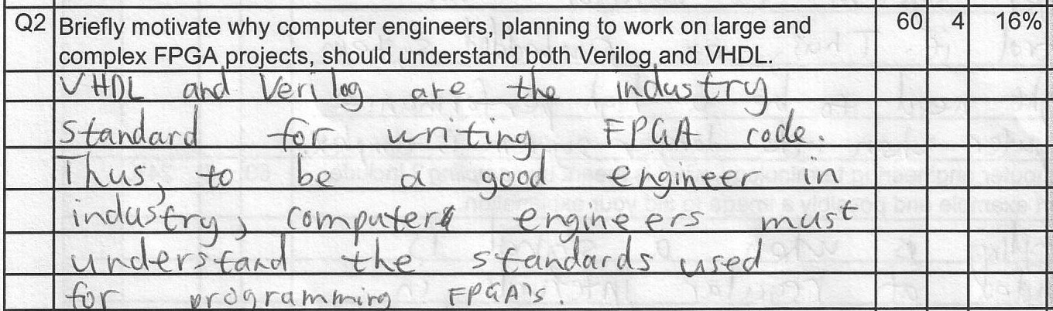
Quiz0 review: Q2 (2012)
Q2 Briefly motivate why computer engineers, planning to work on large and complex FPGA projects, should understand both Verilog and VHDL.
Bla Bla. Starts interesting, but
how relevant is this to the question?
My thoughts…
Sounds pretty good ☺
My thoughts…

Slide 6
Quiz0 review: Q2
Q2 Briefly motivate why computer engineers, planning to work on large and complex FPGA projects, should understand both Verilog and VHDL.
Now you’re talking
big savings & benefits
Answer:
The main reason is reuse. Reusing existing gateware devices. For example, there might be an excellent digital filter out there on the web (e.g. opencores) that does almost what you want; but it’s in Verilog instead of your favorite VHDL. So you have to either start from scratch or learn Verilog.

Slide 7
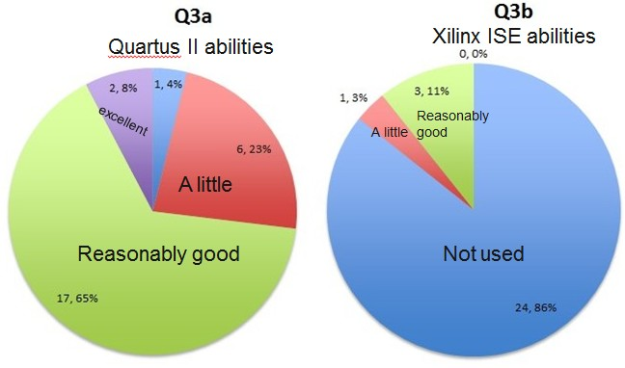
Quiz0 review: Q3
Have you used Altera Quartus II? Or Xilinx ISE? Check appropriate boxes.
excellent
2014
A little
A little
Not used
Reasonably good
(i.e. almost everyone has used it)
2013
2012
2013

Slide 8
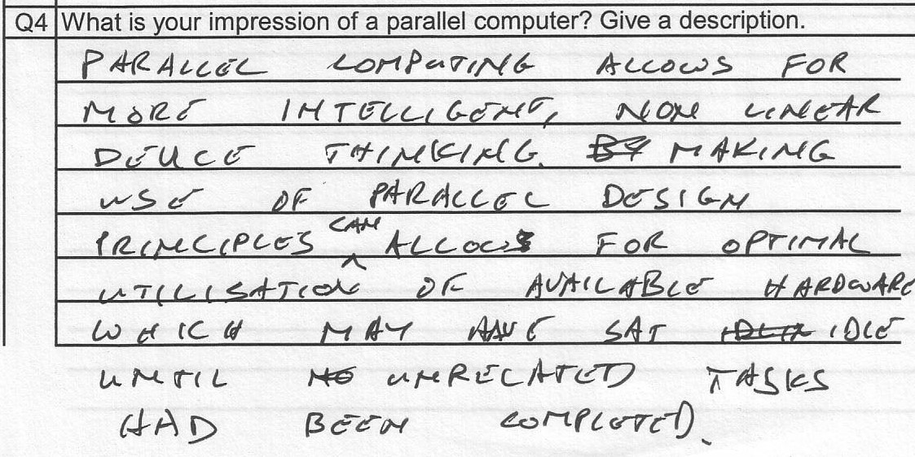

Quiz0 review: Q4
More ‘intelligence’?!
My cellphone is probably as intelligent as my PC… as in not at all intelligent based on the turning test. Heading into troubled waters here
My thoughts?...
Close! But no cigar ☹

Slide 9
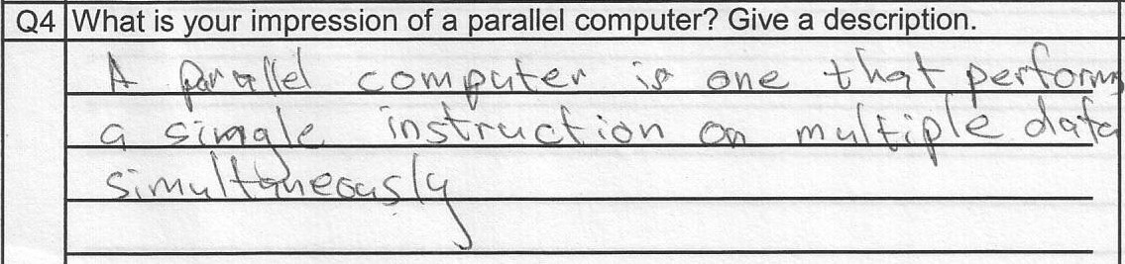
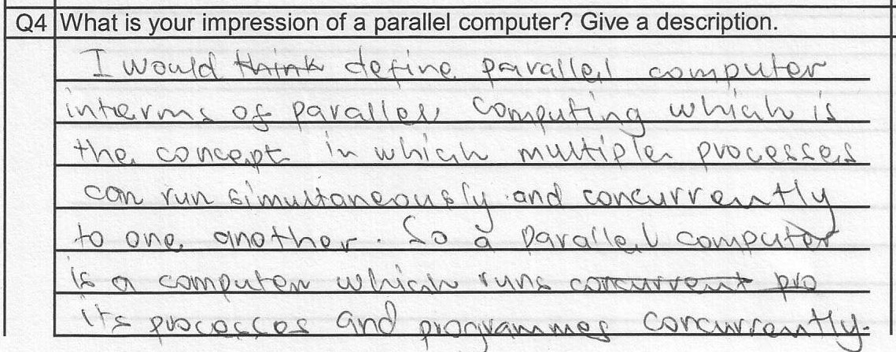
Quiz0 review: Q4
Not precisely… That’s a special case
Pretty good, if a
bit wordy
I’d be happy with something clear & general. E.g.:
It is a computer that is able to perform multiple computations in parallel.
Suggested sample answer…

Slide 10
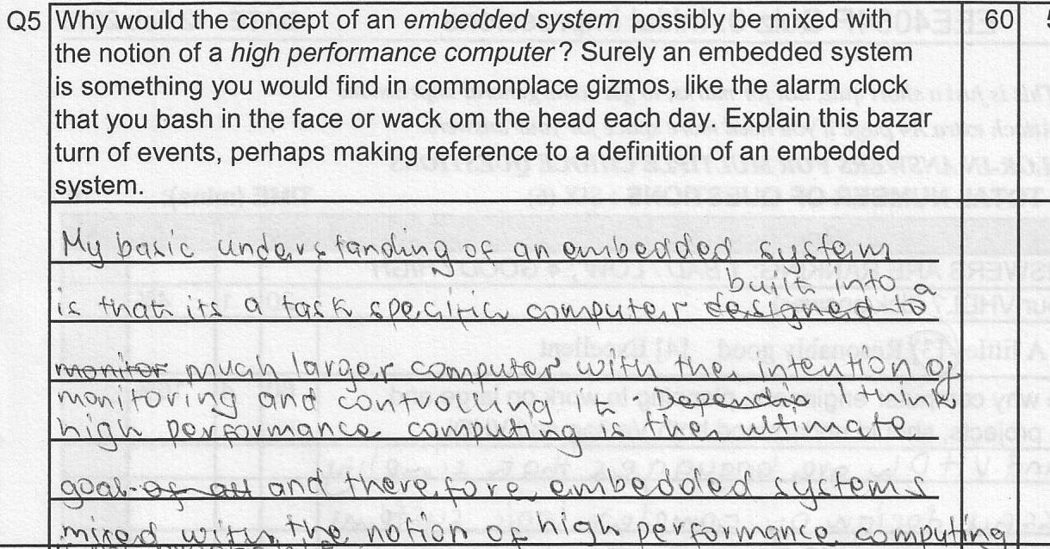
Quiz0 review: Q5
The story seems on the right track; don’t
really find it all that clear.
My thoughts on the topic: high performance computers are becoming more task-specific – the trend is moving away from supercomputers for general applications, towards platforms that are more custom-designed (or tailored) to a particular domain of application (or even to a specific application – e.g., reconfigurable computing platforms).
My thoughts…

Slide 11
Question 6
Good:
HPC system can be in the form of an embedded system: its special purpose, must be fast, real-time, and perform tasks concurrently.
An HPC with a well defined task can be optimised for that task - hence akin to an embedded system.
Bad:
An embedded system can be very complex, such as a HPC placed into a bigger system, still making it embedded.
HPCs are trending towards embedded systems because they are becoming more task specific.
To enhance performance and increase functionality (?)

Slide 12
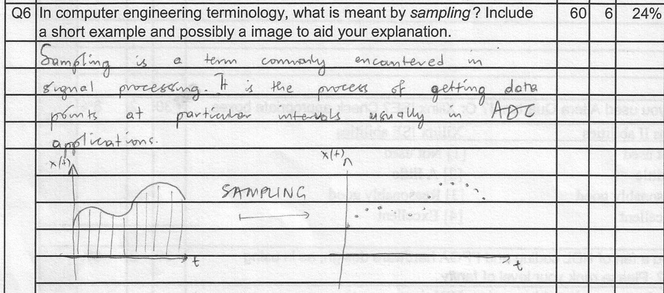
Quiz0 review: Q6
In computer engineering terminology, what is meant by sampling? Include a short example and possibly a image to aid your explanation.
A student’s answer…
Pretty good!!
my description …

Slide 13
Quiz0 review: Q6
In computer engineering terminology, what is meant by sampling? Include a short example and possibly a image to aid your explanation.
Sampling, used by computer engineers, typically refers to the process of digitizing an analogue signal, or looking at discrete instances of a continuous signal. A sample is basically a value or set of related values representing an instance in time of an analogue/real event. Usually a fixed sample period is used.
a sample
Analogue / real signal
time
sample period

Slide 14
UML Review*
General errors that student often make:
  Not using the UML syntax (at all)
    Block and line models, things like flowcharts
  Using the UML syntax wrongly
    Invalid modelling constructs (i.e., wrong type of connectors / associations and blocks)
    Vague models
    Insufficient information
Some examples of common mistakes…
* No longer a UML assessment in Quiz0 due to time constraints

Slide 15
UML demonstration
Look at this if your UML
understanding is lacking.
Task: Produce a UML model describing the products and people related to Joe Baggits, according to the description below.
JOE'S STORY:
Joe Baggits is a developer in the Construction Division of Freezit Commerial Products (FCP) Pty. Ltd. The FCP corporation produces a variety of Cooling systems, grouped into two product ranges, namely: 1) the portafrige range and 2) the coolzone range. The portafrige range includes the Icecart™ and the Chillblock™. Coolzone range includes the ShopFrige™ and Coolroom™. Andy Wrapp is also a developer in the Construction Division and is Joe's manager. Joe works on portafridge products, whereas Andy works on coolzone products.

Slide 16
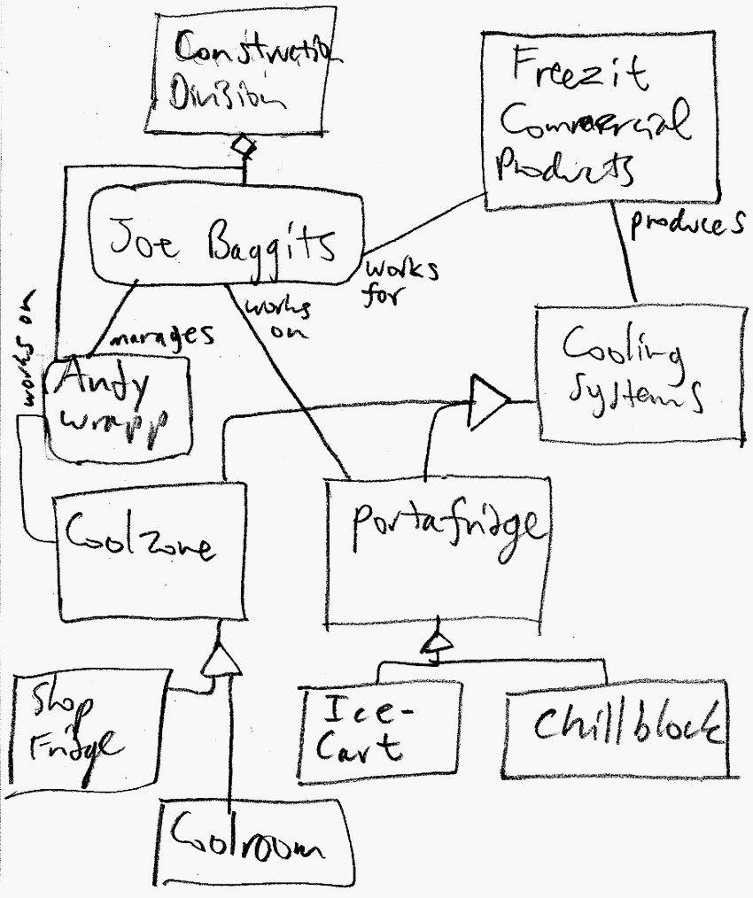
Sample
Solution
Notice use of roles, aggregation and inheritance.
In this situation, it is handy to use objects instead of classes to clearly capture things that exist as physical entities (e.g., the people)

Slide 17


Containment
vs.
Aggregation
Container
Group
Container has solid diamond
Aggregation has outline diamond
n
Arity next to item
(not next to container)
n
Item in the container
Item in the group

Slide 18
Super fast class exercise
(for Thurs double)
Briefly describe the following as a UML diagram:
A new computer system called PMB (Parallel Multicore Beast) contains eight CPUs and two blocks of 8Gb memory. It can run multiple programs from its built-in Linux O/S. Each program can spawn multiple threads. The programs each contain one or more data blocks.
Take around 5 minutes to draw a rough UML class diagram

Slide 19
Sample solution
A new computer system called PMB (Parallel Multicore Beast) contains eight CPUs and two blocks of 8Gb memory. It can run multiple programs from its built-in Linux O/S. Each program can spawn multiple threads. The programs each
contain one or
more data blocks.
PMB
2
8GB Memory
8
Linux
CPU
Assumptions:
Threads are contained in a program, and there must be at least one thread in a program.
By stating Linux is built-in it indicates that this O/S is an instrumental non-optional aspect so this is probably more a containment relation than an aggregation.
*
Program
1..*
Thread
1..*
Data block

Slide 20
Parallel Systems
Y !
A?
-
C?
+
*
X !
B?
EEE4084F: Digital Systems

Slide 21



Question:
Do you sometimes feel that despite
having a wizbang multicore PC,
it still just isn’t keeping up well
with the latest software demands?...
…
Anyone else beside me feel that way?
Major software
Processor cores

Slide 22



It may be so because your software isn’t designed to leverage the full potential of the available hardware.
CPUs at idle

Slide 23
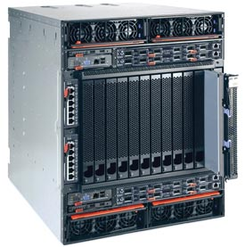
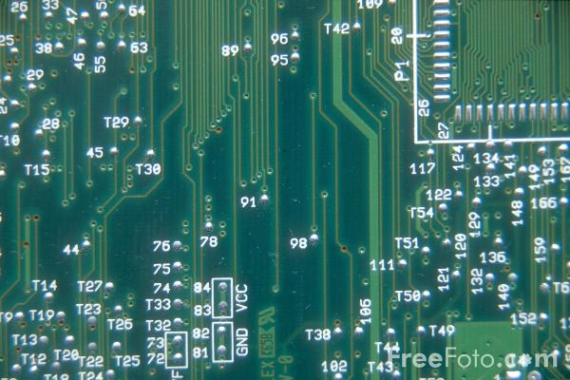
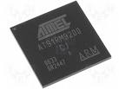
Computation Methods
Hardware
Reconfigurable
Computer
Software
Processor
E.g. PCBs, ASICs
Advantages:
High speed & performance
Efficient (possibly lower
power than idle proc.)
Parallelizable
Drawbacks:
Expensive
Static (cannot change)
E.g. IBM Blade, FPGA-based
computing platform
Advantages:
Faster than software alone
More flexible than software
More flexible than hardware
Parallelizable
Drawbacks:
Expensive
Complex
(both s/w
& h/w)
E.g. PC, embedded software on microcontroller
Advantages:
Flexible
Adaptable
Can be much cheaper
Drawbacks:
The hardware is static
Limit of clock speed
Sequential
processing

Slide 24
Intermission

Slide 25
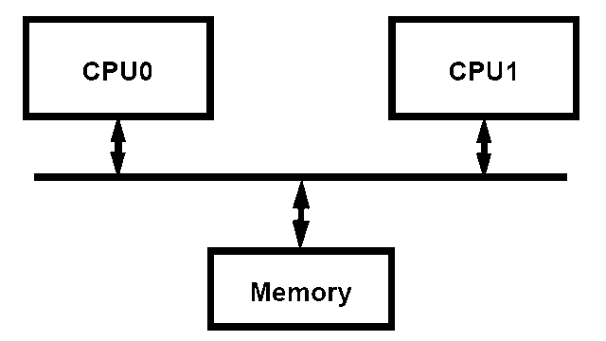
Mainstream parallel computing
Most server class machines today are:
  PC class SMP’s (Symmetric Multi-Processors *)
  2, 4, 8 processors - cheap
  Run Windows & Linux
Delux SMP’s
  8 to 64 processors
  Expensive:
  16-way SMP costs ≈ 4 x 4-way SMPs
Applications: Databases, web servers, internet commerce / OLTP (online transaction processing)
Newer applications: technical computing, threat analysis, credit card fraud...
SMP offers all processors and memory on a common front side bus (FSB –bus that connects the CPU and motherboard subsystems).
* Also termed “Shared Memory Processor”

Slide 26
Large scale parallel computing systems
Hundreds of processors, typically built as clusters of SMPs
Often custom built with government funding (costly! 10 to 100 million USD)
  National / international resource
  Total sales tiny fraction of PC server sales
Few independent software developers
Programmed by small set of majorly smart people

Slide 27
Large scale parallel computing systems
Some applications
  Code breaking (CIA, FBI)
  Weather and climate modeling / prediction
  Pharmaceutical – drug simulation, DNA modeling and drug design
  Scientific research (e.g., astronomy, SETI)
  Defense and weapons development
Large-scale parallel systems are often used for modelling

Slide 28

Software development for parallel computers
Important software sections
(frequently run sections) usually hand-crafted (often from initial sequential versions) to run on the parallel computing platform
Why this happens:
  Parallel programming is difficult
  Parallel programs run poorly on sequential machines (need to simulate them)
  Automatic parallelization difficult (& messy)
Leads to high utilization expenses

Slide 29

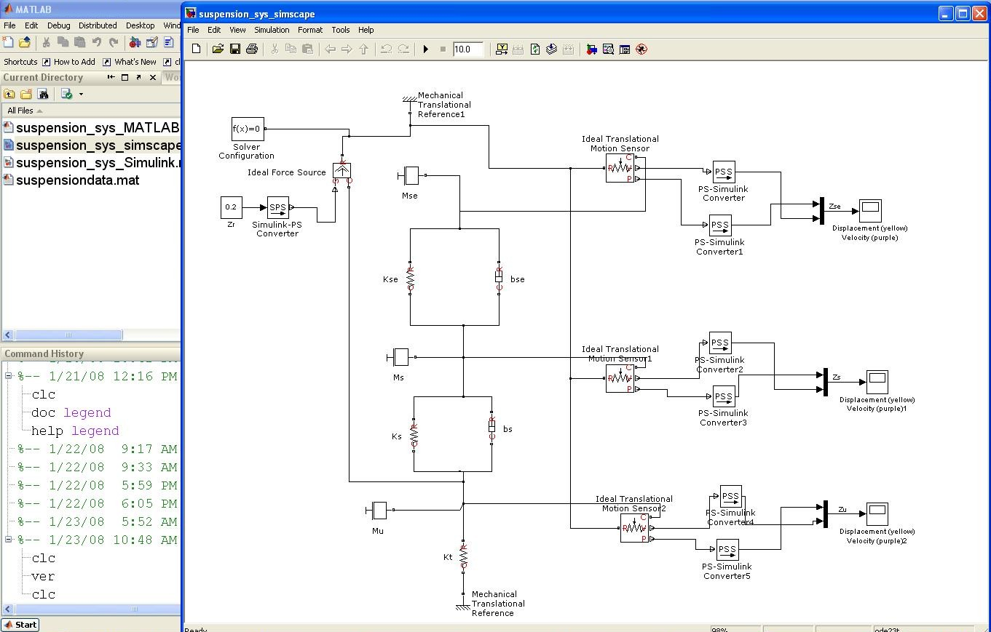
Do parallel languages and compilers exist?
Yes!
… some other examples…

Slide 30
Do parallel languages and compilers exist?
Yes!
  MatLab, Simulink, SystemC, UML*,
  NESL** and others
“Automatic parallelization”:
  Def: converting sequential code into multi-threaded or vectorised code (or both) to utilize multiple processors simultaneously (e.g., for SMP machine)
  … short powwow on the topic…
Try interactive tutorial on: http://www.cs.cmu.edu/~scandal/nesl/tutorial2.html
* Model-Driven Development using case tools, e.g. Rhapsody for RT-UML

Slide 31

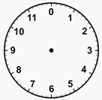
Powwow* moment
Consult the four winds, and your neighbouring classmates, as to:
Why is it probably not easy to automate conversion from sequential code (e.g. BASIC or std C program) to parallel code?
HINT: Perhaps start by clarifying the difference between sequential and parallel code.
TIME
UP
Time
limit
Next slide provides some reasons...
PS: You’re also welcome to get up, stretch, move about, infiltrate a more intelligent-looking tribe, and so on. Note approx. 5 min. time limit!
* It’s a term from North America's Native people used to refer to a cultural gathering.

Slide 32

Return from the
Powwow
What the winds decree…

Slide 33

Some thoughts
On why is it probably not easy to automate conversion from sequential code (e.g. BASIC or C) to parallel code.
Difficulty in figuring out data dependencies
Deciding when to implement semaphores and locks
What the wind has
to say…
How to split-up a loop into parallel parts
Timing issues
Deciding how to break-up data to distribute
Data hazards
When code needs to block and when not
Figuring out timing dependencies
Having to convert clocks of statements
or functions in inter process calls

Slide 34
Why automatic parallelism isn’t “quite there yet”
Accumulation of 30+ years of research…
Only limited success in parallelism detection and program transformations
  Instruction-level parallelism at the basic-block level (e.g., pipelining of instructions)
  Parallelism in nested for-loops containing arrays with simple index expressions
  Analysis methods: data dependence analysis, pointer analysis, abstraction back to more optimized implementation, flow analysis

Slide 35
Why automatic parallelism isn’t “quite there yet”
Main reasons (user perspective):
  Tends to take too long.
  Tend to be too fragile (i.e., breaks down after small changes to the code).
  Tends to miss many things a human would notice and provide an effective solution for, i.e., human intellect, underlying knowledgeable of the application, and trained to write and problem-solve parallel code.
So: Instead of training compilers to recognize parallelism, people are being trained to write parallel code (i.e., no “middle man” approach).

Slide 36
Seminar Groups
Try to start on formalizing groups
Group | Date | Members | Chapter
 | TERM1 | Microprocessor-based parallel systems
1 | 25 Feb 2014 | S. Winberg (done by lecturer) | The landscape of parallel computing research: a view from Berkeley
2 |  |  | CH1 A Retrospective on High Performance Embedded Computing and CH2Representative Example of a High Performance Embedded Computing System
3 |  |  | CH3 System Architecture of a Multiprocessor System
4 |  |  | CH5 Computational Characteristics of High Performance Embedded Algorithms and Applications (optional additional reading: CH15 Performance Metrics and Software Architecture)
5 |  |  | CH13 Computing Devices
 | TERM2 | FPGA / Reconfigurable parallel systems
6 |  |  | CH9 Application-Specific Integrated Circuits and CH10 Field Programmable Gate Arrays
7 |  |  | CH7 Analog-to-Digital Conversion
8 |  |  | CH14 Interconnection Fabrics
9 |  |  | CH24 Application and HPEC System Trends NOTE: this last seminar is on a Thursday as the Tues is a holiday
10 |  |  | CH20 Radar Applications (probably discard)
Will be posted as
Sign-up on Vula

Slide 37
Next lecture
Moore’s law and related trends, from a high performance computing angle
Discussion of Prac1 & Pthreads
Conceptual Assignment planning
Finalizing Seminar Groups
Benchmarking, etc.
No quiz next week

