Slide 1
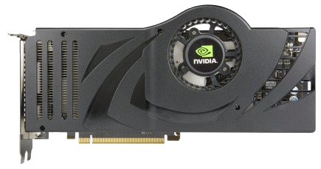
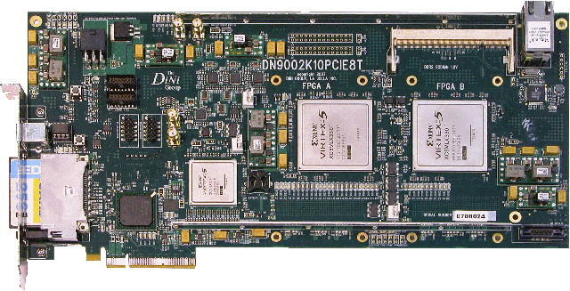
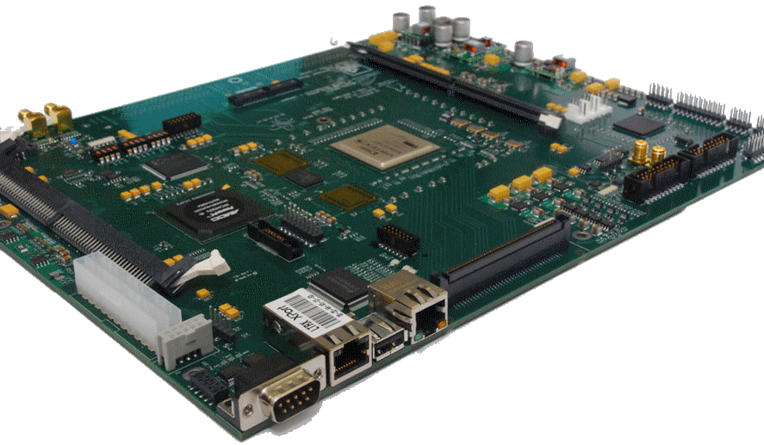
EEE4084F
Digital Systems
Lecture 0
Meet & Greet
Lecturer:
Dr. Simon Winberg
Notes:
This pre-lecture session is intended as an opportunity to meet the class, give everyone a chance to find the venue and ensure the venue is suitable. Prac times and general logistics plans about the course should be discussed.

Slide 2
Objective of today?
According to the UCT policy, there is meant to be a meet & greet initial lecture in which one shouldn’t cover content, but allow students to find the venue, discuss prac times, etc.
EEE4084F
Class handout distributed in Lecture 1

Slide 3
“Digital Systems” EEE4084F…
Top of the chart…
for courses with vague course names
EEE4084F
Digital Systems
Basics of Electrical
Engineering
Signals and
Systems
Transmission
lines

Slide 4
More suitable names for this course…?
“High performance computing systems for electronic and computer engineers”
“Design of special-purpose parallel and reconfigurable computer systems”
Threads, clusters, clouds, GPUs & FPGA digital accelerators… and other interesting computer stuff.

Slide 5
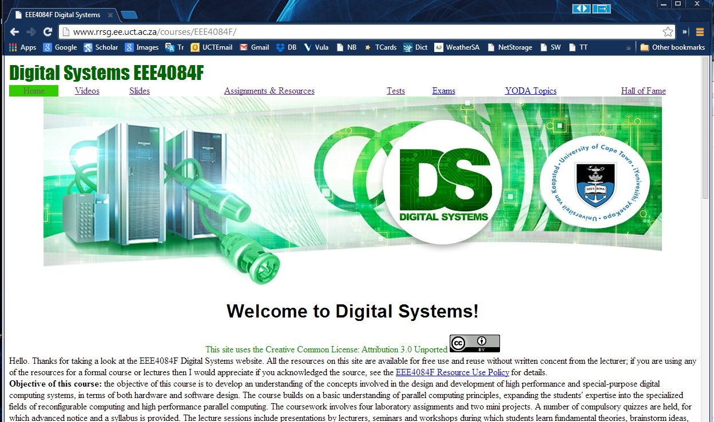
Course Websites
Resources, lectures, etc: www.rrsg.ee.uct.ac.za/courses/EEE4084F/
+
Vula site used for submitting assignments, announcements, etc.

Slide 6
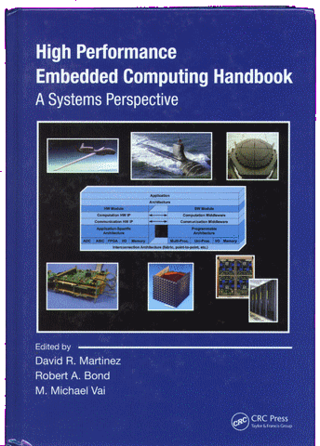
Textbook
Martinez, Bond & Vai, 2008. High Performance Embedded Computing Handbook. CRC Press.
The book should already be available from the UCT bookshop, local Rondebosch bookshops and Jutas bookstore in Claremont. (The local bookshops should be selling it for a lot less than the new book price shown on Amazon).

Slide 7
Lecture & Prac times
Lectures
Day | Time | Venue | Description
Tuesday | 9am | Chem Eng Seminar Rm | Lecture
Tuesday | 3pm | LCOM 2G | Seminar
Thursday | 2pm | Menzies 11 | Lecture / Q&A / class activity / quiz
Pracs
Day | Time | Venue | Description
Mon. | 09h00-11h00 | Blue lab | Prac / Project
Wed. ? | 09h00-11h00 | Blue lab | Prac / Project

Slide 8
When do pracs start?
Would like to make a start on pracs in the first week on Wednesday.
Homework 1 / Prac0 starts now
No official pracs this week, but you’re welcome to use the Blue lab when you can find some free time.
Officially lab pracs start first Monday of the 2nd week of term
Prac vs. Lab? and prac attendance? …

Slide 9
Do I need to attend lab sessions?
We know the simple terminology!
To clarify (for my nomenclature):
Prac = the assignment you are tasked to do (not necessarily the place to do it)
Lab / Lab session = the booking of the lab (i.e., Blue Lab)
To answer: No, you don’t need to attend lab sessions. Work where you want, when you want. You just might have to use the lab in order to access the required hardware.
NB: But you do need to complete all the pracs.
To answer…

Slide 10
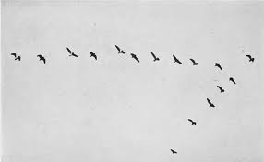
Change Wed Lab time?
Wed 10am might have few attendees (due to DSP lecture)
If you want an alternate time, get together and decide a better time. Use Chat for example on Vula. Then (the class rep can) email me a request.
An example of the
‘emergence’
phenomenon in birds

Slide 11
Lab Practicals
Prac Num | Title (draft name)
0 | OCTAVE testing. Login trials, test machines (optional) See Homework 1
1 | Pthreads + performance benchmarking techniques
2 | CUDA (acceleration using GPUs)
3 | Cluster – Graphics + OpenMP
4 | Xilinx ISE, FPGA Kits
Links to recommended C / C++ tutorials if you haven’t used C much before

Slide 12
TO DO for next week…
EEE4084F Digital Systems

Slide 13
Planning for 17-20 Feb
Monday – prac avail for you to work on Prac0 or experiment with C (note that the Homework1 is for marks)
Tuesday – 9am lecture, no 3pm afternoon lecture

Slide 14
Heads-up on reading task…
First 3pm seminar facilitated by me (group facilitated seminars in 25 Feb)
Reading to be done for first seminar:
See Resources/Readings on Vula site
R01 handed out:
Asanovic et al. “The Landscape of Parallel Computing Research: A View from Berkeley”
R01b – supplementary (voluntary) reading
Discusses Berkeley parallel computing lab

Slide 15
Homework 1 / Prac0: OCTAVE & Correlations
See Assignments on the course website
rem.
to do
h/w
See you all on Tuesday 9am

Slide 16
Some thoughts &
Inspirations…

Slide 17
In this course…
2x project-based learning tasks
1x small project – making sense of a schamatic
1x BIG project – implementing a digital accelerator on an FPGA
I’m open for mini project ideas on this too – previous year’s list will be avail. online
Thoughts on
Final year projects? Eeeek!!
The RRSG group has projects on offer, a initial listing is available at:
http://www.rrsg.ee.uct.ac.za/proposals/
idea
If YOU have an idea of a project you want to suggest (within my area of expertise) I’d consider supervising it and adding it to my list of BSc projects offered. *
* Would need to prepare a description and discuss it with me pref. early March.

Slide 18
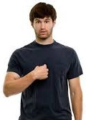
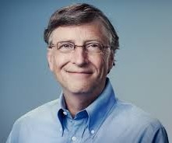
Some inspiration & food for thought…
Considering…
Your own startup
vs.
Work for someone
vs.
Postgraduate work
My
Boss
research
industry
Decide later?

Slide 19
Consider the pros & cons
Postgraduate work
Like researching & experimenting; initially pay not as good thought.
Might want to dev. own product, get support from adviser & community, lab space
May lead to better job options later
Work for someone
Gain experience, very beneficial; but likelihood of doing further study tends to diminish over time
Working for yourself?
Nice idea and big possibilities ☺..
but more risky ☹

Slide 20
Thinking about your own business
Why?!
Toying with an idea of starting your own business? Then ask yourself:
Why do you want to go into business?
List your reasons; pros & cons..
What is the right business for you?
Your ambitions; your work ethic; Your emotions; Your connections
What niche/new product will you provide?

Slide 21
Your own business (harsh) realities
What resources are needed? (equipment, software, people, space)
How long before it’s self-sustaining?
How much cash does it need?
How will it make a profit? (business model)
Where can I get the finances / should I get a business loan? *
How to maintain your own living expenses?
* As a graduate (esp. young graduate like most of you will be soon) with a good idea or IP and promising business plan, then there’s actually many options (at least for SA citizens), where you don’t need to commit your own or family’s hard earned cash, e.g. using an incubator or somehow having the government / venture capitalist give you a chance (but in exchange for a cut of the future earnings and/or demonstrating that you business will be creating jobs).

Slide 22
End of todays lecture
Summary:
You and I managed to find (hopefully) the correct venue ☺
We discussed a number of relevant, and some not-so pertinent, issues
You’re hopefully been fired up with ideas of
- considering your own business / finding work & gaining experience
- thinking about postgrad study
- considering projects to work on this year
Lecture 0: Meet & Greet

